Slide 1
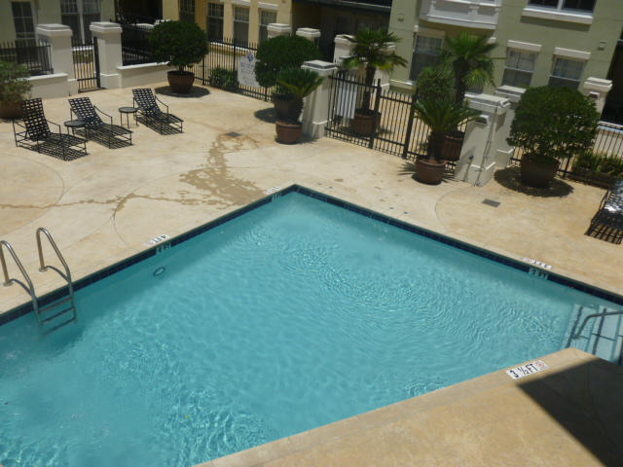
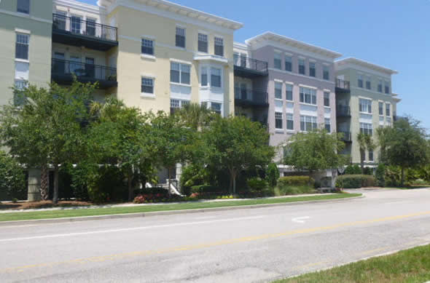
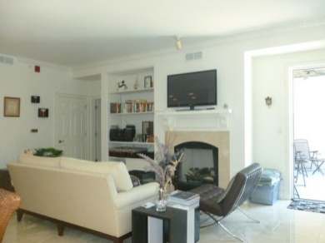
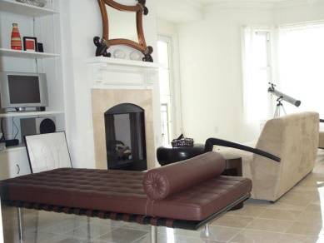
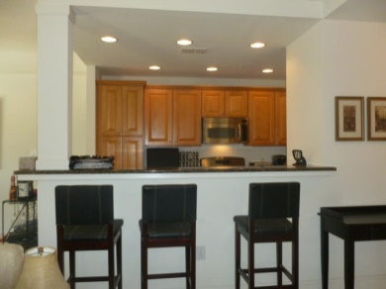
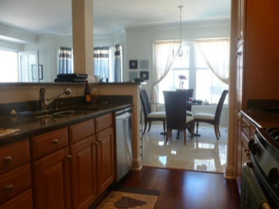
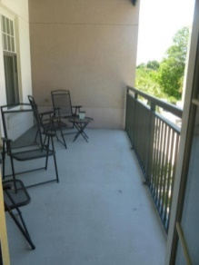
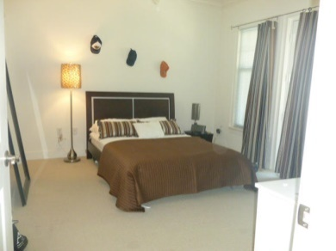
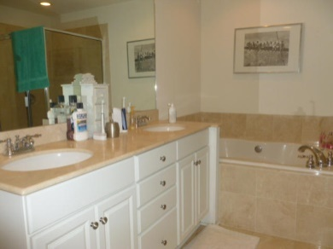
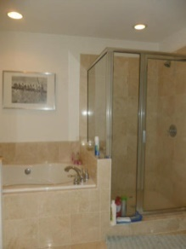
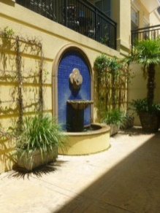


Luxury Condo Close to Downtown
498 Albemarle Road #315
Albemarle
Charleston, SC 29407
MLS# 15000817
$285,000
1 Beds | 1½ Baths
1,075 Square Feet
Luxury condo w/terrace overlooking pool in a secure building w/secure covered parking. This unit owns space #88. Gourmet granite counter kitchen w/gas range; pantry storage & bar counter overlooking LR. Bright and roomy with 9 1/2 foot ceilings and walls of windows. Terrace access from LR & Master BR. Gas FP in LR; large Walk-in closet and elegant bath w/garden tub & separate shower in Master BR. Unit has separate DR; laundry w/stackable Washer/Dryer; powder room off LR/kitchen; marble tile floors except Master BR which is carpeted. Furnishings in photos are owner's and may be available by separate Bill of Sale. Tenant's rights until 4/5/15. Building has gym; club room; pool; elevator; & electronic key fob access. Less than 1 mile from dwntwn/MUSC. Over $15K of upgrades when purchased.
Pam Paxton
843-509-2350
pam@agentownedrealty.com
www.pampaxton.realtor
AgentOwned Charleston Group
902 Savannah Hwy
Charleston, SC 29407

