Slide 1
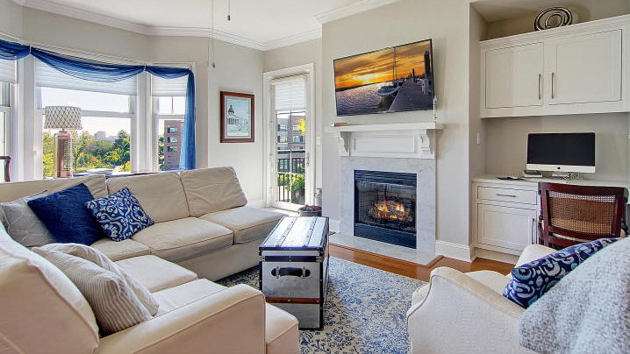

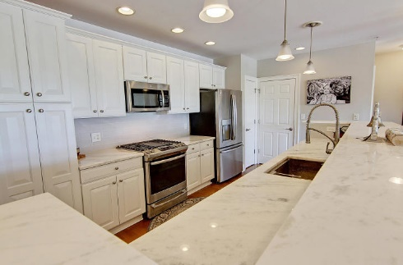
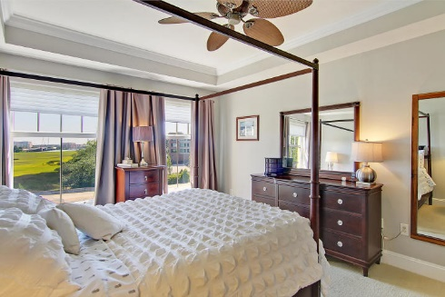
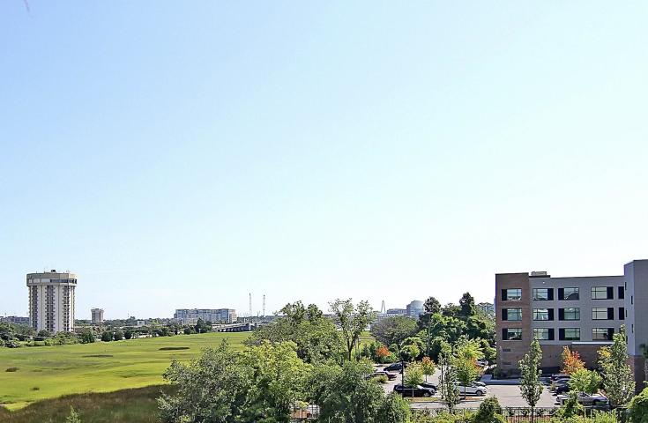
Price Reduced!
Price Reduced
For Quick Sale
Open House Saturday 12-3
498 Albemarle Road #405
Albemarle ~ Charleston, SC 29407 ~ MLS# 20021044 ~ $479,900
Resort style amenities, low-maintenance living, & a location just minutes away from Downtown Charleston, the Marina, MUSC & Roper Hospital are just a few highlights of this luxurious condo. This 4th floor condo has an open concept layout, a gourmet kitchen with an expansive Carrara marble counter & seating area, new SS appliances, tile backsplash, & a gas range. The stunning kitchen opens to the living and dining area where there's a cozy gas fireplace with Carrara marble trim & a built-in desk area plus double-access from the guest room & living area to the balcony with gorgeous views of the Ashley River and Ravenel Bridge. The spacious master suite has a coffered ceiling, two closets & an en-suite bath with dual vanity, relaxing garden tub & walk-in shower. Hardwood floors, crown molding & wonderful natural light make this unit incredibly inviting. Extra shelving and large closets make for ample storage. There is covered parking available & two elevators to bring you home.
Additional features include:
New GE appliances in 2020 (stainless steel dishwasher, gas range, microwave, & refrigerator, & a new washer & dryer)
Lighting under kitchen counters and in cabinets
Ceiling fans in all rooms & porch
8 ft ceilings and crown molding
Echobeat thermostat with wifi
Freshly painted
Gas outlet on balcony for grill
New HVAC
Garbage shoot on each floor and recycling in garage
Sellers have low heating bills in the winter months (approx $50 and under/month) and low cooling bills in the summer (approx $70/month). Regime fee covers the gas for the range and fire place- so no heating cost in the cooler months when using the fireplace.
Gated community
Sparkling pool
Fitness center with a sauna
The Albemarle amenities include pool, fitness center, meeting/club room and elevator
Regime fee covers water, gas, common area maintenance, building/flood insurance, gym, spa, amenities, landscaping and termite bond. Common areas have just been redone. Assessment in 2018 paid for roof repairs, new gym flooring, new gym equipment and hall, common areas upgrades on each floor.
Book your showing today!
Katie Wishneff kwishneff@mattoneillteam.com 843-870-8784

