Slide 1
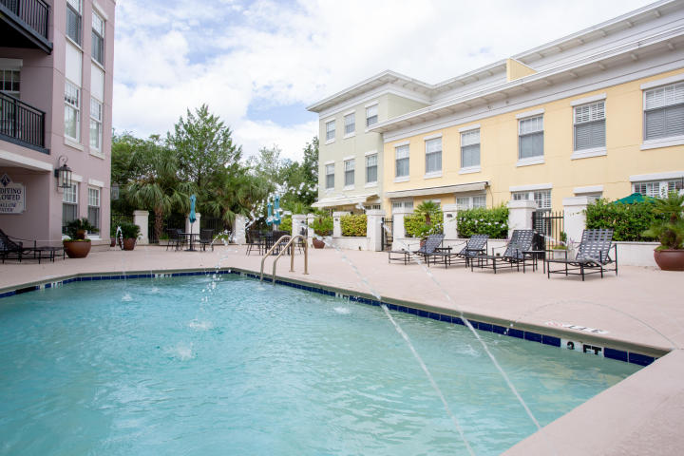
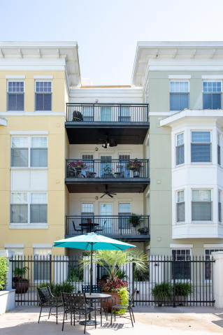
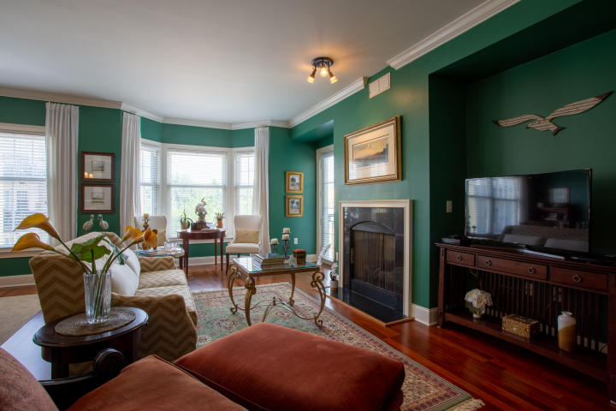
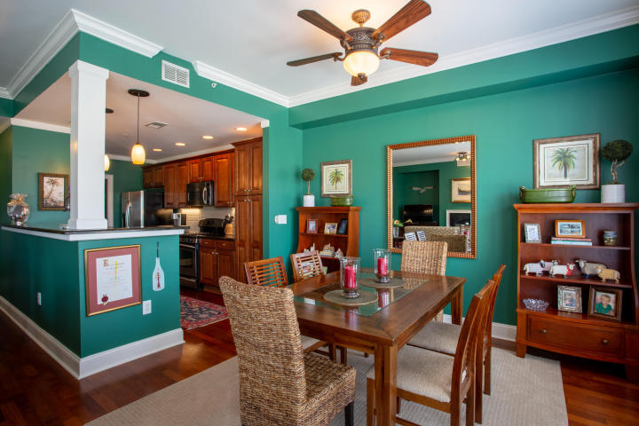
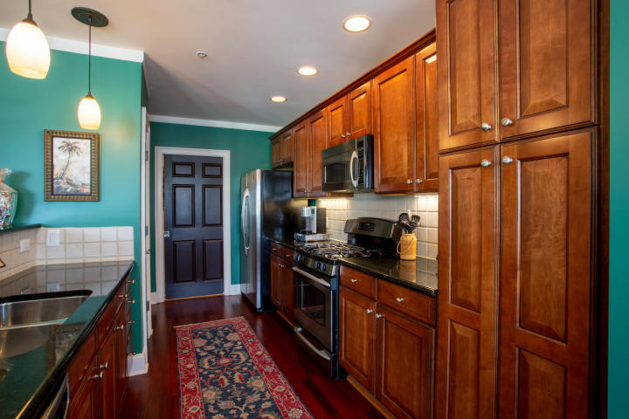
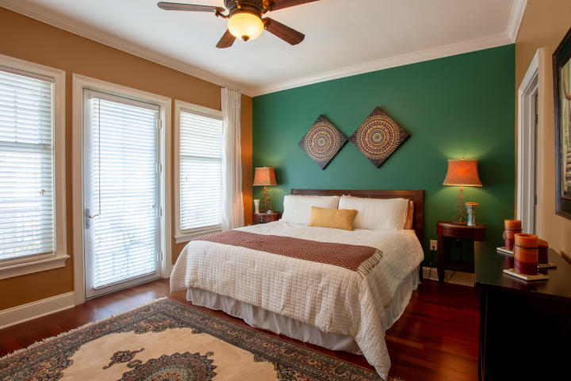
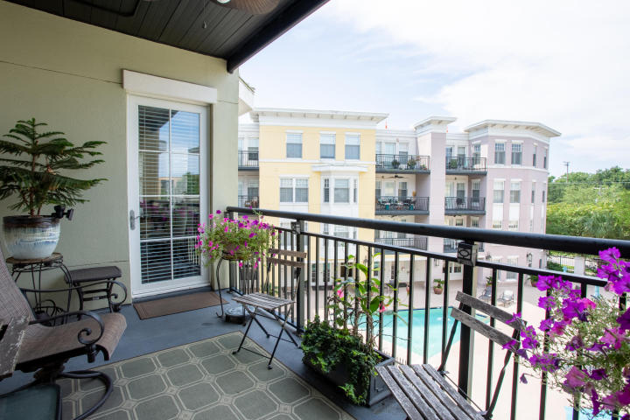


Amazing Location at the Albemarle
DRAFT
498 Albemarle Road 409
Charleston, SC 29407
MLS# 18020969
$329,500
Stunning fourth floor condo in the highly sought after Albemarle. This spacious one bedroom condo has an open floor plan with hardwoods, granite counter-tops, and high-end stainless steel appliances. The condo gets plenty of natural light with its large windows. The living room has a gas fireplace and gives access to the balcony overlooking the pool + courtyard. The master bedroom has a large walk-in closet and also has access to the spacious balcony. The master bath has double vanities, a garden tub, and a large walk-in shower. The Albemarle has top of the line amenities including a pool, fitness center, club room, and sauna. This condo conveys with a parking space in the gated garage and a storage unit. Amazing location a mile from downtown Charleston and Avondale.
82 Sans Souci Street
Charleston, SC 29403
Greg Gelber
(843) 494-2354
greg.gelber@agentownedrealty.com
AgentOwned Charleston Group | 902 Savannah Hwy | Charleston, SC 29407-7802

