Slide 1
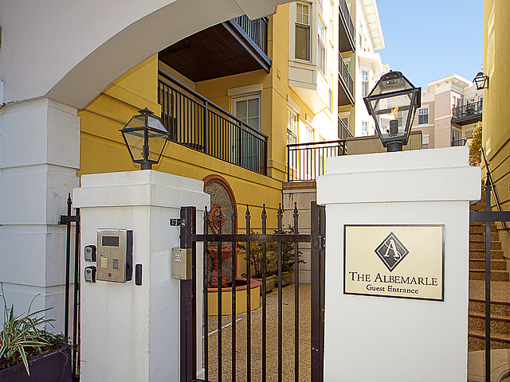
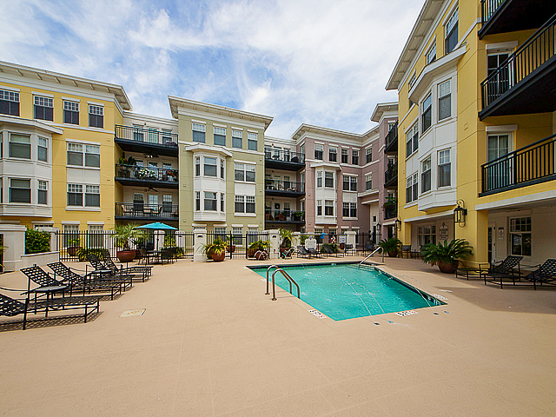
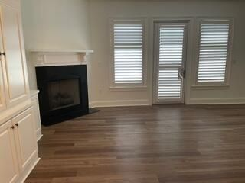
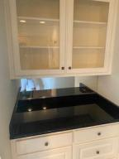
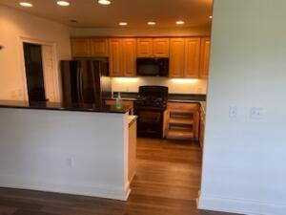
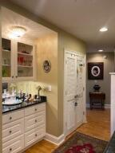
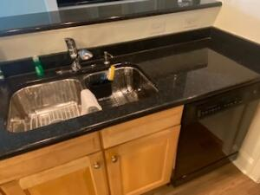
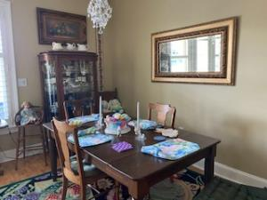
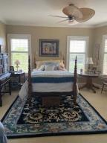
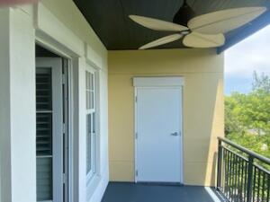

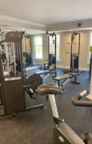
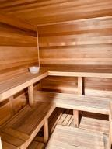


Potential Short Sale!
Available For Quick Close ~ Owner Has Moved
498 Albemarle Road 413
Albemarle ~ Charleston, SC 29407 ~ MLS# 21010855 ~ $469,000
Less than a mile to downtown, this beautiful condo is freshly painted, has new flooring, new vanity in master, new fridge and washer and dryer - and that's just a start of owner updates. This home is move-in ready and is easy to show. The bright, open living space has gas fireplace, dry bar and built-in bookshelves. Master Bedroom is very spacious, the bath offering dual vanities and a whirlpool tub. The large second bedroom has a private bath and both closets have built-ins. Most kitchen appliances are new including fridge, washer, dryer and hot water heater. AC was new in 2018; Roof new in 2019. This home has a great outside balcony with access to storage. In addition, this unit has a separate storage unit on the same floor and comes with 2 covered parking spaces close to elevator for easy access. Great location close to downtown.
Chuck & Edy Mimms
Cell 843-224-9507
Office 843-530-8100 www.sanddollarsc.com
www.facebook.com/Sanddollarsc
Sand Dollar Real Estate Group | 2205 Middle Street | Suite 203, Mailbox 2 | Sullivans Island, SC 29482

