Slide 1

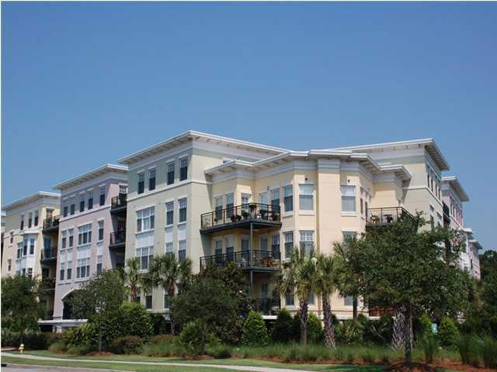
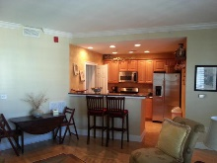
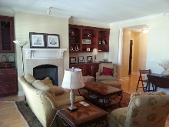
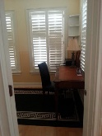
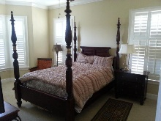
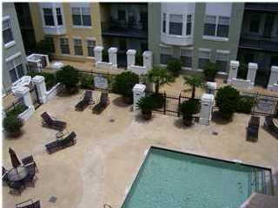
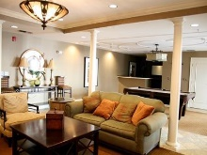

Luxury Condominium near Ripley Light Marina
498 Albemarle Road #414
Charleston, SC 29407 - MLS# 16011423 - $344,900
Well maintained move-in-ready condo only minutes from downtown Charleston in the desirable Albemarle Complex Enjoy this 1 Bedroom, 1 1/2 Bath, maintenance free condo. Balcony overlooks the pool and courtyard. Brazilian Cherry hardwood floors, granite counter tops, upgraded fixtures, walk-in-closets, fireplace, and more!! Master bath has a large garden tub, separate shower, marble counter tops and dual sinks. Office can easily converted to 2nd bedroom. The Albemarle offers a beautiful club room with a conference room, a fitness center, Sauna, large swimming pool, and a great security system for the homeowners. Regime fee includes building, hazard insurance along with all the amenities. This unit comes with 2 designated parking spaces.
Andrew Tackitt
843-437-8726 cell
andrew@radekopf.com
1205 Two Island Court, Suite 201 | Mount Pleasant, SC 29466
Phone: (843) 579.2217 | Fax: (843) 971-0281

