Slide 1
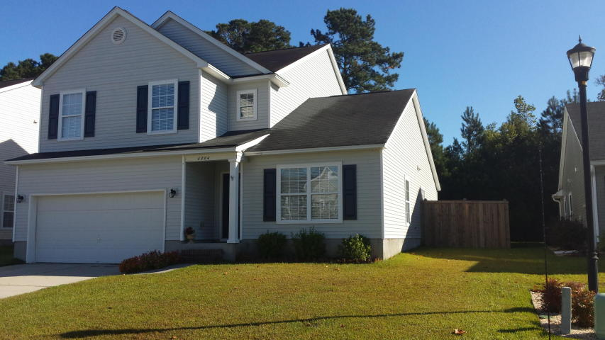
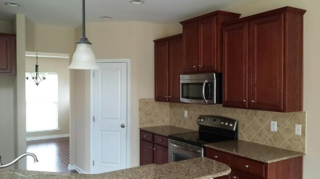
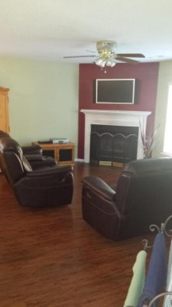
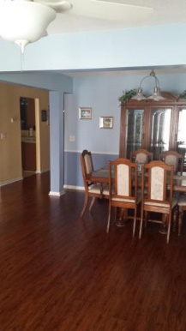
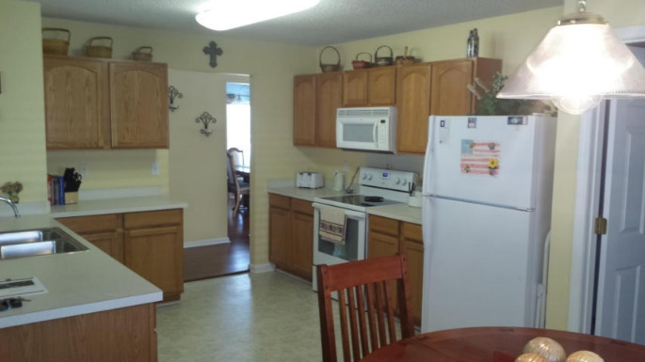
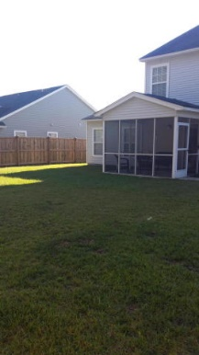
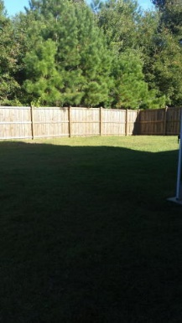


4994 Ballantine Drive Summerville, SC 29485 ~ MLS# 15027235 ~ $239,900
REDUCED FOR QUICK SALE IN WESCOTT PLANTATION
4 BEDROOMS | 3½ BATHS | 3,600 SQ FT
Super clean and organized with terrific floor plan that flows openly. This home is spacious with a formal dining room living room combo. The large kitchen with eating area overlooks the large family room that is equipped with a great fireplace for those cool nights. Off the family room is a screened porch and large fenced yard. The master bedroom with garden tub and walk in shower is located on the first floor and this home has an additional 3 bedrooms and bath with a large loft on the second floor. The home is equipped with many nice features to include beautiful laminate flooring and chair rail. This home is perfect for the family and has all that you could possibly need. You will love this home!
Randy Spear
843-568-2800 M
rspear@carolinaone.com
Carolina One Real Estate
1530 Trolley Road
Summerville, SC 29485

