Slide 1
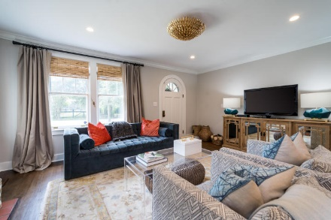
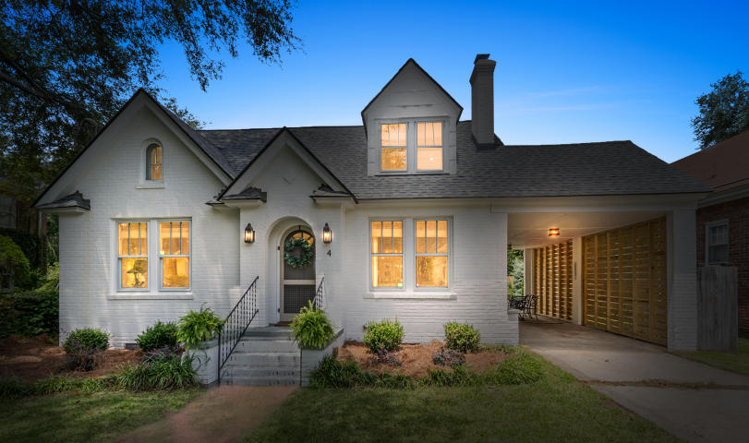
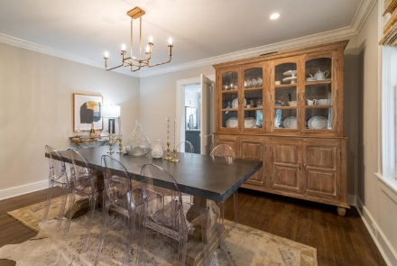
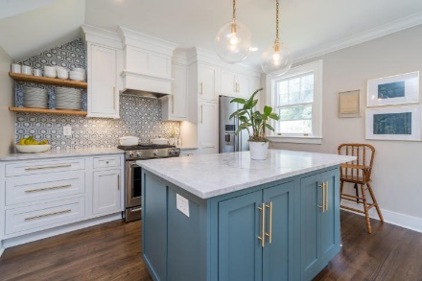
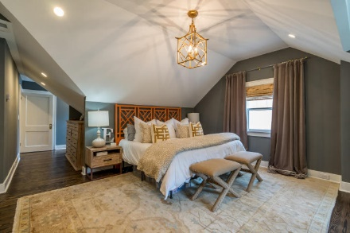
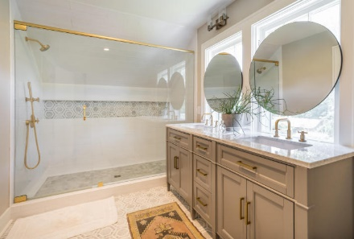
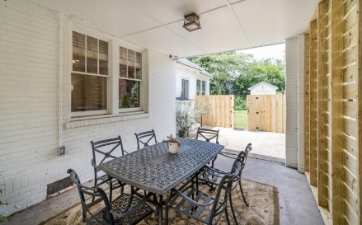
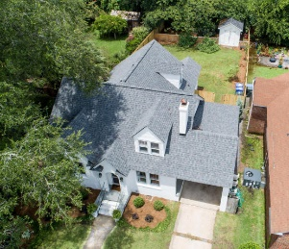
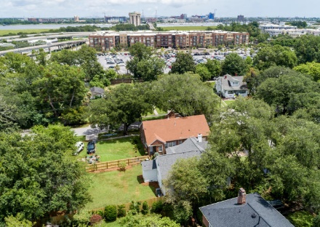

Minutes to Downtown Charleston!! 4 Belvue Road Windermere ~ Charleston ~ MLS# 18021442 ~ $714,900
This home appears in the new "Halloween" movie
starring Jamie Lee Curtis coming out in October.
Ideally located in the heart of the Windermere neighborhood, this home has been tastefully upgraded and immaculately maintained and is move-in ready. The grounds are equally pleasing, with a beautifully manicured front courtyard/patio combined with a tranquil backyard. The home presents the opportunity to enjoy a sophisticated, carefree lifestyle close to all of the places you enjoy. Nestled on a prime location within just minutes to all the South Windermere Shops and downtown Charleston. The stylish, upgraded residence features fashionable color themes and appointments throughout a bright and open floor plan of approximately 2,175 square feet. There is a flawless merging of historic details including original pulley windows and glass door knobs.
An entry with chic stacked-brick feature walls leads to a stunning formal living room, fireplace, picture windows and a glass door leading to the sunny patio/courtyard. Enjoy casual get-togethers on a lower level with the living room, and an open dining and kitchen area that hosts an island, marble counter-tops with tile back-splash, handsome floor-to-ceiling cabinetry, and chef-caliber stainless steel appliances. Four bedrooms and 2 baths are showcased, including a spacious master suite with romantic sitting area, lots of windows, a large closet, and an opulent bath, separate shower and dual vanities. For added convenience, the home includes a laundry room with ample cabinetry and a climate controlled storage area. We can't wait for you to see 4 Belvue Road. Call your Realtor today to reserve your showing appointment.
Gil Aviles
843-697-5535
gil@aviles-realestate.com
www.Aviles-RealEstate.com
Aviles Real Estate Brokerage
1840 Cherokee Rose Circle | Mt. Pleasant, SC 29466

