Slide 1
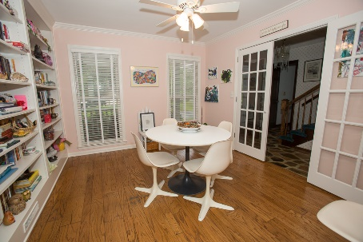
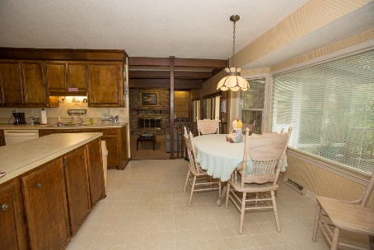
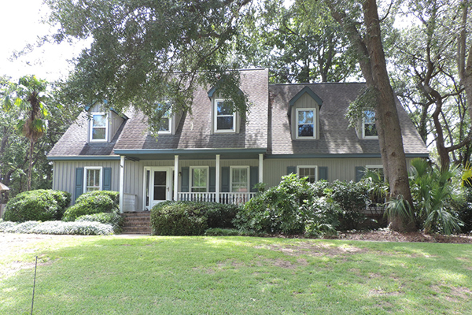
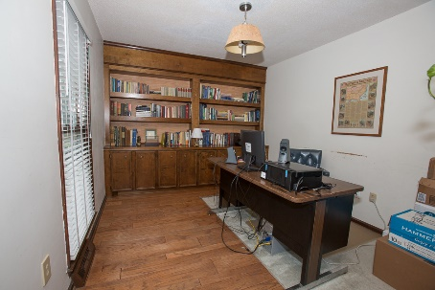
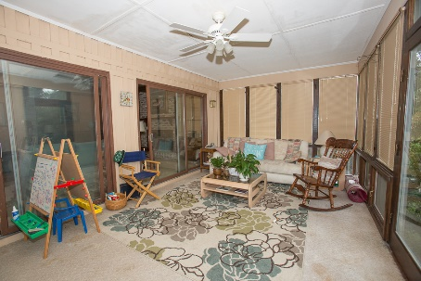
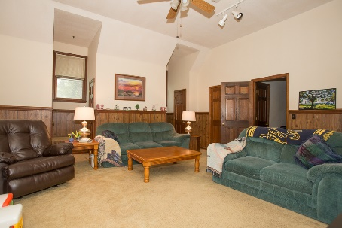
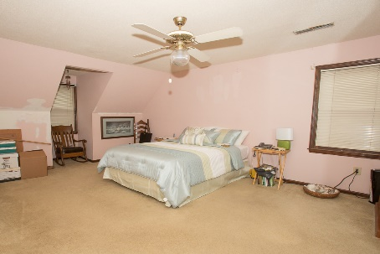


Price Reduction!
Must See!!
4 Birmingham Coure
Parkshore III · Charleston
MLS# 17021678 · $439,900
Fabulous 4 bedroom, 2.5 bath home with great layout.
Located on a quiet cul de sac.
Formal living and dining room.
Step down into the huge family room with fireplace and wet bar. Beautiful air conditioned sun room.
Dual staircase to 2nd level with 4 spacious bedrooms.
Frog is considered 4th bedroom.
Nice deck over looking fenced in back yard.
Great location!
Michael Dew
O (843) 870-7000
M (843) 870-7000
michaeledew@gmail.com
www.michaeldewrealestate.com
AgentOwned Charleston Group
902 Savannah Hwy
Charleston, SC 29407
Real Estate ● Mortgage
Insurance ● Business Brokerage

