Slide 1
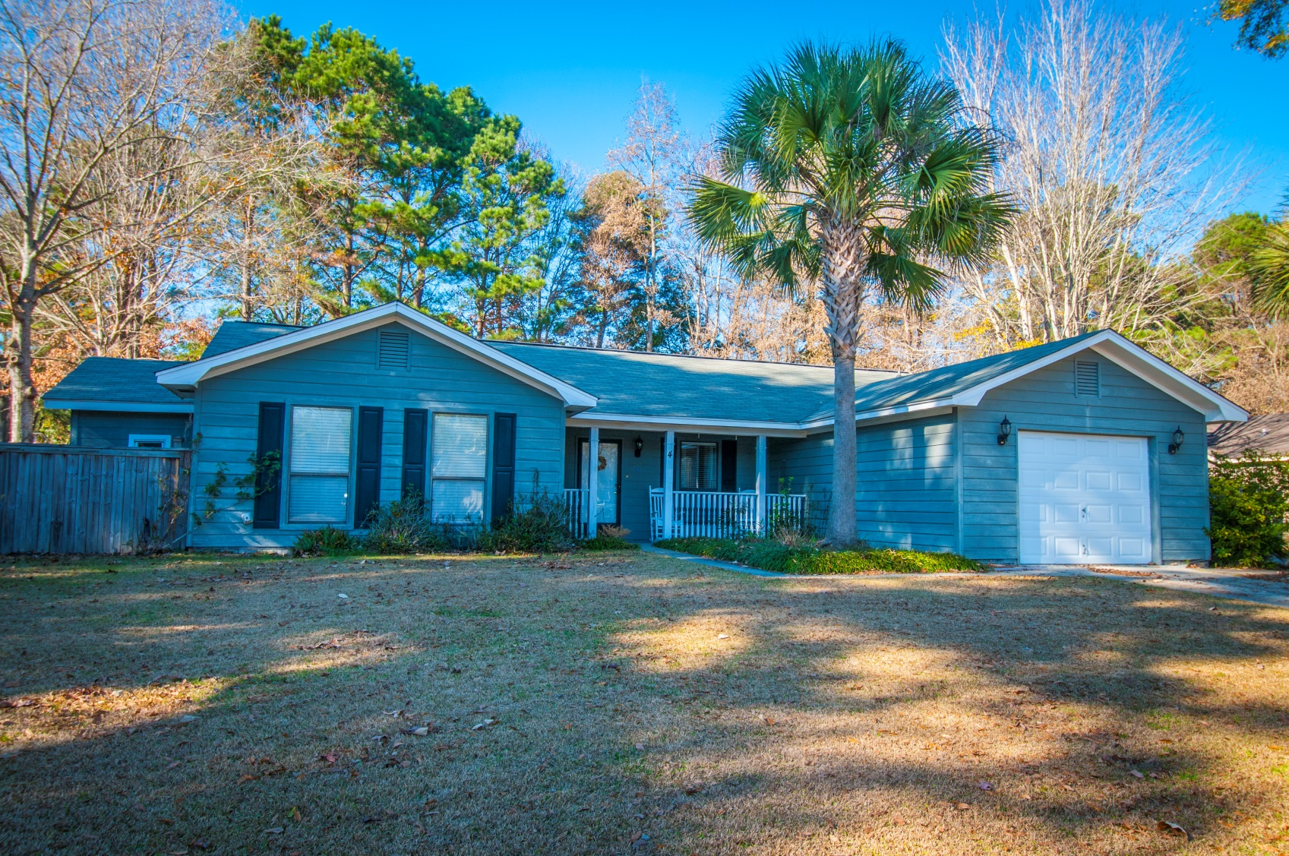
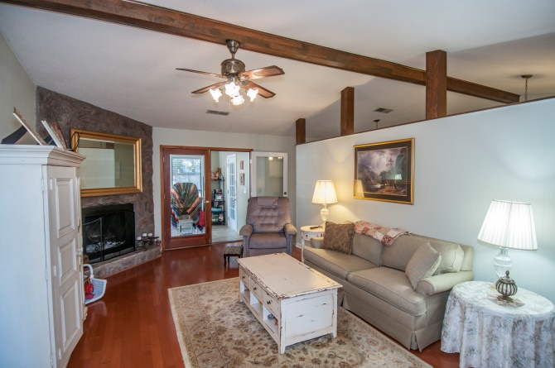
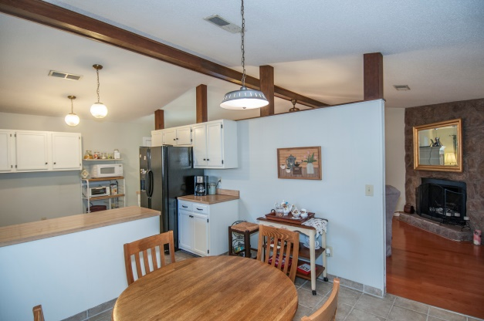
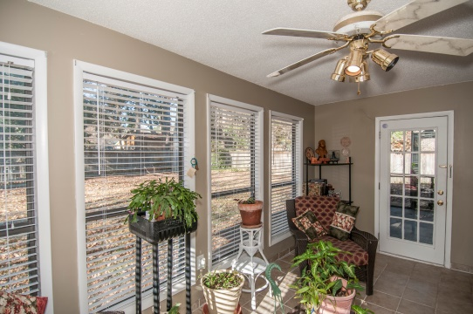
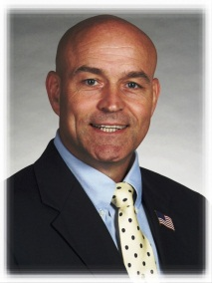

“Quiet Cul-de-Sac, Comfortable Home…”
4 Drummond Ct
Charleston, SC 29414
Low $200s
Wonderful quiet neighborhood, one-story living,
nice yard space, extra parking room…
1739 SF
3Bedrooms, 2 Full Bathrooms
Lovely, functional heated/cooled sun room
Many renovations
Single floor plan
No mandatory HOA fee in this section
Amenities membership available
STEVE ROWE
,Realtor®
Retired Military. Active Agent.
(843) 303-7438
srowe@carolinaone.com
www.SteveRoweHomes.com

