Slide 1
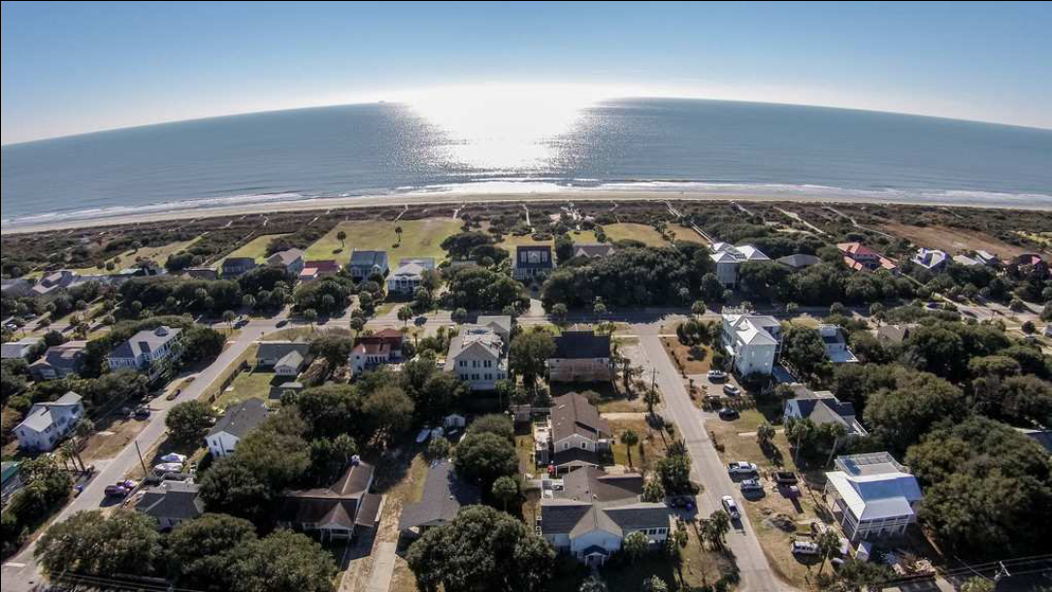
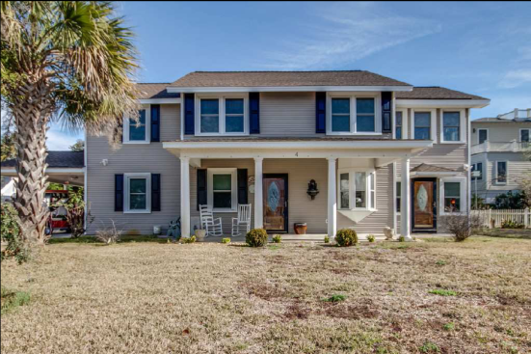
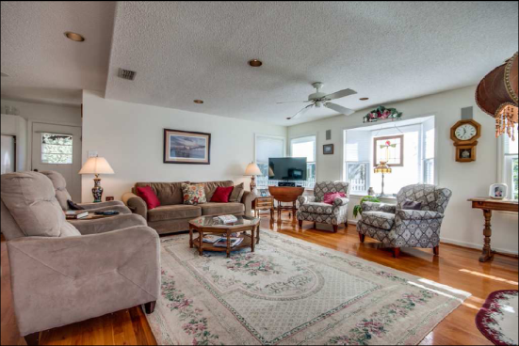
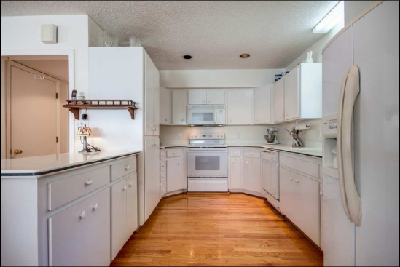
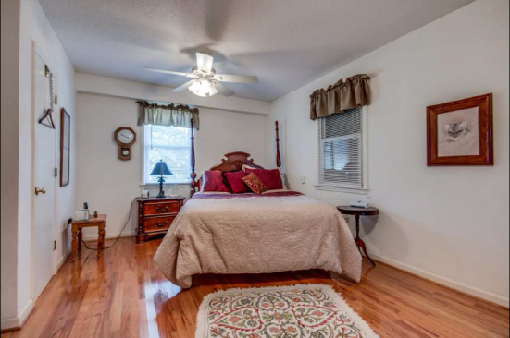
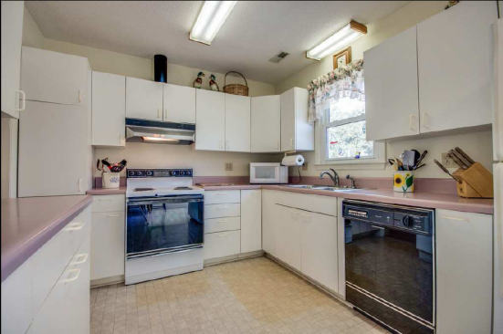
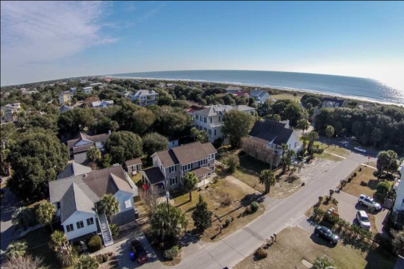

4 26th Avenue Isle of Palms, SC 29451 :: MLS# 14031121 :: $700,000
Isle of Palms Single Family OR Duplex!
Ahhh, if these walls could talk! This thoroughly enjoyed beach home is actually a legal duplex although used as single family and family shared! Approx. 1250 SF up and 1250 SF down. Years have gone by, but updates have been regular. High lot, 50 year architectural shingle roof, updated windows, HVAC, electrical and plumbing, flooring and nice kitchens both up and down. Grow into this home by renting half and living in other, later - improve as single family or...start over on great lot! Shallow well for irrigation. 2 storage bldgs. Plenty of parking - city water - Palm Boulevard and beach access is just across the street. Current Flood $2450 yr, W/H $2931
Renee Meyer 843-991-0007 - M
843-886-8110 – O
renee@carolinaoneplus.com www.CharlestonHomesHotline.com
Carolina One Real Estate
1503 Palm Blvd
Isle of Palms, SC 29451

