Slide 1
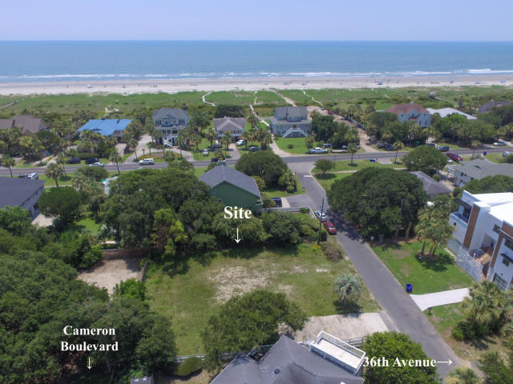
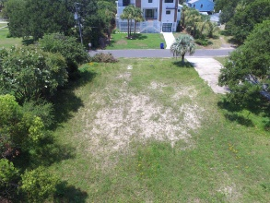
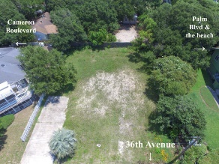
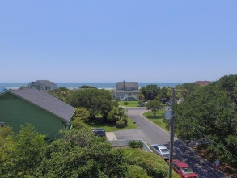
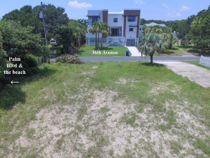
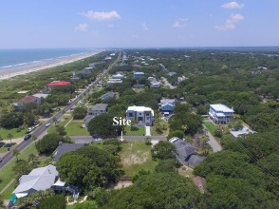


4 36th Avenue
Isle of Palms, SC 29451
MLS# 18019692
$790,000
Just Reduced
$790,000!
Great Ocean View Lot - Ready To Build!
Beautiful high ground corner lot right off Palm Blvd and just steps to the beach with great ocean views from second floor and upper deck.
Perfect for building a spec or dream vacation home. Updated survey. Water and septic tank available at site.
City sewer is also available but will require a grinder pump to connect.
Charles Riley
(843) 729-8077
yachtharbor16@gmail.com
BHHS Carolina Sun Real Estate
1440 Ben Sawyer Blvd ste 1503
Mt Pleasant, SC 29464

