Slide 1
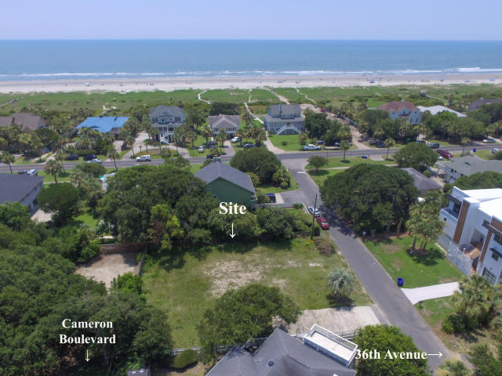
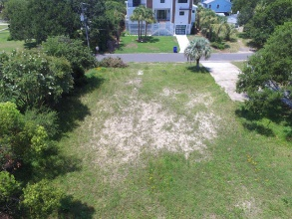
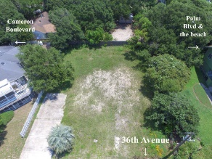
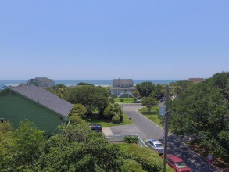
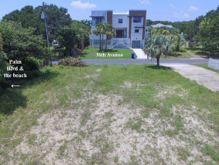
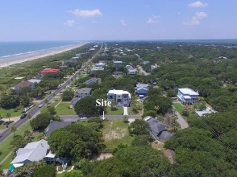


4 36th Avenue
Isle of Palms, SC 29451
MLS# 18019692
$820,000
4% TO SELLING AGENT
Just Reduced
$789,000!
Beautiful high ground corner lot right off Palm Blvd and just steps to the beach with great ocean views from second floor and upper deck.
Perfect for building a spec or dream vacation home. Updated survey. Water and septic tank available at site.
City sewer is also available but will require a grinder pump to connect.
OWNER TO OFFER FINANCING
Charles Riley
(843) 729-8077
yachtharbor16@gmail.com
BHHS Carolina Sun Real Estate
1440 Ben Sawyer Blvd ste 1503
Mt Pleasant, SC 29464

