Slide 1
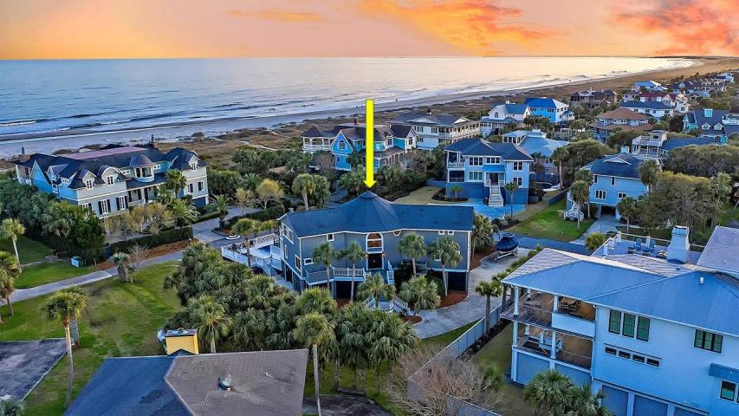



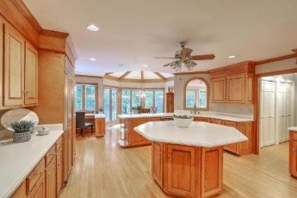
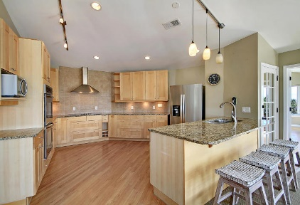



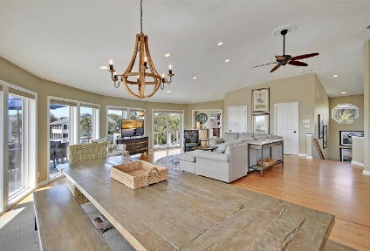


Parkshore Marshfront
Breathtaking Ocean Views On IOP!
4 46th Avenue
Isle of Palms, SC 29451 ~ MLS# 20007383 ~ $2,950,000
The absolute ultimate in island living can be found here at this magnificent beach home on Isle of Palms. With a deck surrounding the sparkling pool and two levels of wrap-around porches that show off the ocean views, this home offers unrivaled indoor and outdoor accommodations. The reverse floorplan boasts dual masters and a total of six bedrooms all with incredible en-suite full baths. There's even a room with built-in bunk beds! The granite kitchen opens to the living room and dining area while high ceilings and a wall of windows give this a bright and open feel. Literally just steps from the beach, you can spend the day in the sand, wash off in the outdoor shower and relax in the pool while the outdoor entertaining goes into the night.
Additional features include:
Hardwood floors
Two story foyer
Recessed lighting
Kitchen has granite counters, stainless steel appliances, stone tile backsplash, ample cabinet and countertop space, and breakfast bar seating
The master bedroom includes vaulted ceilings, tons of natural light, and access to the porch
The master bath has dual vanities, tub and gorgeous walk-in tile shower
First and second levels offer great gathering/living spaces
One of only a few homes on the island that can accommodate 17 guests as a rental property
Amazing location on beautiful Isle of Palms!
Book your showing today!
Christopher Smith christopher@mattoneillteam.com 843-267-0735

