Slide 1
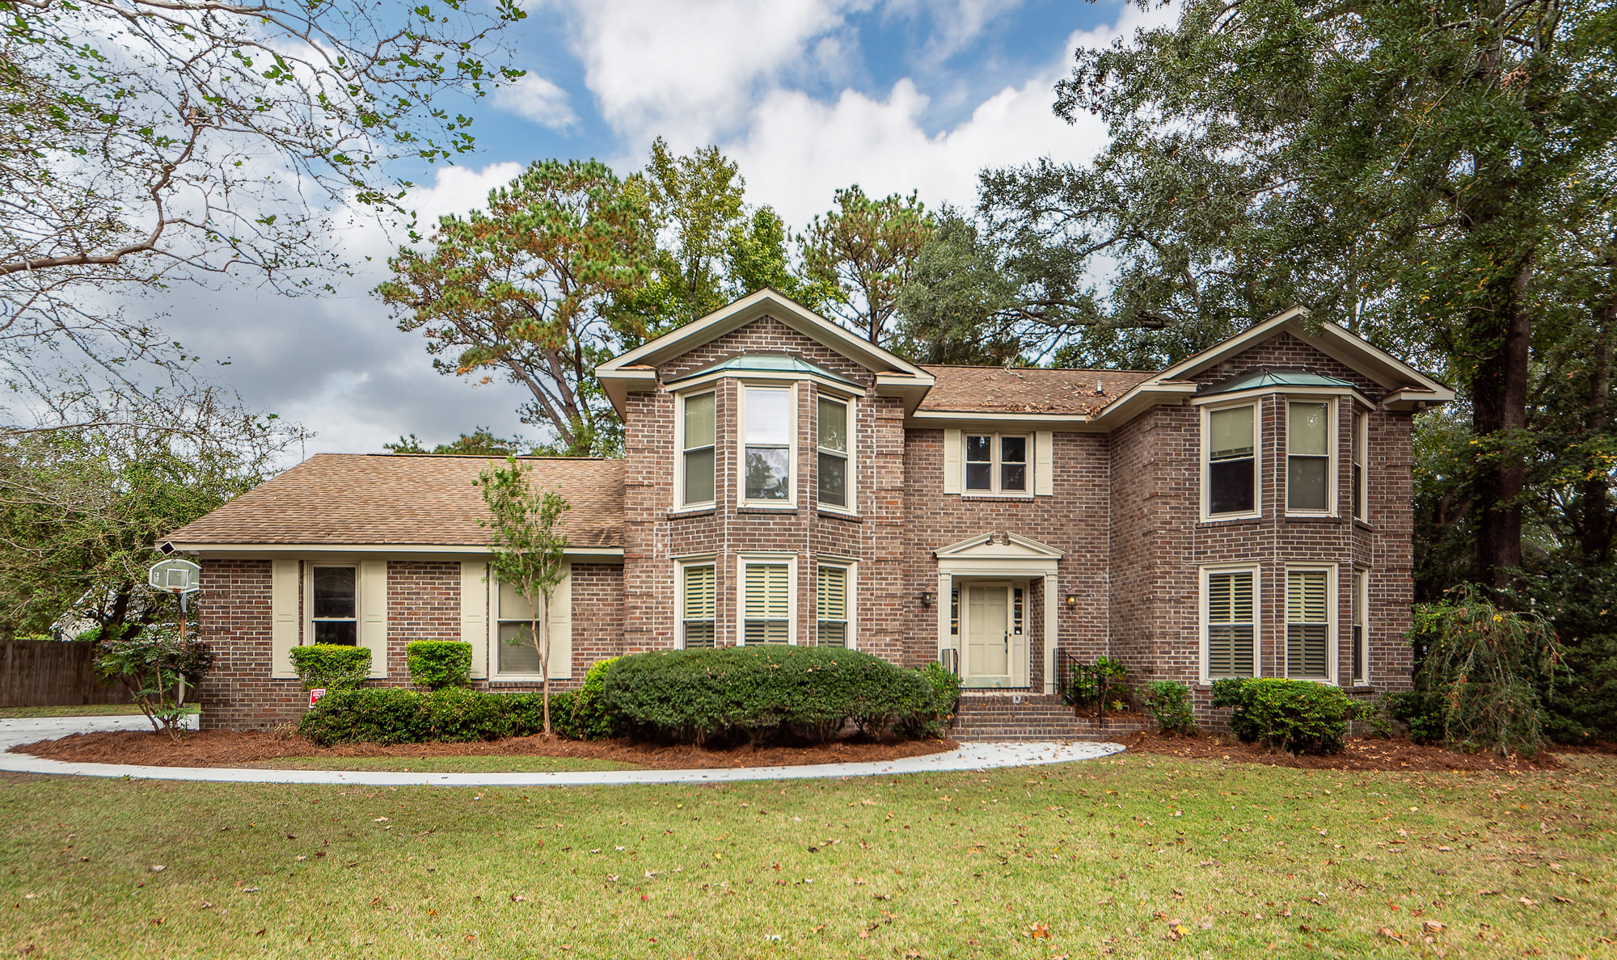
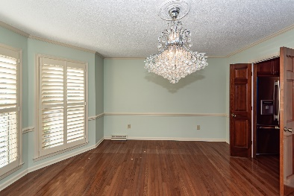
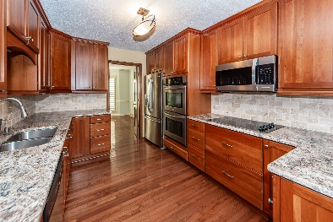
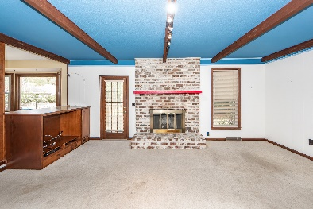
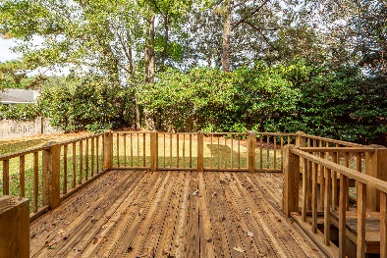

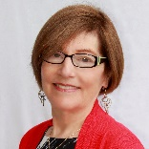
4 Berwick Circle Parkshore • Charleston, SC 29407 • MLS# 24028262 • $925,000 4 Bedrooms | 3 Full Baths | 3340 sq. ft. (Per tax record)
OPEN HOUSE SUNDAY NOVEMBER 17th 12:30-2:30
In a quiet cul de sac of Parkshore II, this spacious 2-story brick home offers ample room for family and guests. The inviting foyer opens to a light-filled living room and a formal dining room with space for 10-12 people, perfect for entertaining. The adjacent kitchen features granite countertops, a double sink, ample cabinets, and modern appliances, plus an eat-in area with views of the deck and landscaped backyard. The large family room includes a brick fireplace, built-in cabinets, a wet bar, and plenty of space. An office or extra bedroom and a nearby full bath complete the first floor. Upstairs, the primary bedroom boasts an ensuite bath with double vanities and a roomy closet. Three additional bedrooms share an updated bath, and a versatile room over the garage could serve as an office, exercise room, or extra bedroom. The home also includes a laundry room, a 2-car side-entry garage, and access to a nearby swim club with tennis courts. Parkshore II offers convenient shopping and easy city access, with Orange Grove Charter Elementary nearby.
TAKE A VIRTUAL TOUR
Susan Garfinkel
843-696-5838 | sngarf2@gmail.com
Elaine Brabham and Associates, LLC • 1890 Sam Rittenberg Boulevard, Suite 217 • Charleston, SC 29407

