Slide 1
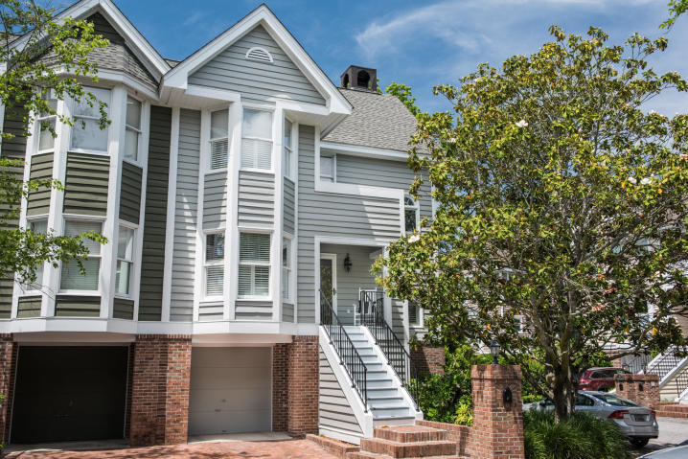
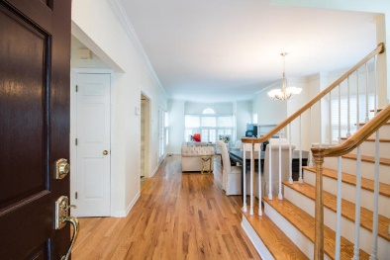
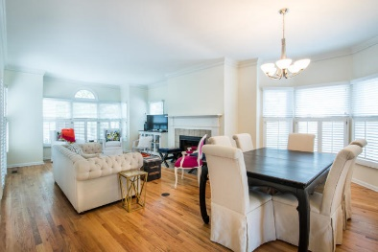
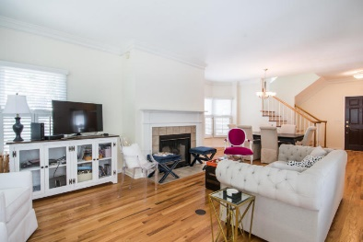
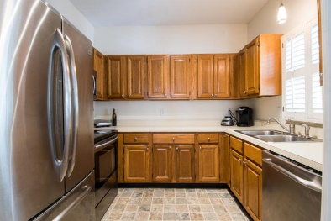


4 Harleston Place Harleston Village :: Charleston, SC 29401 MLS# 19012778 :: $639,000
Don't overlook Harleston Place!
Beautiful 3 bedroom / 3 bath townhome with many special features. Hardwood floors in the main living area with a fireplace and tall ceilings. This is a great end unit with a one car garage, plenty of storage space and a private walled courtyard.
Fantastic location, close to MUSC, College of Charleston and many great shops and restaurants; a few blocks away in historic Charleston.
See more at openhomepro.com/property/5d598fd11b3bde2602cc95d3
Carolina One Real Estate 1503 Palm Blvd Isle of Palms, SC 29451
Bill Donovan Office - (843) 242-3018
Mobile - (843) 991-0146
donovans@carolinaone.com
Carolina One Real Estate
1503 Palm Blvd
Isle of Palms, SC 29451-2280
www.billdonovan.com

