Slide 1
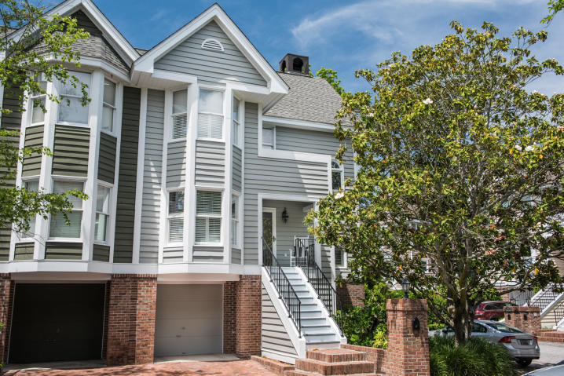
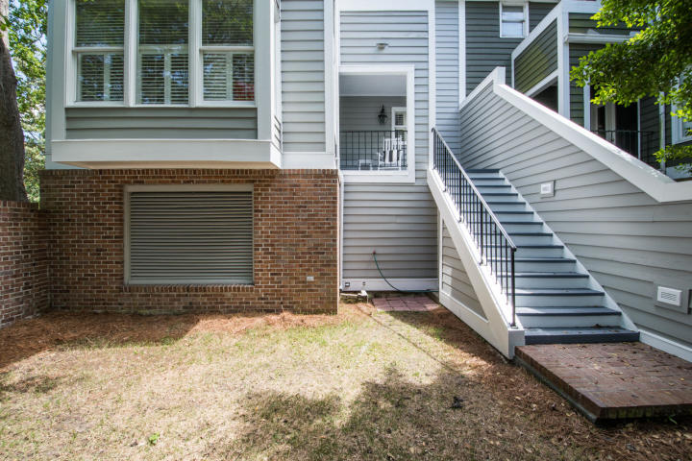
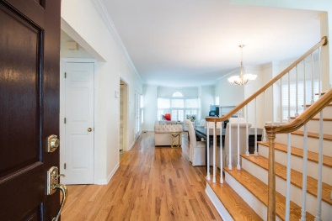
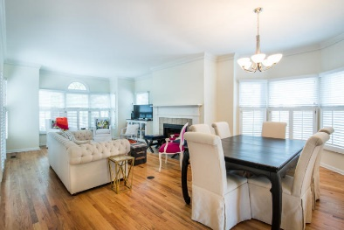
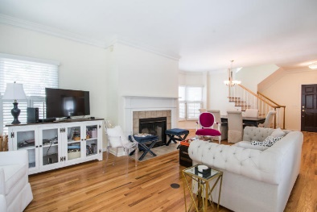
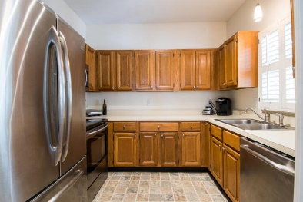
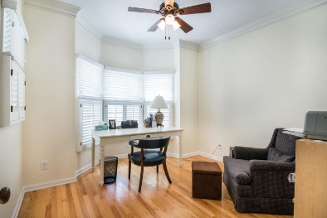
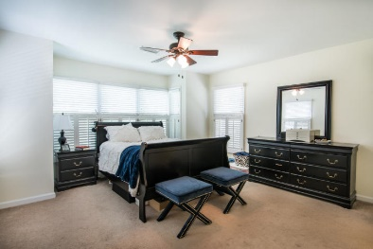
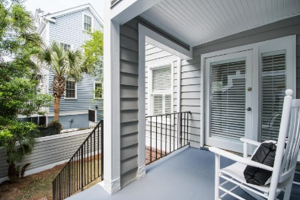
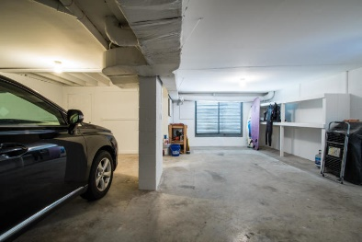


4 Harleston Place
Harleston Village :: Charleston, SC 29401
MLS# 19012778 :: $649,000
Great Townhome In Desired Harleston Place!
Beautiful 3 bedroom / 3 bath townhome with many special features. Hardwood floors in the main living area with a fireplace and tall ceilings. This is a great end unit with a one car garage, plenty of storage space and a private walled courtyard.
Fantastic location, close to MUSC, College of Charleston and many great shops and restaurants; a few blocks away in historic Charleston.
Carolina One Real Estate
1503 Palm Blvd
Isle of Palms, SC 29451
Bill Donovan
Office - (843) 242-3018
Mobile - (843) 991-0146
donovans@carolinaone.com
Carolina One Real Estate
1503 Palm Blvd
Isle of Palms, SC 29451-2280
www.billdonovan.com

