Slide 1
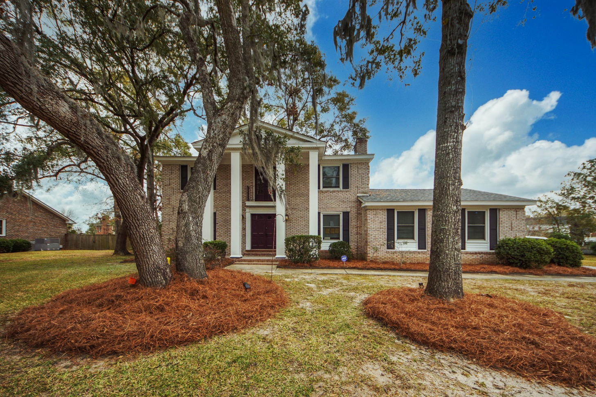
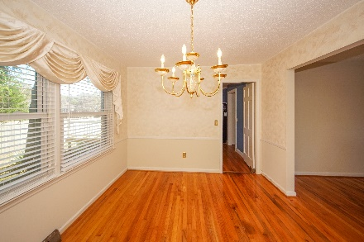
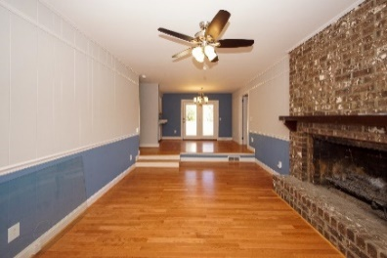
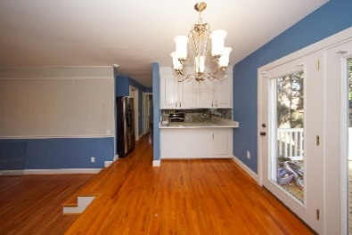
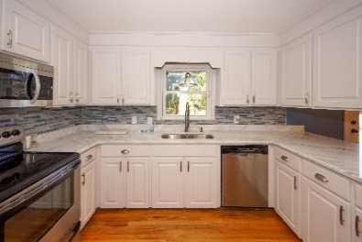
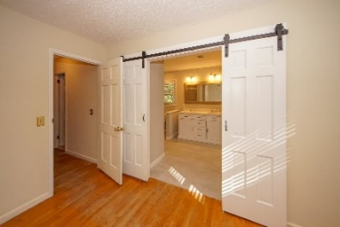
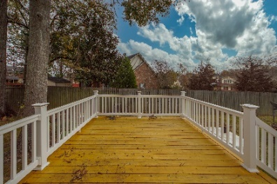


4 S Basilica Avenue
Otranto :: Hanahan, SC 29410
MLS# 20014384
REDUCED TO $318,000
Otranto Beauty
$318,000
New Year
New Price!!
Freshly Painted Interior! View This Beauty Again!!
Come see this Beautiful 4 bedroom home in desirable Otranto in Hanahan. Pronounced porch columns greet you as you enter a traditional home with formal living, formal dining, family room with fire place and eat in kitchen. Kitchen was remodeled and french doors lead to a newly installed deck. Master bedroom is located upstairs and the master bathroom had a complete make over! Wood floors are installed on both levels to include the staircase. New roof installed 2017, HVAC was replaced in 2014 and sellers installed a Generac generator. Two car garage has a stair case that leads to open storage. Mature trees, corner lot and fenced in yard add to the impressive exterior features of this home!
Come take a virtual tour: https://charlestonvirtualhomes.com/20014384
Connie White, Broker
843-532-3356
connie@chrepros.com · conniewhiterealestate.com
Charleston Homes · 597 Old Mt. Holly Road · Suite 301 · Goose Creek, SC 29445

