Slide 1
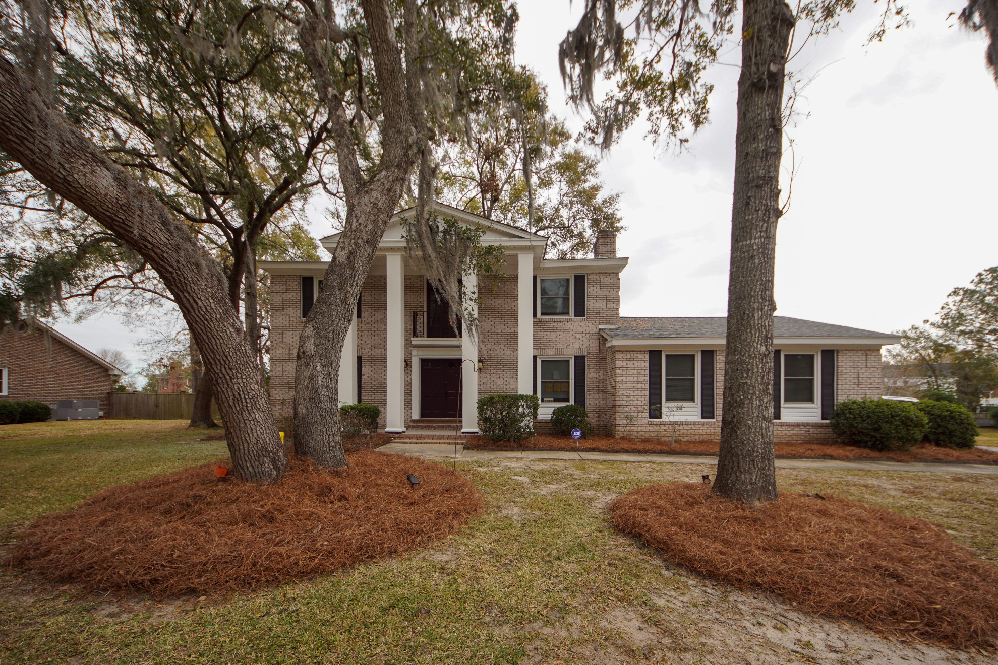
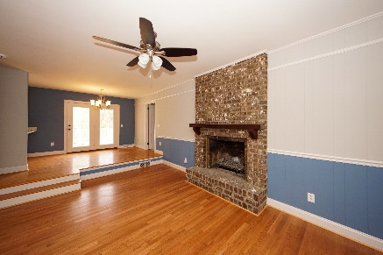
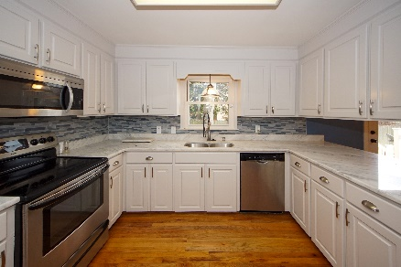
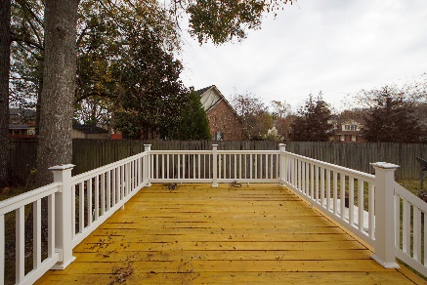


4 S Basilica Avenue Otranto :: Hanahan, SC 29410 MLS# 19033645 :: $380,000 4 Bed / 2½ Bath
Otranto Beauty
Just Listed!
Gone With the Wind comes to mind when you drive in front of this prestigious brick home with soaring porch columns in Otranto. Own a 4 bedroom home with traditional formal living, formal dining, family room with fire place and eat in kitchen. Original hard wood floors are on both first and second story. Kitchen is modern with granite and stainless appliances with French doors leading to the back yard deck. Master bathroom had a complete remodel with new tile, new shower, new vanity, new mirror, new closet and barn doors. Secondary bathroom upstairs had a face lift as well as the half bath down stairs. New roof in 2017 & AC replaced 2014. This home has been in the same family since it was originally built. Own a piece of history in Otranto!
Connie White, Broker
843-532-3356
connie@chrepros.com · conniewhiterealestate.com
Charleston Homes · 597 Old Mt. Holly Road · Suite 301 · Goose Creek, SC 29445

