Slide 1
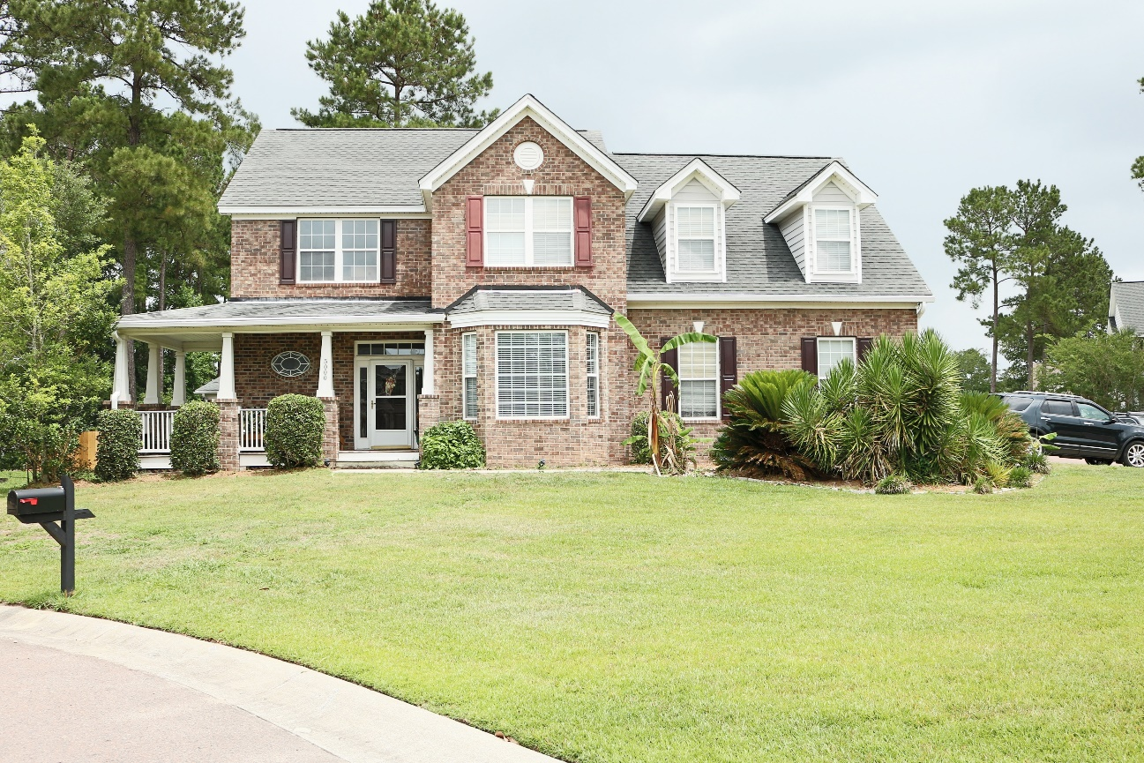
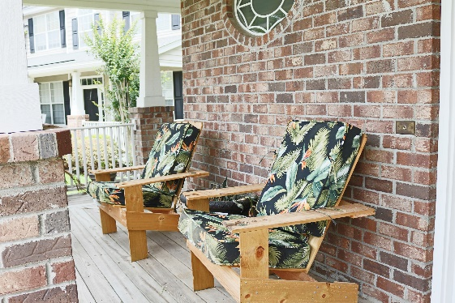
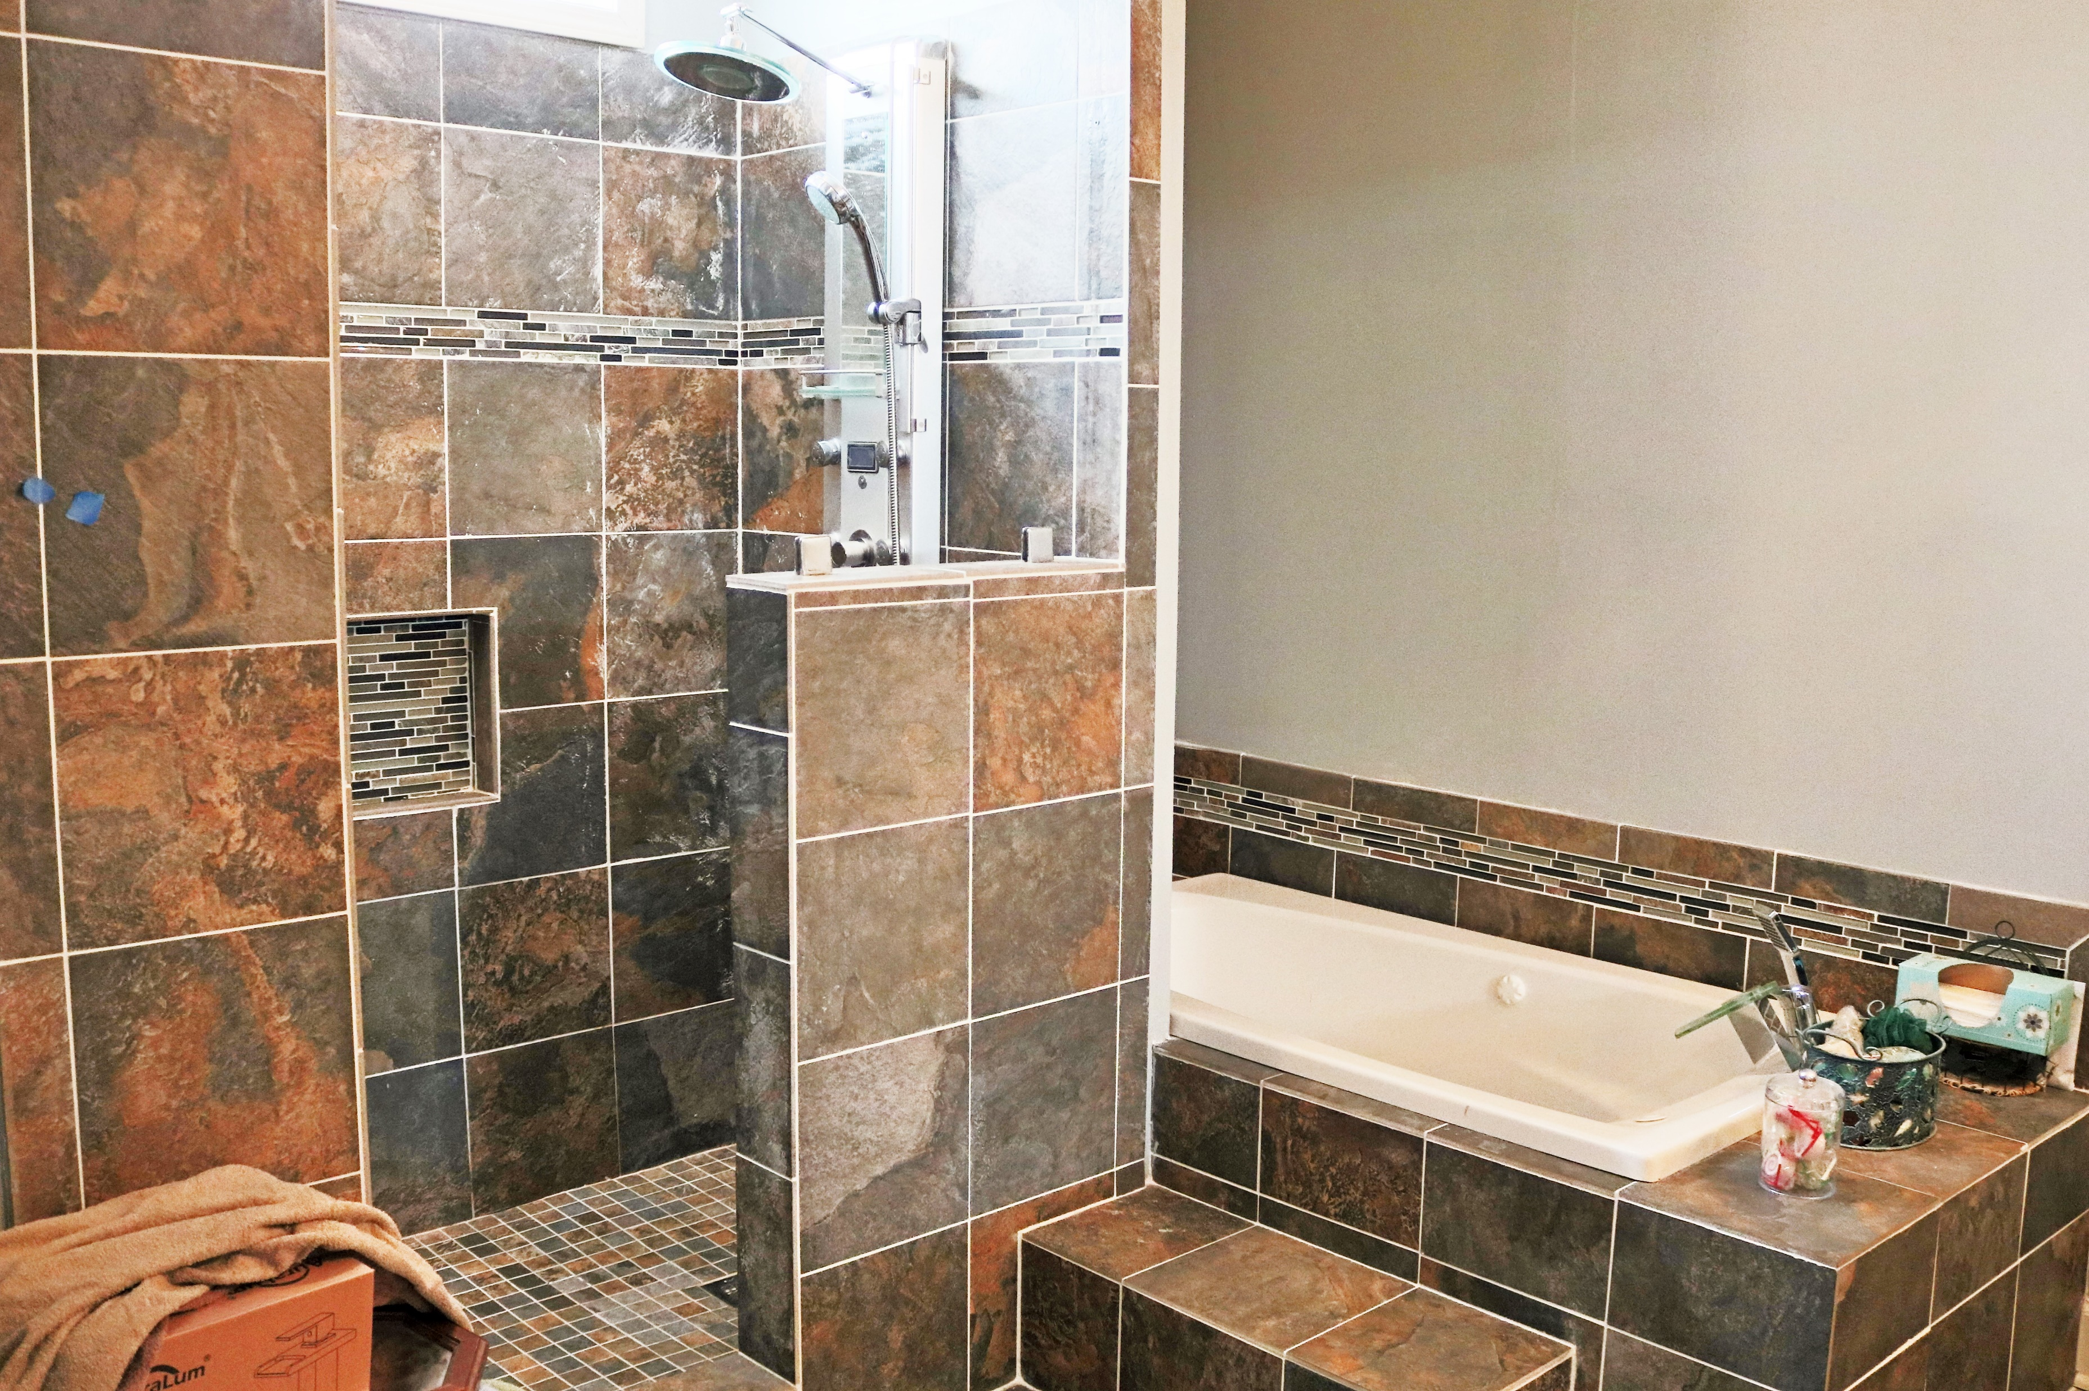
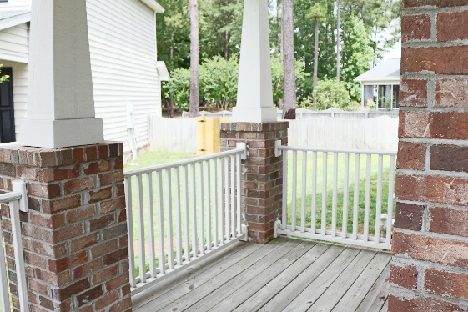
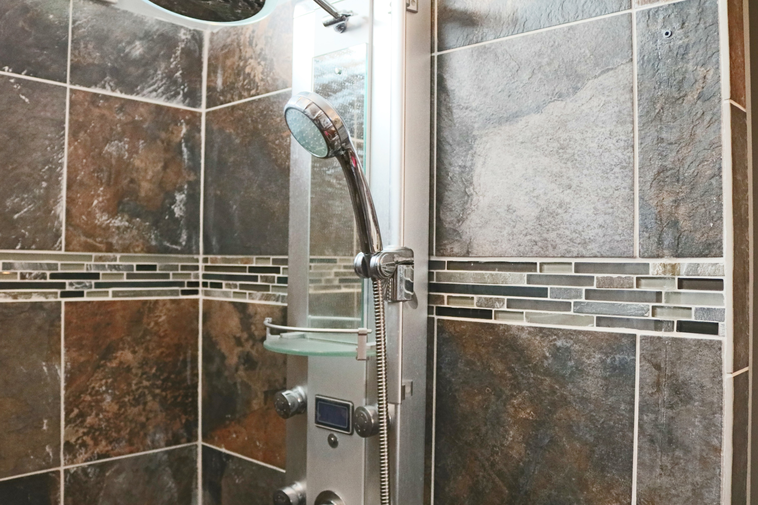


Coming Soon… Wescott Preserve - Wescott Plantation
5000 Pratt Ct
Wescott Plantation | Summerville
4 bedroom | 2.5 baths | 2,812 sq ft | Corner Lot In A Cul-de-sac
Carmilla Brown, REALTOR
Mobile - (843) 926-2007
crbrownrealestate@gmail.com
www.yourcharlestonnewhome.com
Keller Williams Realty 496 Bramson Ct Ste 200
Mt. Pleasant, SC 29464

