Slide 1
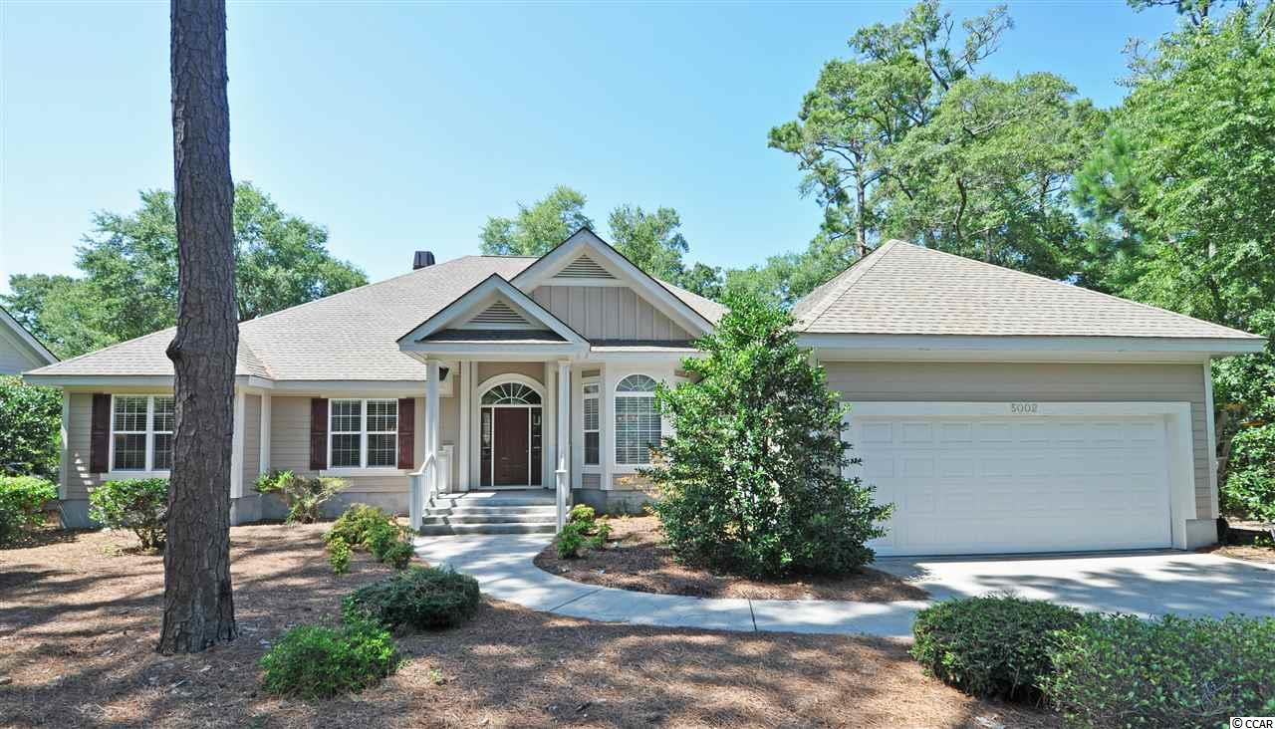
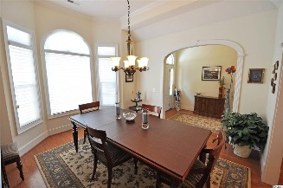
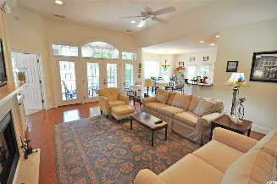
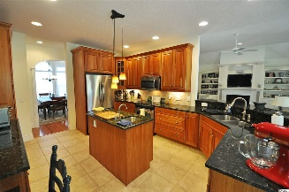
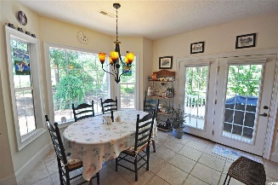
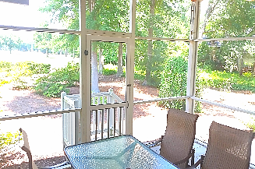
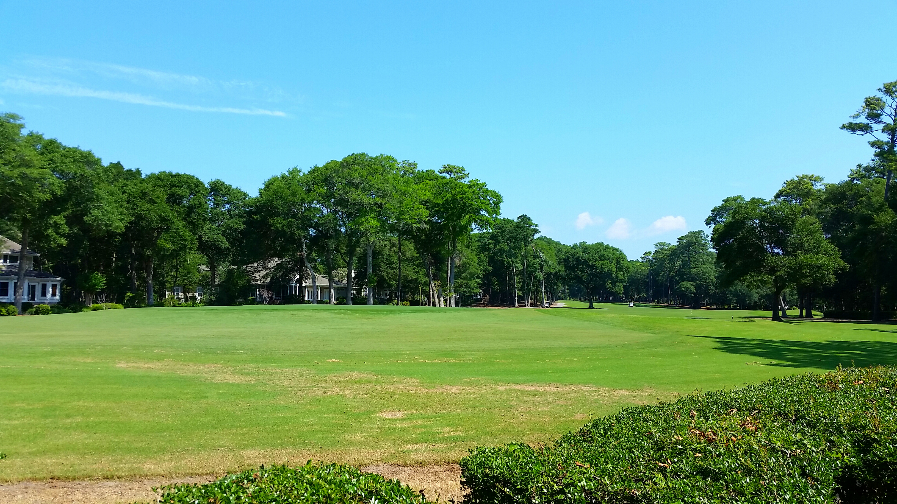
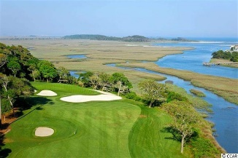
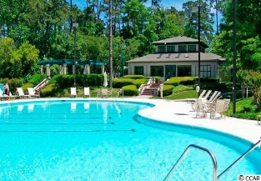
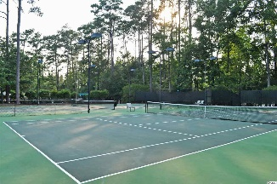
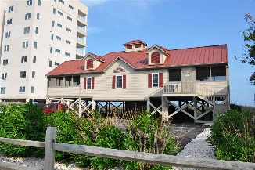


5002 Gilbert Lane
Tidewater Plantation ~ North Myrtle Beach
MLS# 1715432 ~ $429,900
It is rare to find a custom-built 4 bedroom, 3 1/2 bath impeccably-maintained home on the golf course
in this price range in Tidewater today.
Amenity-rich Tidewater is a 24-hour, manned gated community on a tree-lined road to oceanfront Anne Tilghman Boyce Coastal Reserve, a nature conservancy, including Waities Island, with access for managed recreational use. Tidewater itself is on an elevated peninsula of live oaks and southern pines between the Intracoatal Waterway and the Cherry Grove Inlet to the Atlantic Ocean. The plantation also preserves the singular look of its own historic origins. It is minutes from the beach, shopping, entertainment and access to major highways. The development boasts a private owners' beach cabana on the wide, white sands of the Cherry Grove Beach.
Well cared for, big value, comfort and location, this Tidewater home on nearly a half acre is the perfect choice for a traditional,
high-style, easy-living beach house.
Tidewater amenities at surprisingly low HOA fees include that oceanfront beach cabana for owners' use with open/screened porches, bathrooms, showers and kitchen. Residents of The Bluffs enjoy the use of 3 pools/hot tubs -- one of which is specific only to Bluffs' residents. Other amenities include driving range, golf shop, clubhouse with bar and dining overlooking the 18th hole, clay and hard-surface tennis courts, pickle ball court, fitness center, bocce courts and amenity center. Activities include concert series, workout & art classes, Happy Hours & clubs. There is a gated storage yard. Tidewater Plantation truly reflects a "way of life." Welcome!
Deborah Collins
843-424-9013
dctidewater@yahoo.com
Connie Ross-Karl
702-306-2643
conniesross@aol.com
NEW WAY PROPERTIES MYRTLE BEACH

