Slide 1
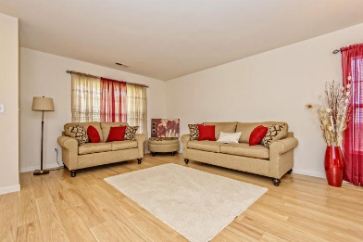
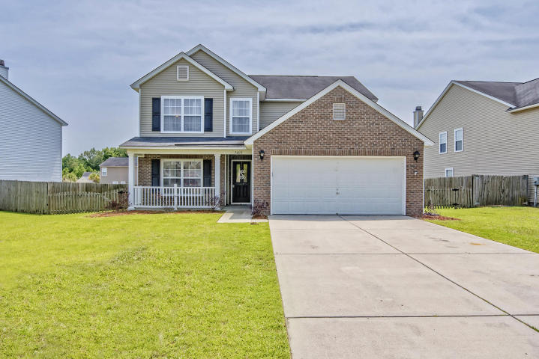
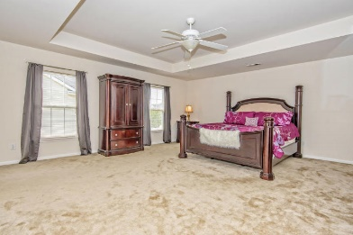
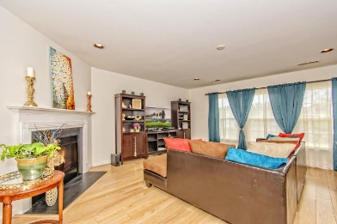
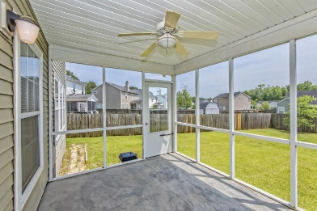
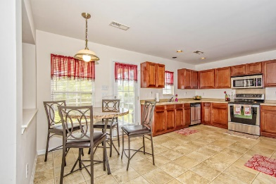
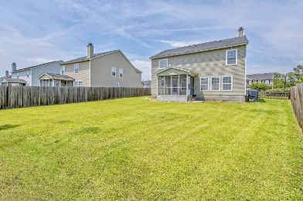
Beautiful Home in Paddock Point
0.5% Buyer’s Agent Bonus!
5003 Ballantine Drive
Wescott Plantation ~ Summerville, SC 29485
MLS# 17013337 ~ $255,000
MOTIVATED SELLER makes this 5 bedroom, 3 bath your new home! This great floor plan offers large rooms throughout. First level boasts spacious living/dining area, private family room with wood burning fireplace, large eat-in kitchen, laundry room, full bath, and 5th bedroom or this can be great flex space for office/study area! Rear staircase leads to 2nd floor featuring oversized king master suite with deep tray ceiling, deluxe master bath with dual sinks, soaking tub, separate shower and large walk-in closet. 3 additional bedrooms on 2nd level are all great sizes with wide double-door closets and large windows. Rear yard is privacy fenced with both a single gate & a double gate for easy access. Full front porch, rear screened porch, two car garage... with sheetrocked walls and auto opener, wood hurricane panels cut for every window convey with the house. Wait, there's more! Large walk-in pantry off the kitchen, refrigerator, washer & dryer included with sale, New Laminate Floors! Come see this home today!!
Eric McFadden
emcfadden90@gmail.com | Cell (843) 408-9235 | Office (843) 225-8830
Brand Name Real Estate | 4 Carriage Lane Suite 106 | Charleston, SC 29407

