Slide 1
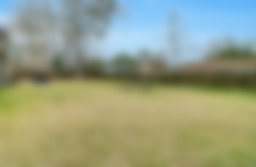
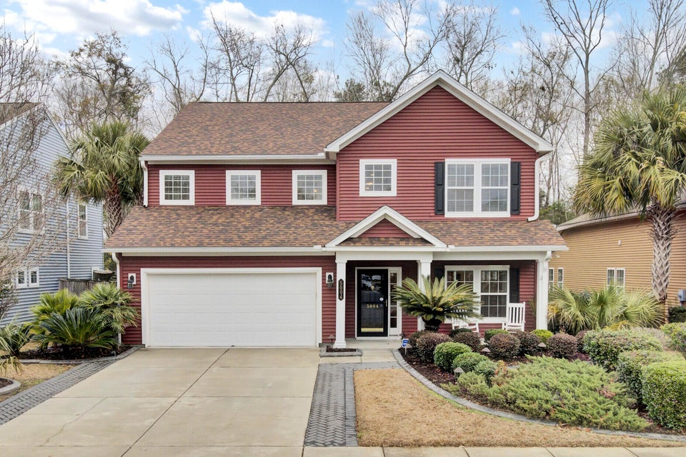
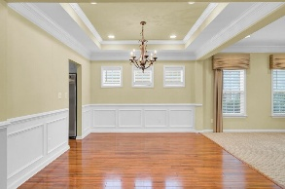
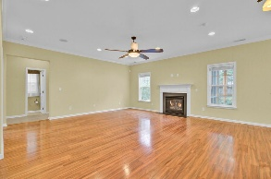
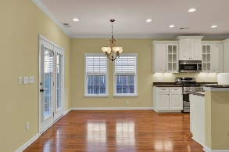
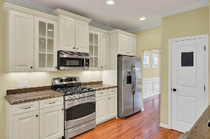
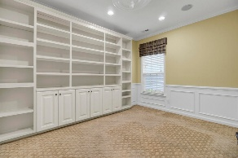
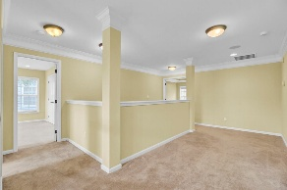
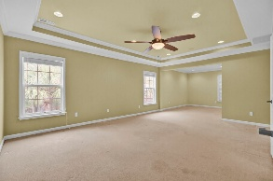
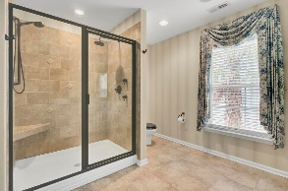
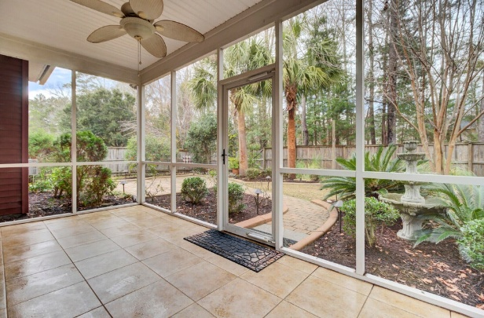
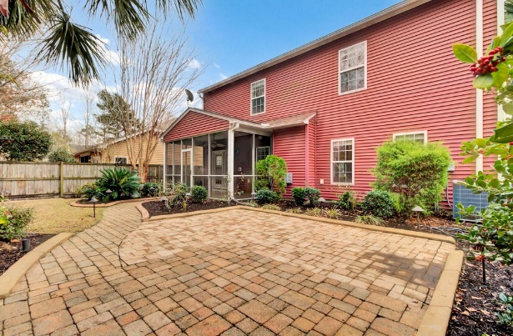


Buyer Agent Commission! 3000+sqft in Wescott, Like New!
5004 W Liberty Meadows Drive
Wescott Plantation | Summerville, SC 29485
MLS# 25001763 | $498,900
Beautiful well cared for home, freshly painted throughout, with every upgrade imaginable! Located at Sandpines in Wescott Plantation, Wescott's best kept secret! Additionally, it's in the sought-after Dorchester 2 School District! Originally the builder's model home featuring wood floors in great room, kitchen, breakfast area, formal dining room & spacious foyer. Approximately 40 recessed lights throughout home! Architectural arches, crown molding, wainscoting, trey ceilings & fireplace all contribute to the elegant feel of this home. The study (potential 5th Bedroom) has added touches such as wainscoting, a built-in bookcase and a great closet for storage. Other amenities include a great master bath with a five-foot walk-in shower featuring thermostat controlled dual shower heads and ceramic tile, bronze fixtures, and a linen closet. The large master suite contains a trey ceiling, crown molding, recessed lighting, a separate sitting area, and an extremely large walk-in closet. The remainder of the upstairs has a loft area and three other bedrooms. One of which comes with its own full bathroom making it a great guest room! There is a 3rd full bathroom with double sink vanity and bronze fixtures conveniently located in the hall between the 3rd and 4th bedroom. Additionally, the home is wired for sound, intercom, security system and has 2 programmable thermostats. The screen porch (apprx 17' x 8') on the rear of the home has speakers and ceramic tile. Yard was professionally landscaped with several palm trees, numerous shrubs, pampas grasses, various plants and includes an irrigation system. The backyard has a brick paved walkway and grilling area. This property also backs up to a wooded buffer (owned by HOA) for added privacy and is centrally located to Summerville, Joint Base Charleston, Boeing, Bosch and much more. The Golf Club of Wescott is very close by and has 27 holes, driving range, & pro-shop. The beautiful clubhouse has a full restaurant and is open to the public. This is a great home for family or entertaining! Just professionally cleaned & gleaming like new, once you see inside, you are sure to fall in love!
David Tester, ABRM
(843) 452-7337 | david@davidtester.com
www.davidtester.com
Charleston First Real Estate, Inc | 2208 Forest Lakes Blvd | Charleston SC 29414

