Slide 1
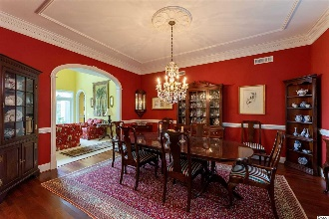
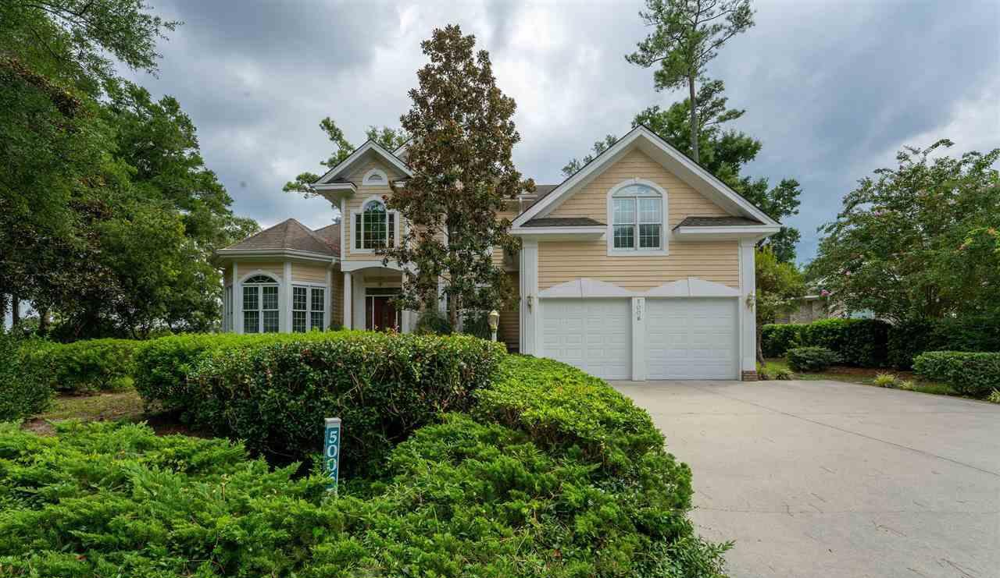
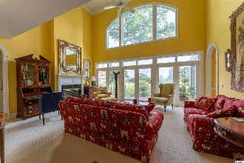
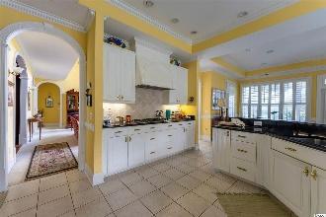
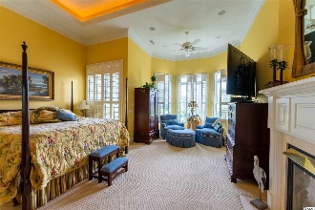
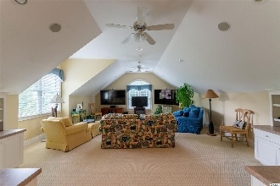
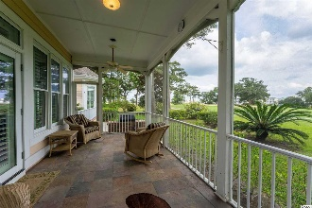
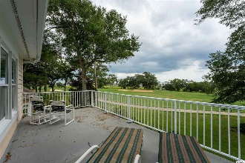
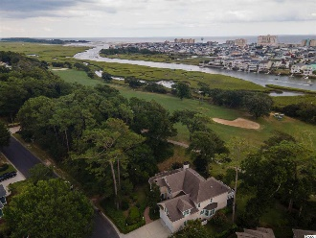
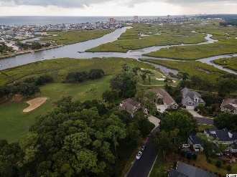


Stately & Inviting
5006 Bucks Bluff Dr
Tidewater Plantation ~ North Myrtle Beach ~ MLS# 2019377
Stately and inviting, this wonderful two-story, custom-built beauty presents immediate curb-appeal and epitomizes charm! Enter through a lovely brick, covered front porch into a gracious foyer with views of a magnificent staircase, French-doors to an inviting cozy office, formal dining area, living room with fireplace and infinity scenic views to the golf course and the Cherry Grove Marsh. The dining area for family gathering or for entertaining is magnificent and calls for lavish holiday dinners or for lingering over informal meals with plenty of space for a couple of foursomes and great group conversation. The office has good function yet is in keeping with the overall beauty of the home with rich-wood custom built-ins and bathed in light from a focal front window. The living area is set for chats by the fireplace, relaxation, more group conversations and, of course, the never-ending views. The over-sized kitchen-family room is to the right. The easy-living lay-out encompasses a wet bar, with ice-maker, wine bar, large TV, and breakfast bar and nook, which highlight the multi-function of this perfectly planned heart of the home. There is also a coveted screened porch off the family room with cooling ceilings fans, more views and peaceful seclusion from well-manicured mature landscaping to just relax and to enjoy the splendid natural environment and wildlife. Back in the kitchen, there is a desirable large gas range, double oven, built-in appliances and lots of planned work-, cabinet-space and storage. The utility room and pantry are likewise off the kitchen which can be conveniently entered from the double-car garage. A half bath is nearby for easy access by guests. There are also three other full baths. The master bedroom and luxury en suite are first floor and share the double-face open fireplace; there is a homely sitting area also. There are three big bedrooms, two baths and a huge bonus room upstairs, along with that viewing balcony. The home is built on a one-third-plus-private-acre, well-landscaped lot of about 15,246 sq. ft. in the preferred Bluffs of Tidewater Plantation Resort! Tidewater Plantation is a world-class golf/Intracoastal Waterway/beach community. The Bluffs Section adjoins the Cherry Grove Marsh and peaks at the Atlantic Ocean. Lot 687 is a high property, situated on Tidewater Golf Course's signature 13th hole which plays along the marsh and Inlet towards the ocean. No flooding ever! Golf course lots may not be fenced; however, this large property on the Point of Tidewater has many possibilities for backyard enjoyment and truly some of the best views in Tidewater or anywhere, featuring those from the screened porch, brick and stone deck/patio and upstairs sun balcony with line of sight to the ocean. Long-term rentals only are allowed on the Bluffs side; so, at this compelling price, low HOAs & taxes and rich amenities, this amazing, rare dream home is also an excellent investment as well as being desirable for a treasured vacation home. Tidewater boasts many other upscale amenities, including owners' beach cabana on the Cherry Grove Beach named the 11th best in the nation, pools & spas, clay- & hard-surface tennis courts, pickle ball, bocce, horseshoes, amenities center, fitness center, driving range and putting green, 24-hour gated, manned security and clubhouse with bar & restaurants. There is even a complimentary gated storage yard for boats, campers, recreational vehicles and the like. The convenient HOA building has rooms for business and other meetings and events and a lending library. Tidewater itself is on a tree-lined road to oceanfront Anne Tilghman Boyce Coastal Reserve, a nature conservancy. It is minutes to the beach, shopping, entertainment, medical services, outstanding schools and parks and access to major highways. The jewel in the crown of the development is that private owners' beach cabana on the wide, pristine sand of Cherry Grove Beach in popular, safe North Myrtle Beach.
Deborah Collins
843-424-9013
dctidewater@yahoo.com
Connie Ross-Karl
702-306-2643
conniesross@aol.com
NEW WAY PROPERTIES MYRTLE BEACH

