Slide 1
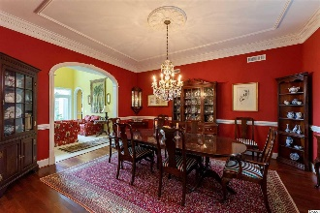
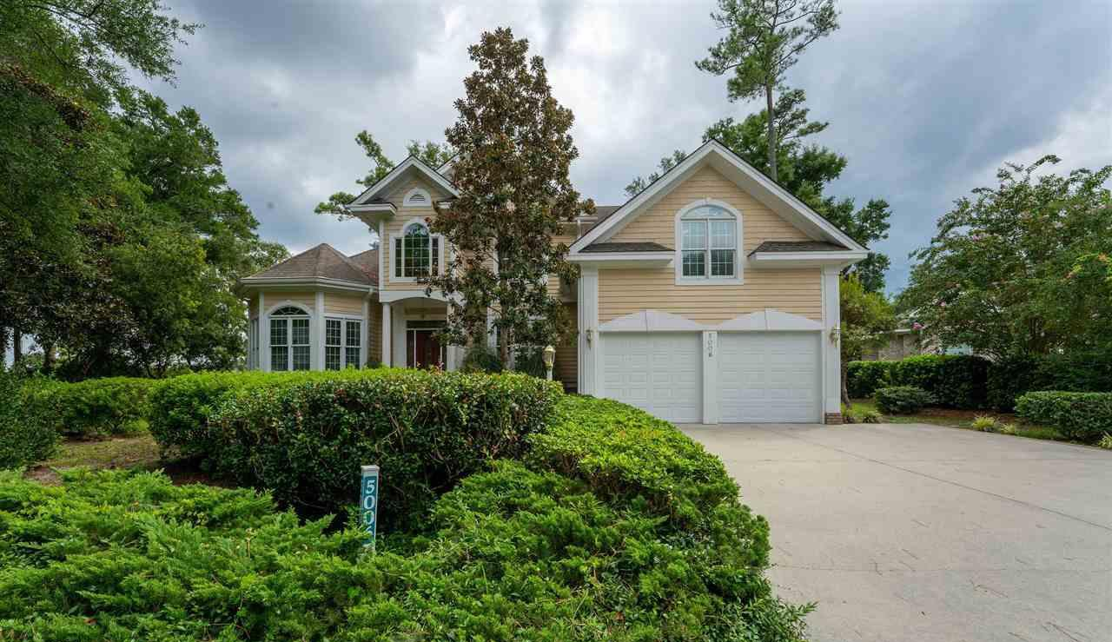
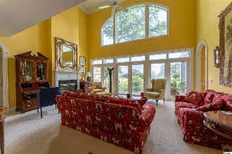
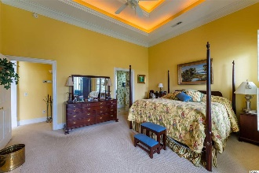
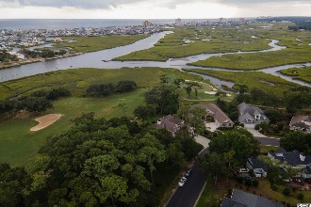
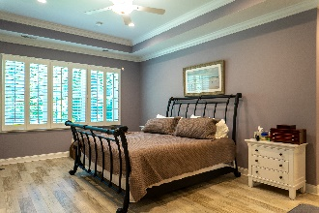
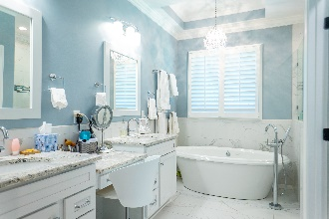
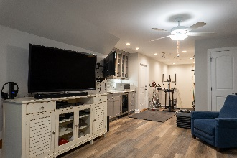
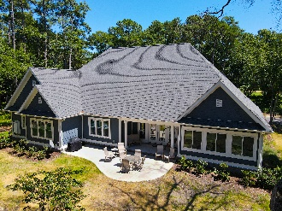
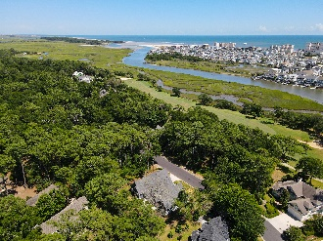


Stately & Inviting
WELCOME TO 5006 BUCK'S BLUFF DR.
BLUFFS OF TIDEWATER PLANTATION RESORT
NORTH MYRTLE BEACH SC 29582
1/3+-acre lot, on the 13th hole and along the Cherry Grove Marsh
High property /no flooding ever
Large, double-car garage
Stately brick entry, covered porch
Inviting entry foyer with hard-wood stairs and decorative railing
Office with built-ins and French Doors
Oversized formal dining room
Formal living room with fireplace and vaulted ceilings
Stone and brick veranda/porch off living area with views
Kitchen-family room combination is the heart of the home
Wet bar, ice maker, wine refrigerator great cabinetry
Gas cook top, double oven, built-in refrigerator and freezer
Breakfast bar and nook, pantry
Utility room off kitchen
Screened porch off family room-kitchen
Half bath first floor
Plantation shutters throughout
Master bedroom has fireplace, tray ceiling and sitting area
En suite has two walk-in closets and linen closet
Whirlpool tub and separate shower
His and hers sinks and vanities
Upstairs has 3 spacious bedroom, one an en suite and two share a jack and jill bath
Sun porch with line of sight to the ocean off second master bedroom upstairs
BIG bonus room!
Security System
Built-in barbecue
Gas (propane) heat, fireplace, water heater & range
Range hood
Chair-assist lift on stairway to second floor
Large, floored attic
Bluffs is a double-gated Tidewater neighborhood with 24-hr., manned and roving security
Deborah Collins
843-424-9013
dctidewater@yahoo.com
Connie Ross-Karl
702-306-2643
conniesross@aol.com
NEW WAY PROPERTIES MYRTLE BEACH

