Slide 1
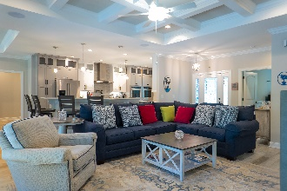
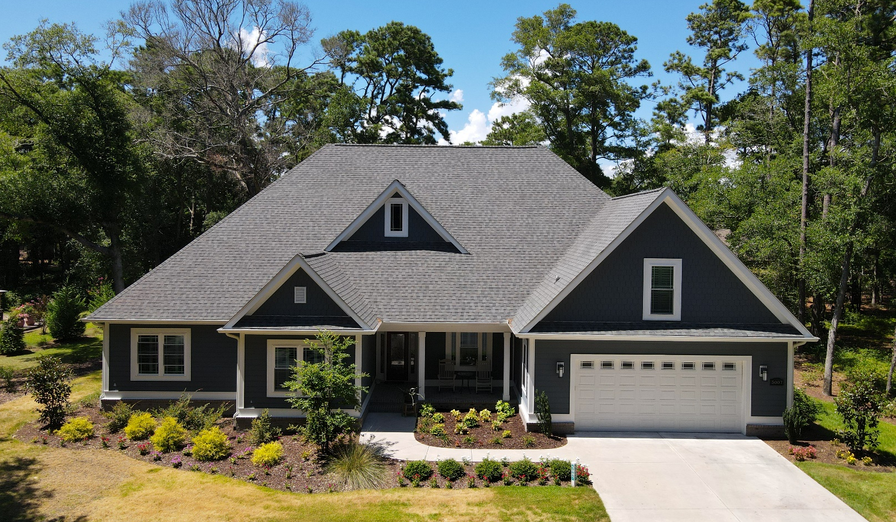
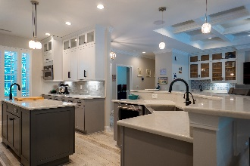
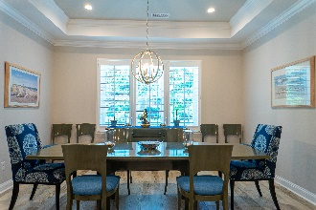
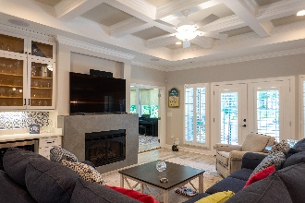
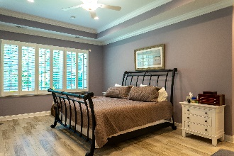
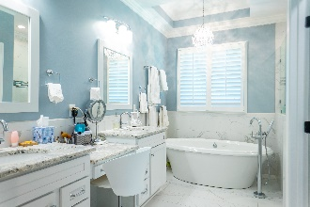
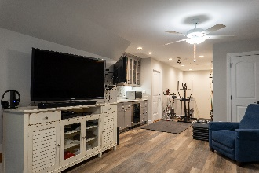
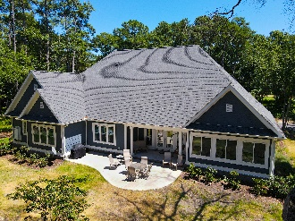
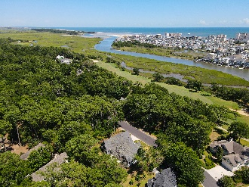


Just
Perfect!
5007 Bucks Bluff Dr
Tidewater Plantation ~ North Myrtle Beach ~ MLS# 2016414
Home and Garden Magazine should feature this newer, custom-built, impressive and super-spacious 4-bedroom, 4-full-bath contemporary-ranch-beauty with big, self-contained and luxurious upstairs flex suite/with en suite. This fabulous bonus space can also function as a true mancave, giant fifth bedroom or family-fun area, roomy enough for even a home gym, too! All four bedrooms and three full baths are conveniently located on the first floor, along with the gigantic great-family room with fireplace and wetbar, casual/formal dining room, magnificent designer chef's kitchen with breakfast bar & island and comfortable Carolina room. Plus, lots of storage. Notice the wonderful Southern-style front porch, overisized double-car garage and welcoming craftsman-inspired exterior design. Fashion and function define every upscale upgrade: Envision popular, beach-color pallettes and relish light and airy rooms throughout with subtle yet remarkable architecture & cool, calming decor. Perfect! See Assoc. Docs for complete, amazing features, too many to list in remarks. The home is built on an approx. third-acre private, well-landscaped lot in the preferred Bluffs of Tidewater Plantation Resort! Tidewater Plantation is a world-class golf/Intracoastal Waterway/beach community. The Bluffs Section adjoins the Cherry Grove Marsh and peaks at the Atlantic Ocean. Lot 681 is a nice-sized, 14,375-sq.-ft., high property, situated across the street from and facing Tidewater Golf Course's signature 13th hole which plays along the marsh and Inlet towards the ocean. No flooding ever! Golf course lots, however, may not be fenced; so the lovely, large private backyard enclave with patio unique to this house is pet-friendly & has many possibilities for enhanced enjoyment, including fencing, pool, hot tub, lanai, secret garden and the like, with the approval of the Design Review Board. Long-term rentals only are allowed on the Bluffs side; so, at this compelling price, low HOAs & taxes and rich amenities, this amazing, rare dream home is also an excellent investment as well as being desirable for a treasured vacation home. Tidewater boasts many other rich, upscale amenities, including owners' beach cabana on the Cherry Grove Beach named the 11th best in the natiion, pools & spas, clay- & hard-surface tennis courts, pickle ball, bocce, horseshoes, amenities center, fitness center, driving range and putting green, 24-hour gated manned security and clubhouse with bar & restaurants. There is even a complimentary gated storage yard for boats, campers, recreational vehicles and the like. The on-site, convenient HOA building has rooms for business and other meetings and events and a lending library. There are many clubs and activities year round. In Tidewater, you can do it all, or just relax in the perfect Tidewater lifestyle. Tidewater itself is on a tree-lined road to oceanfront Anne Tilghman Boyce Coastal Reserve, a nature conservancy, including Waties Island, with access for managed recreational use. Tidewater, a historic plantation, is on an elevated peninsula of live oaks and southern pines between the Intracoatal Waterway and the Cherry Grove Inlet to the Atlantic Ocean. The plantation also preserves the unique look of its own origins. It is close to the beach, shopping, entertainment, medical services, outstanding schools and parks and access to major highways. The jewel in the crown of the development is that private owners' beach cabana on the wide, white sands of the Cherry Grove Beach, just a few minutes drive. This charming home enjoys a pristine, indigineous peaceful environment of wildlife and natural scenery, in addition to the excellent reputation of the Tidewater Golf Course, the Pebble Beach of the East. Tidewater Plantation, in one of the U.S.'s Top-10 beach towns, highly desirable, safe North Myrtle Beach, reflects a "way of life." Welcome to the the best of the beach in the Bluffs of Tidewater Resort! Did we say IT'S PERFECT?
Deborah Collins
843-424-9013
dctidewater@yahoo.com
Connie Ross-Karl
702-306-2643
conniesross@aol.com
NEW WAY PROPERTIES MYRTLE BEACH

