Slide 1
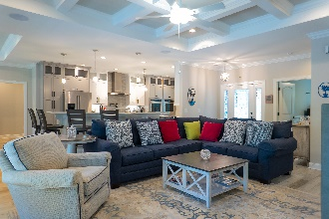
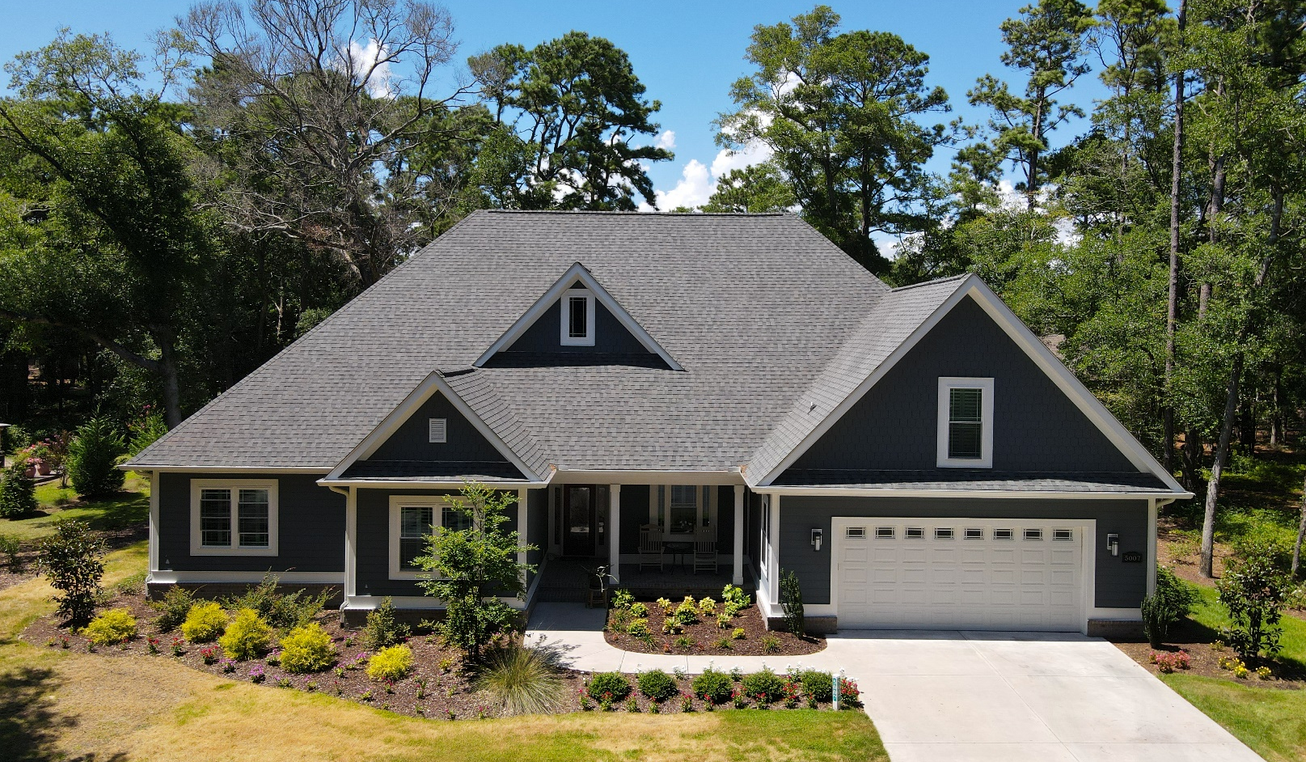
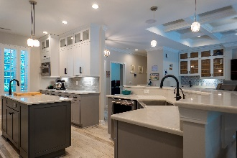
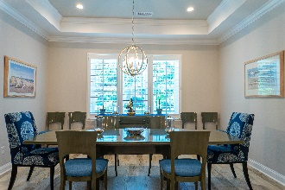
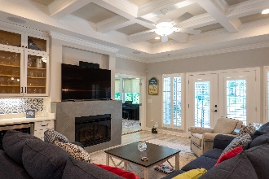
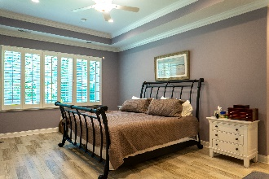
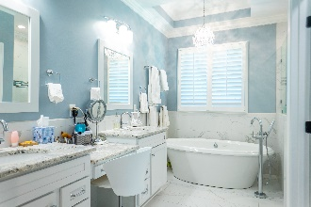
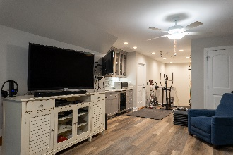
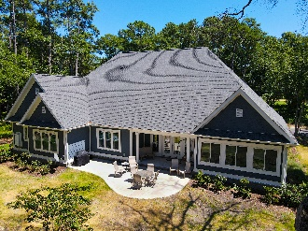
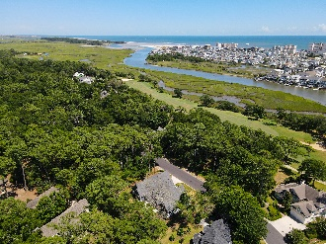


Just
Perfect!
WELCOME TO 5007 BUCK'S BLUFF DR.
BLUFFS OF TIDEWATER PLANTATION RESORT
NORTH MYRTLE BEACH SC 29582
FEATURES:
Overview
Open concept dining, kitchen and living
Custom home built by one of area's leading contractors
Built in 2018
Transferable termite warranty
All walls 2 x 6 construction
All ceilings main floor 9 ft, 10 ft in tray area
Full 8 ft ceiling in bonus room
9 ft long pantry shelving with lights
Hurricane straps and plates/all framing and roof sheathing
Maintenance-free Hardie concrete board siding
Alarm system on doors and internal space sensors/smoke alarm wired in
Fish scale trim over garage peak and front peak
Raised-slab construction with brick skirting all around
Front porch surface and steps matching brick as house skirting
Whole-house generator/Kohler gas-fired auto on and off, if power goes off and returns
2 on-demand Renai gas-fired hot water heaters
All appliance manuals, warranties, and house blueprints available
Plentiful storage in mud room, laundry room, under stairs and
walk-in attic space
Plantation shutters on whole house, including garage door and windows
Entire house wired for cable or satellite
All Delta faucets/black or chrome
Black lever door handles on all doors except front
Recessed LED lighting in all rooms, extra LED lights for
all recessed lights
Custom pendant lights in kitchen
Under-cabinet lights in kitchen
Chandelier lighting in dining area, foyer
Lights in dining and primary bedroom on dimmers
High tech is an under statement
3-zone heating and cooling/bonus room on own zone
Custom surround sound system, speakers recessed into ceiling with denon receiver in living room
Porcelain tile floors on main level all rooms/white oak wood-plank-look
wood grain custom vinyl floor in bonus room
Walk-in attic
All windows protected with 3M tinted hurricane film for
energy efficiency (ELECTRIC BILL AVAILABLE) except Porch has impact glass sliding windows
Ceiling fans all rooms
Double-sided light front door
Covered front porch with seating area
Gas fire place (propane) with tiled surround
Custom wet bar with sink in living room, tiled back splash/glass front Cabinets above bar
Coffered ceiling in living room
French door walkout to rear covered porch from living room
3 full guest baths with custom quartz solid-surface top matching in all bathrooms, including bonus-room bath
Custom oversized bonus room/wet bar, tiled back splash and glass-front cabinets above cabinet and drawer base below in bonus room/full bath with
5 ft shower off bonus room/closet in bonus room which can be used as guest room/mancave/entertainment-media area/space for home gym
Full bath with 5 ft shower off bonus room/closet in bonus room
Marvelous Custom Builds
His and Her custom built-ins in the master suite/en suite bath with tray ceiling and crystal chandelier, closets, linen closet, unique vanities
All bathroom vanities Kraft Maid cabinetry with matching mirror frames
Free-standing air jet tub with heating and LED lighting
Floor filler with hand held
Double bowl with vanity height in center with drawer
Bathroom sinks with 3 drawers and cabinet space
Marble-look tile on floor in primary bath
Toilet closet
Oversized custom walk-in shower with overhead rain head, wall-mounted shower head, body spray heads, hand held
Tiled seat in back of shower
Shampoo nooks built in
Tiled shower floor and walls, half glass wall and full glass door to shower
Enclosed porch off living room 3 1/2- season room with double French doors with plantation shutters from living room to create open look
Porch has hurricane sliding windows to seal room to create quiet oasis
Custom sun shades on windows on porch
Open concept kitchen
Custom kitchen with maple Kraft-maid cabinets to ceiling 9 ft
All counter tops marble-look quartz
Custom pantry cabinet with roll-out shelves
Custom, roll-out shelves on lower cabinets
Stand mixer lift in lower cabinet
2 pull-out garbage cans (waste and recycle in each)
Stainless farm house sink with disposal and sink grate
Large center island with prep sink with disposal
Electric on center island
Breakfast bar height counter on sink island/seats 6
All stainless steel Kitchen-Aid appliances
Two wall ovens mounted side by side at counter height/no bending to use
Separate warming tray under one oven
Induction cook top/has gas line also if gas-top desired
Pot drawers under cook top
Pot filler
Tiled back splash thru-out kitchen
Stainless vent hood with lighting
Microwave mounted in own cabinet does convection cooking and baking
Tray ceiling dinning area has 9 ft table/seating for 12 with buffet in it
Dining area open to kitchen
Oversized primary bedroom suite area
Office/bedroom with closet has custom raised panel wainscoting
All guest bath and bedrooms on opposite side of house from
master suite area
Even Mudroom, Laundry, Garage and so much more – Specialized!
Bench seat in mudroom has cabinets underneath
Oversized laundry thru large mudroom has two drying racks above deep sink
10 ft counter top with sink and folding area opposite washer and dryer
Open storage under folding area
Base cabinets flank washer and dryer
Wall cabinets 10 ft long on washer and dryer side
Staircase to bonus room off mudroom
Storage space under stairs in mudroom with light
Hallway from garage to living areas has enclosed pantry shelving with light
Vented attic
Oversized 2-car garage with epoxy floor
Garage door opener with outside control panel
5-zone irrigation system/room for more
Fully landscaped yard with grass lawns
Concrete free-form patio
Gas line for grill no propane tanks needed
Electric line run for hot tub and fire pit
Outside motion flood lights on rear of house
Gutters with underground run-off away from foundation
Outside weather proof outlets on porches
3 outside hose bibs/closets
Deborah Collins
843-424-9013
dctidewater@yahoo.com
Connie Ross-Karl
702-306-2643
conniesross@aol.com
NEW WAY PROPERTIES MYRTLE BEACH

