Slide 1

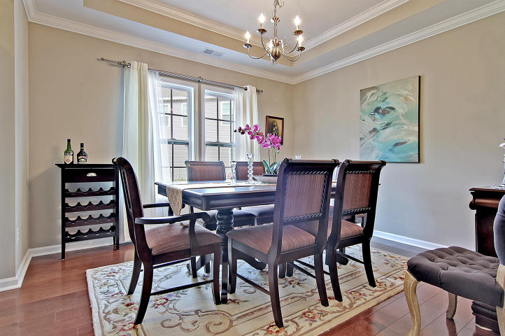
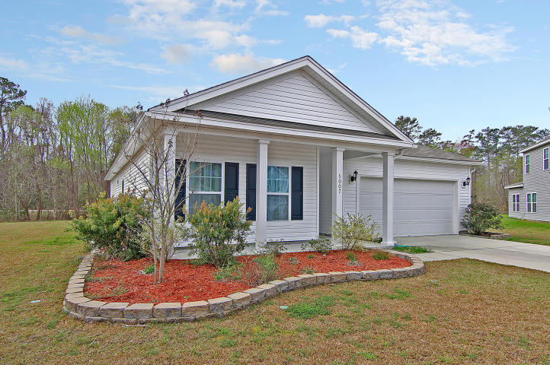
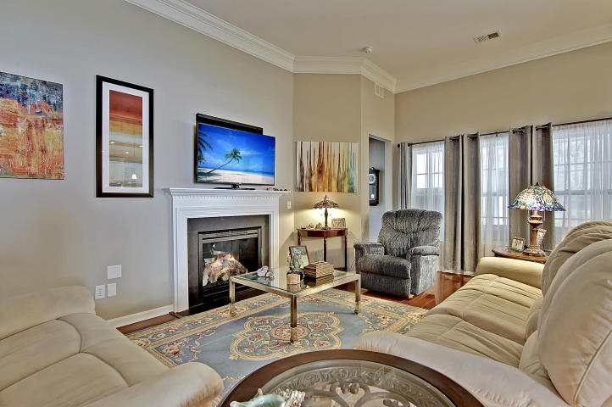
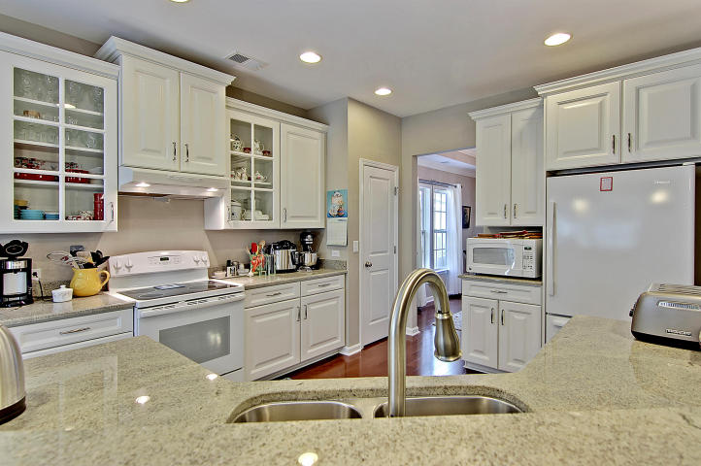
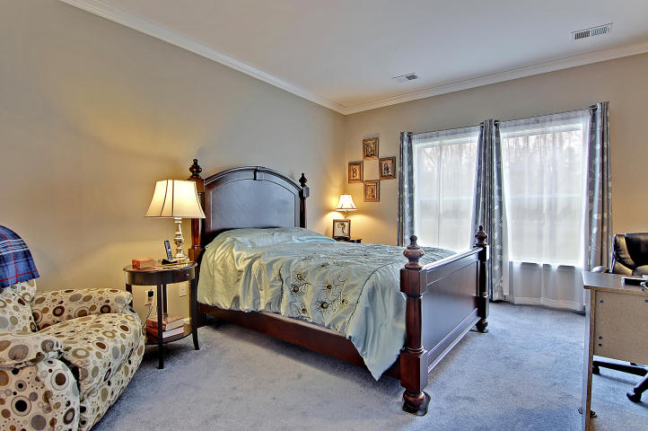
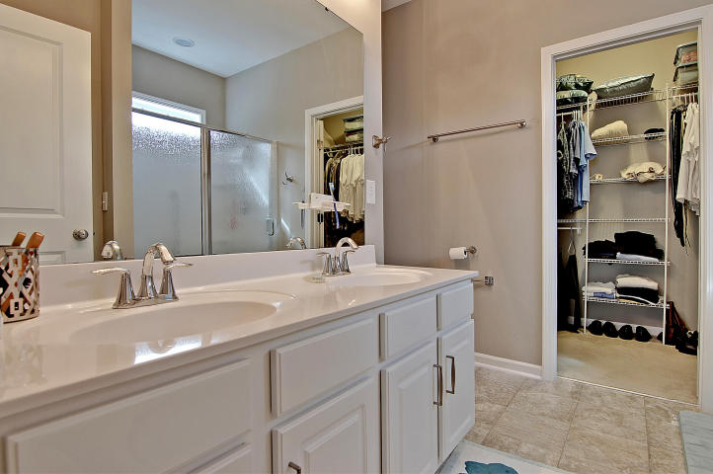
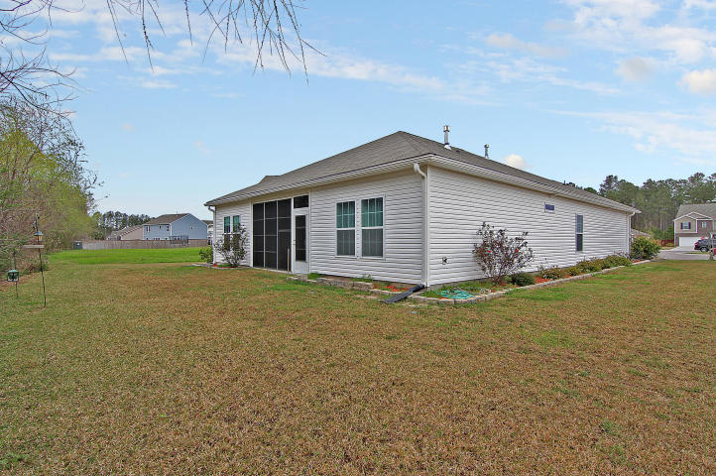

Absolute Bargain! Unbelievable Price!
5007 Shelbourne Court Victoria Pointe
Summerville, SC 29485
MLS# 17006018 ~ $199,900
4 Bedrooms ~ 3½ Bathrooms
Priced low and firm for your pre-approved buyer who wants a great deal on the nicest house in Summerville. Hurry, it won’t last long at this low, low price. Do your buyer a favor and submit a squeaky-clean full-priced offer today and save yourself all the fun of a full-priced counter offer. SPECIAL NOTE: this very special home includes a General Electric ''whole house'' Home Generator system rated at 20 kilowatts, powered by Natural Gas and valued at $6,650.
Chip Walsh
843-822-4663
chipwalsh@gmail.com
The Boulevard Company, LLC 35 Broad Street Charleston, SC 29401
www.TeamWalshRealEstate.com

