Slide 1
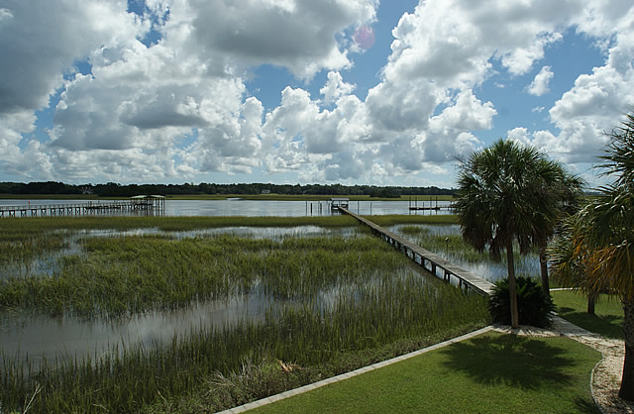
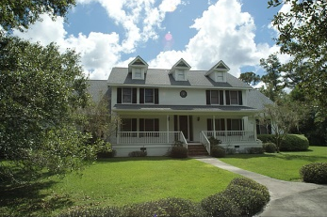
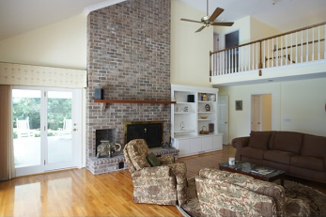
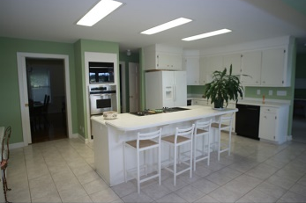
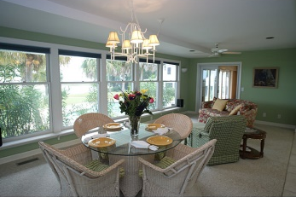
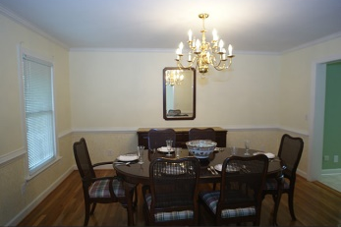
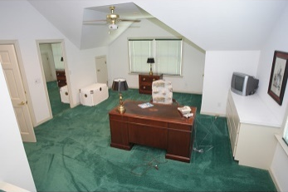
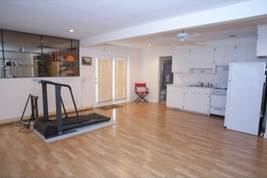
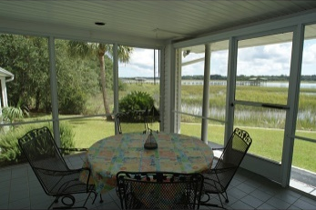
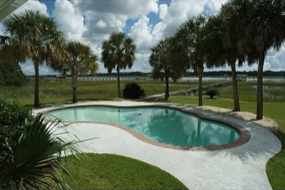
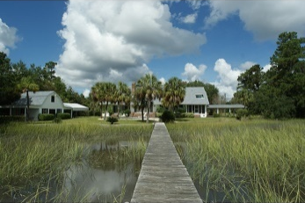


Feel Like You're On A Private Vacation Every Day!
5007 Stono Plantation Dr
Stono Plantation ~ Hollywood ~ MLS# 1417655 ~ $1,085,000
PRICELESS! This property is a rare find on a beautiful, protected portion of the Intracoastal Inland Waterway (ICW) close to Charleston. Located in an exclusive 16 estate private gated community immediately adjacent to an 800 acre natural conservation preserve, this home was built for exceptional Low Country living. The shorebirds, egrets, herons, ospreys and dolphins will greet you in your backyard and private dock on the ICW. Enjoy your privacy and recline by the pool while watching the parade of yachts. This home is designed with an open floor plan that maximizes the gorgeous, world class panoramic water vistas throughout the generous living areas. As you enter this serene home, there is an elegant marble foyer, an enchanting dining room and a peaceful library. An open kitchen flows into a large sitting area overlooking the pool and water. Enjoy relaxed alfresco dining and feel the soft sea breeze on your adjoining fine screened private waterfront porch. The large great room is accented with a 2 story brick fireplace, cathedral ceilings and amazing water views. The first floor master suite with French doors and a large private porch is perfectly situated to capture the expansive water views, the incredible nighttime display of stars and the beautiful sunrises over the waterway. On the opposite side of this home is an adjoining entertainment/multimedia area with a separate kitchen and full bath. The second floor has 4 bedrooms and 3 rooftop balconies/sun porches. All the rooftop balconies have incredible water views, one of which belongs to a spectacular, one of a kind, spacious waterfront home office. Green features include dual zone geothermal heating and cooling that provides comfort throughout the home, reflective coatings on the windows, a discounted conservation electric rate and a deep well irrigation system to water the grounds. The true deep water dock with covered recreational area has unobstructed ocean access. The 2013 property taxes were $4,778.
AgentOwned Charleston Group
902 Savannah Hwy
Charleston, SC 29407-7802
Lisa Deaton
843-224-7878
lisamdeaton@comcast.net
www.agentownedrealty.com

