Slide 1
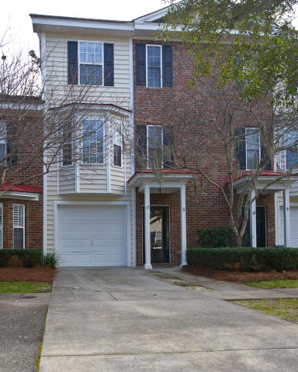
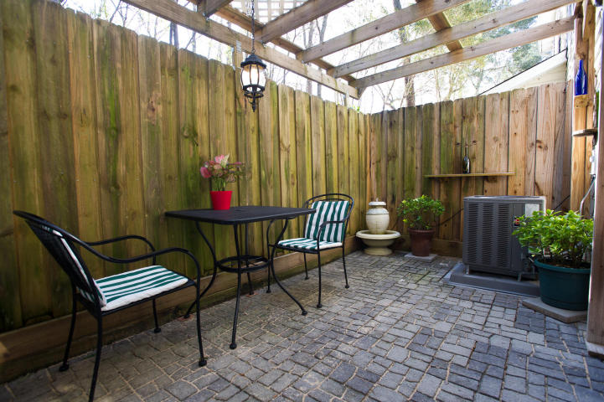
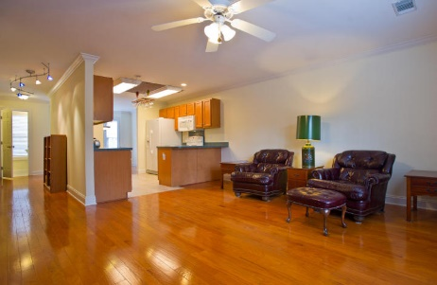
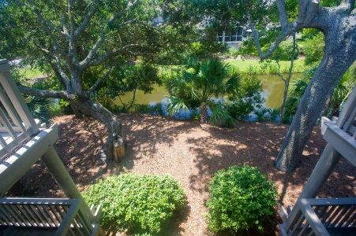
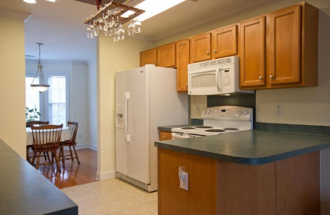
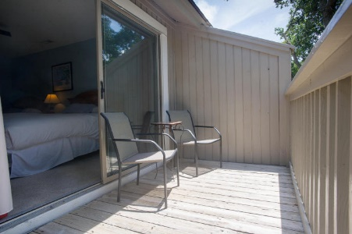
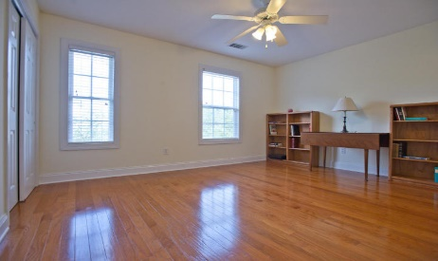
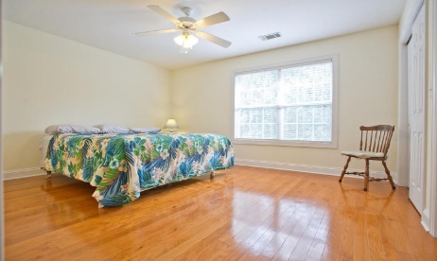
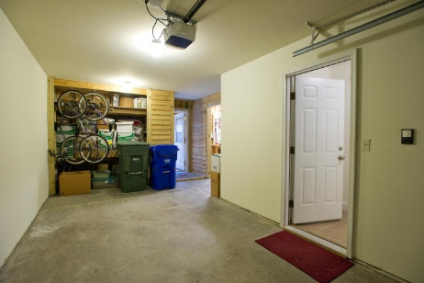


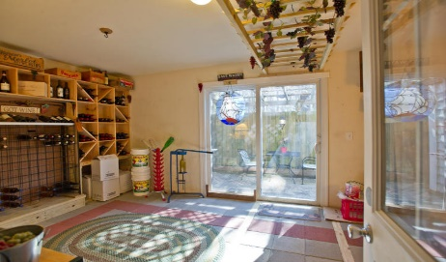
5007 Double Fox Road #5 Charleston ~ MLS# 16001692 ~ $167,000
New Listing!
Radcliffe Place
Look no further. This beautiful townhouse is nestled in the heart of West Ashley. Situated in Radcliffe Place off of Bees Ferry Road, this is one of only a few units that backs up to a wooded area for extra privacy. The home has two bedrooms each with its own full bath and the laundry is located upstairs for extra convenience. The central location of the kitchen offers a nice open feel with a very large family room and a nice breakfast/dining area. On the ground level you will find a large garage with tons of storage...but that's not all!! The current owners have done a lovely job of converting part of the ground floor into a wonderful living space that they used for a wine/entertaining area but it can be anything you'd like including a man cave, an office or bonus room with a kitchenette area with cabinets, a sink and small fridge. Just off of the wine room is a beautifully done patio that has been fenced in for privacy so it is one of, if not the only, unit in the complex that has a really comfortable outdoor living space. Just inside the wine/bonus room is a wonderful work space with a work bench that conveys as well as a nice utility sink. The owners were able to make space for this as they removed the hot water heater and added a tankless water heater! Other updates the current owners have done include fresh paint throughout including the garage, a new entrance and storm door, a new hvac system, new blinds, new kitchen appliances and new lighting in the kitchen. And one of the best features of this home is its proximity to the Bi-Lo Shopping Center. Thus it is just around the corner from Grocery shopping, several cafes including a coffee shop, Chinese Restaurant and much more. This one wont last long!!
Carey Nikonchuk
(843) 276-1701 M
cnikonchuk@gmail.com
www.palmettoproperty.net

