Slide 1
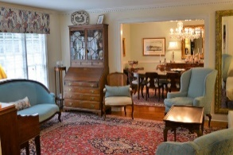
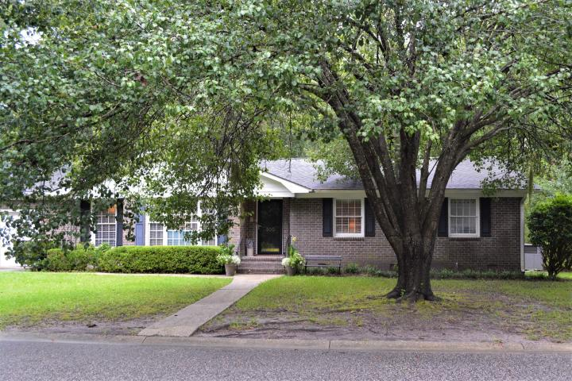
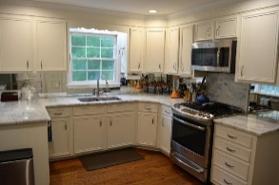
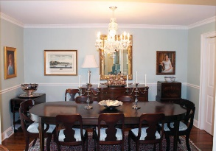
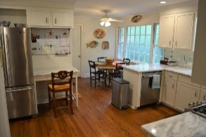
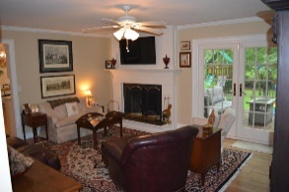
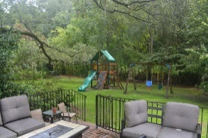
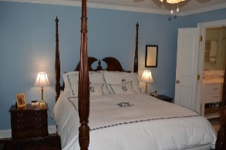
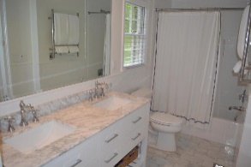
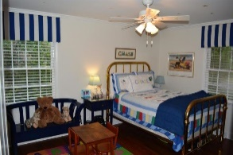
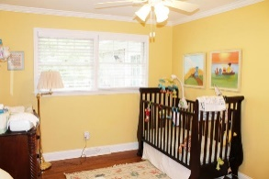
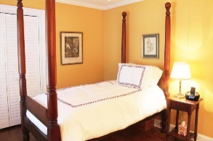

500 E Wimbledon Drive Marlborough | Charleston, SC 29412 MLS# 19023833 | $499,900
New Listing ~ Beautifully Updated Home
Minutes to MUSC & Downtown
$550,000
Gracious four bedroom home, totally renovated in 2015, and five minutes to MUSC and downtown. Gorgeous hardwood floors throughout, beautiful moldings and smooth ceilings. Formal living room and dining room, large totally renovated eat-in kitchen with granite and stainless steel appliances, Large laundry with extra pantry space. Bathrooms have been updated with Carrera marble and white subway tile surrounds. Brick woodburning fireplace in family room off kitchen. French doors from the family room and master bedroom open onto a beautiful wrought iron enclosed brick deck that is shaded by a giant live oak tree. Large private fenced backyard with buffer behind. New alarm system, tankless water heater, updated wiring & new water supply lines. Maybank tennis center is close-by in Marlborough.
HEIDI RAVENEL REALTOR (843) 670-1166 | hravenel@arjrc.com www.ravenelrealestate.com/
Arthur Ravenel Jr. Co.
105 Wappoo Creek Suite 4A
Charleston, SC 29412

