Slide 1
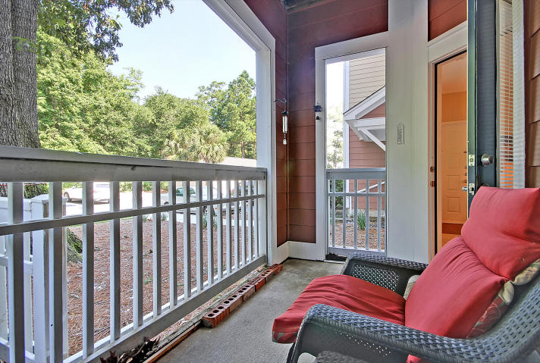
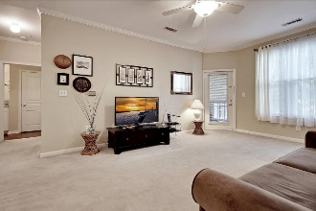
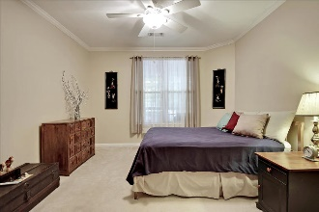
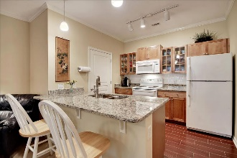
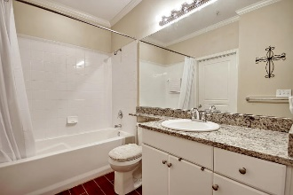
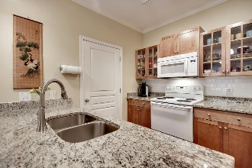
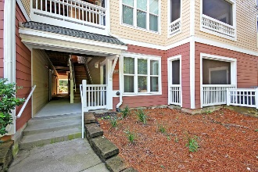
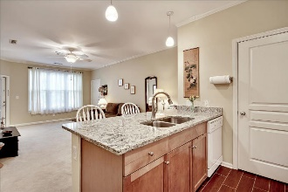
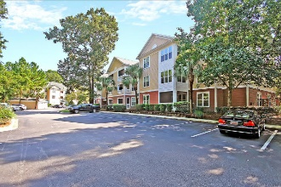
Great Downtown Investment Opportunity
Price Reduced!
500 Bucksley Lane #104 Daniel Island, SC 29492 ~ MLS# 18023196 ~ $159,000
Everything you need is located on the tropical community of Daniel Island & this 1st floor unit puts you in the center of it all! Miles of biking trails along the Lowcountry marshes & rivers, a kayak launch, tennis center, golf courses, playgrounds, churches, schools, great dining & shopping all of which you can literally walk to from this 1 bedroom, 1 bath, move-in ready unit. The living room is spacious & opens to the kitchen which boasts granite counters and a subway tile backsplash. Laundry room next to the kitchen & has a full size W&D that convey with the unit. From the living room you can access the screened-in porch. Gorgeous porcelain ceramic tile flooring in the entry, kitchen & bath, & the bath also includes granite counters! There is also crown moulding throughout the unit.
Amenities include a pool, fitness center, grilling area & picnic areas
Book your viewing today!
Paige Rhodes 843-830-3281 paige@mattoneillteam.com
Ben Laaper 843-642-3546
ben@mattoneillteam.com

