Slide 1
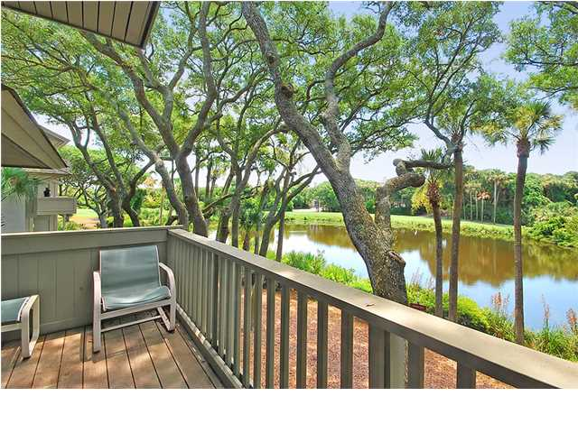
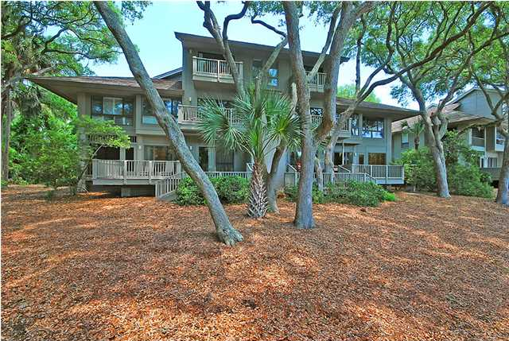
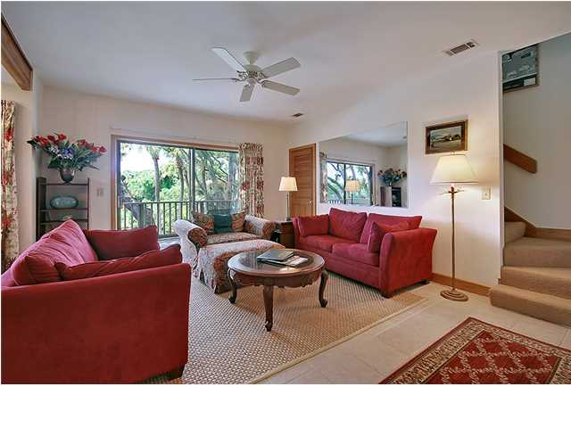
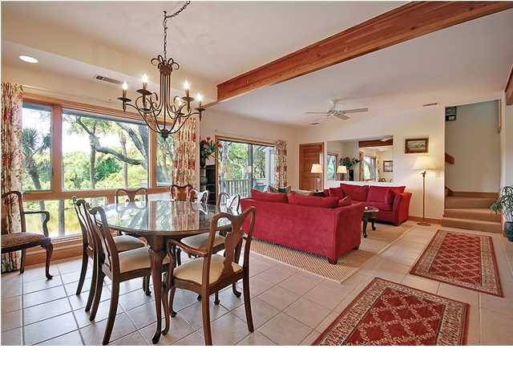
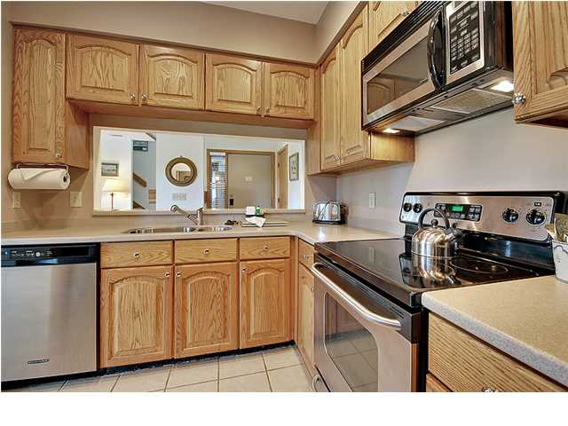
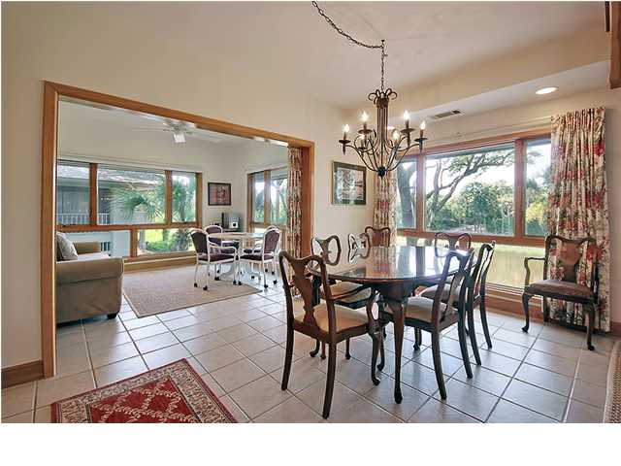
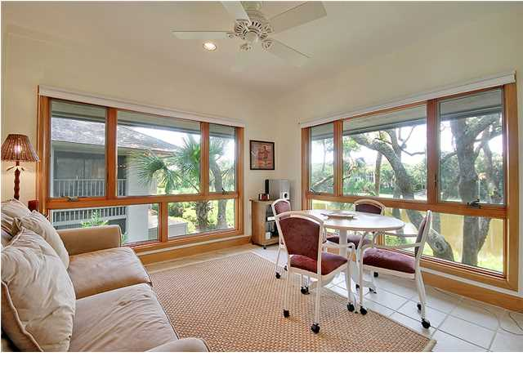
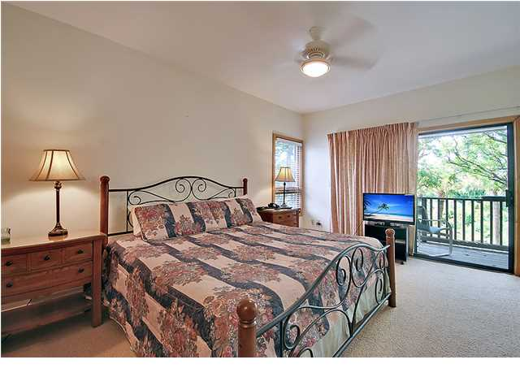
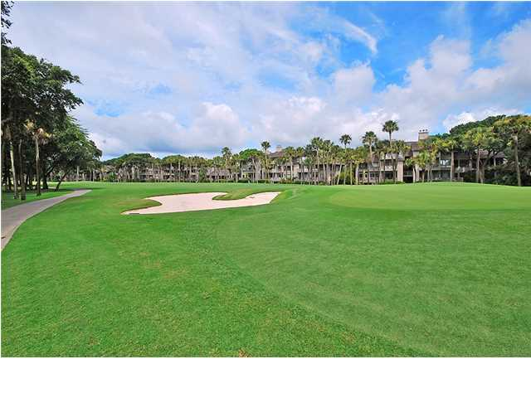
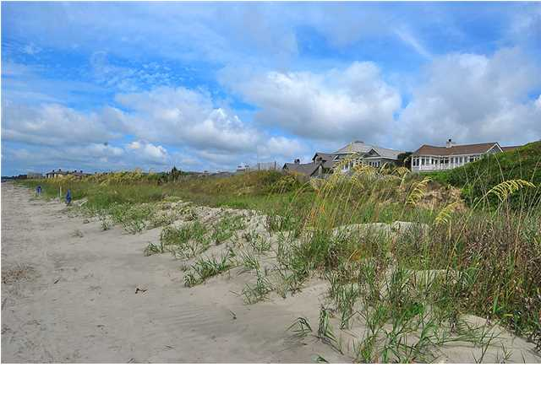

Price Reduced!
Kiawah Island Retreat
5012 Green Dolphin Way ~ Kiawah Island ~ MLS# 1418464 ~ $799,000
Yes, it's true that home is where the heart is, but with this three bedroom villa on Kiawah Island, home also happens to be where there are pristine white sand beaches, a gorgeous golf course, fine dining and an award winning tennis club all within walking distance. This outstanding villa is nestled amongst mature, shade-providing live oaks and offers peaceful water views from its two rear balconies. This lovely villa is only 100 feet from the beach and is located on the 17th hole of Turtle Point Golf Course. The open floor plan offers 1,656 square feet of living area, ceramic tile floors to help keep you cool and loads of windows that let the natural light pour in. The beautiful kitchen features Corian counters, stainless steel appliances and an opening above the sink that reveals the breakfast bar. The living room flows into the dining room which leads to the family room where there is a cozy fireplace to keep you warm on the occasional cool evening. From the family room, a sliding door allows access to this level's deck where you can sip on a cool drink while looking out to the lagoon. Sit back and keep your eye out for pelicans, blue herons, osprey and even bald eagles hidden among the palmettos, magnolias, red cedars, and crape myrtles. As the country's largest sea turtle breeding ground, there's plenty of wildlife to appreciate here. Upstairs, the owner's retreat has its own private deck with a higher vantage point for the view and an en-suite bath with a dual vanity and relaxing jetted tub. As a part of the secure, gated community of Kiawah Island, you'll enjoy the community's walking/biking trail system to take you from the playground to the pool areas to the tennis courts and the golf course. You'll also enjoy the large outdoor park with volleyball, soccer, basketball courts, a water park, and a neighborhood pool & club house featuring exercise equipment, exercise classes, bridge classes, and food. If you've been looking for maintenance-free living on one of the most beautiful places in the world, be sure to check this incredible villa out!
Call or email for details: (843) 654-7777 or Matt@MattOneillTeam.com

