Slide 1
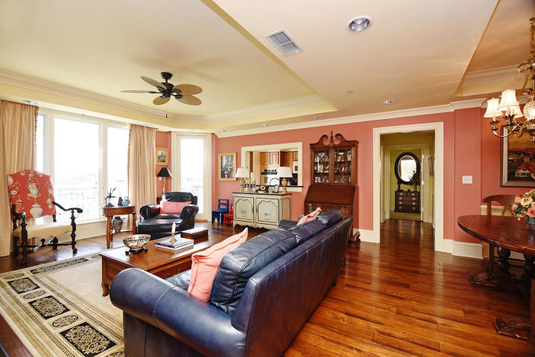
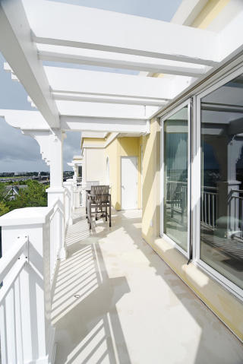
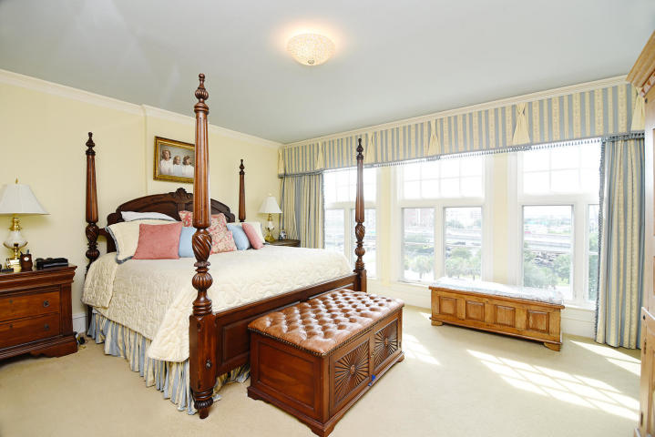
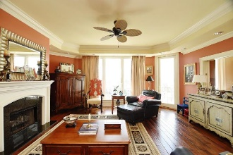
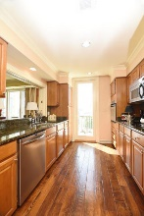
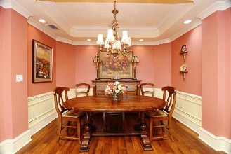
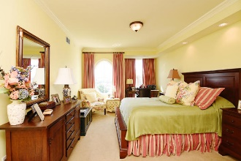

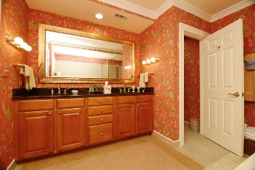
Bristol Condominiums Price Reduced 5016 Old Bridgeview Lane The Bristol ~ Charleston, SC 29403 ~ MLS# 18024291 ~ $659,000
This gorgeous luxury condo located on the top floor of the Bristol, provides panoramic views of the Ashley River and the Bristol Marina. The private terrace allows you to take in the beauty of Charleston. This pristine unit has beautiful hardwood floors throughout the spacious living and dining area, as well as a gas fireplace. The chef's kitchen is complete with stainless steel appliance's and granite counter-tops. Both bedrooms contain full ensuite bathrooms that ensure privacy. An additional half bathroom is located in the main living area. The unit comes with two deeded parking spaces inside the covered parking deck.
The Bristol condominiums located on the banks of the Ashley has just fifty four units and comes with amenities that are unparalleled in Charleston. Amenities include private marina, kayak storage, club room, library, saltwater pool, fitness center, on site management, concierge services and twenty-four hour security.
Kenneth Nix
kenneth@landsouthofcharleston.com
M (843) 222-2582 | O (843) 577-5263
Land South of Charleston, LLC | 180 E Bay St Ste 300 | Charleston, SC 29401

