Slide 1
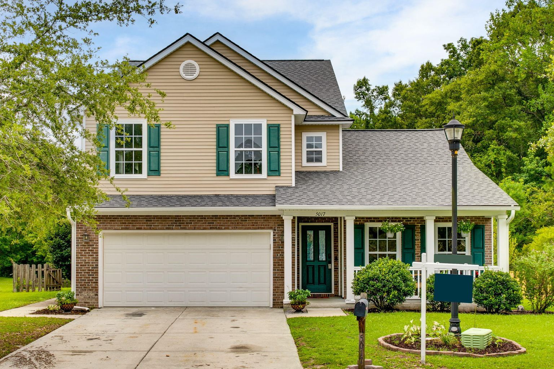
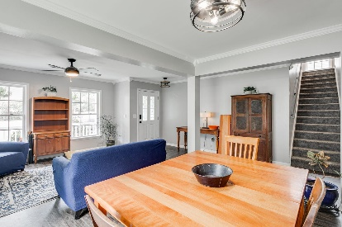
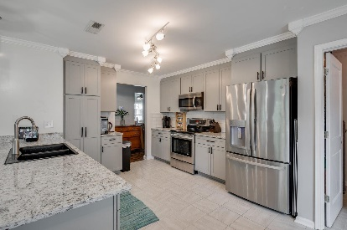
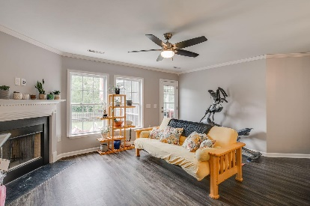
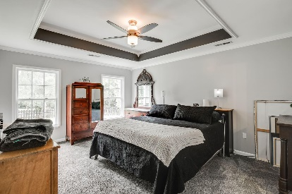
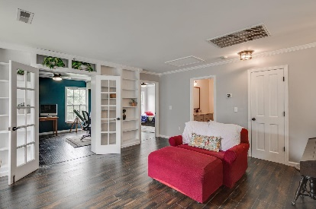
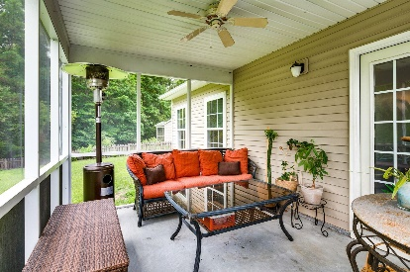
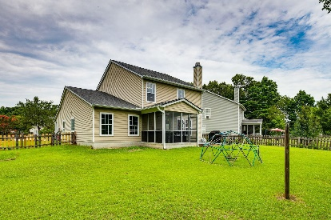


5017 Basnett Drive
Wescott Plantation | Summerville, SC 29485 | MLS# 22014270 | $422,500
New Price
Fantastic opportunity for this beautiful home offering a spacious and open floor plan that is situated in a cul-de-sac on a large pond lot. Upgrades include fresh paint throughout, crown moulding, fully renovated kitchen, new LVP flooring throughout the main level, new fixtures, newer roof(50 yr.), HVAC components, water heater, bathroom vanities and toilets. Light filled family room with fireplace, separate dining room and living room with columns, large primary suite is downstairs and has a separate garden tub and shower. Upstairs you will find a huge loft with three additional bedrooms and a full bathroom with double vanities. Step out back to a screen porch with an adjoining deck. Enjoy the beautiful pond setting and privacy with no neighbors behind you.
Take a virtual tour: https://my.matterport.com/show/?m=id3ruewv7sG
Beth Mandell
M 803-463-7734 | O 843-871-2121
bmandell@century21properties.com
www.bestcarolinahomedeals.com
Century 21 Properties Plus of Summerville | 118 W Richardson Ave | Summerville, SC 29483

