Slide 1
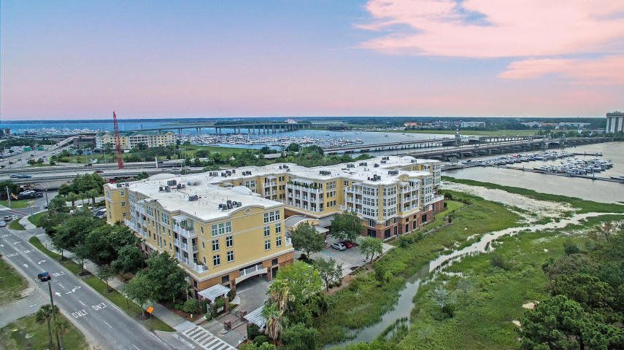


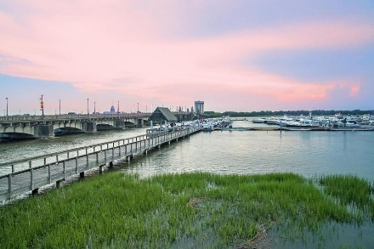
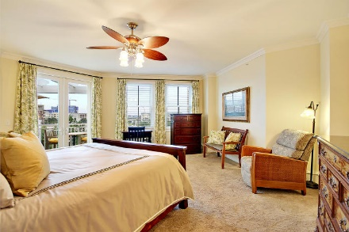
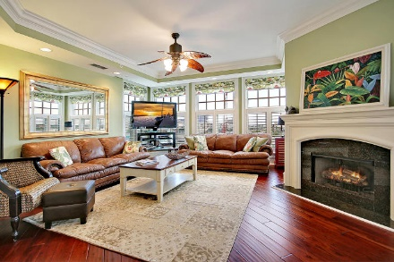
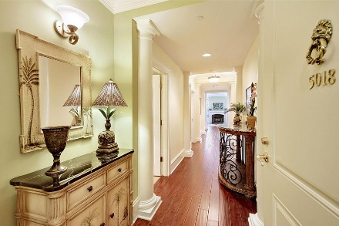
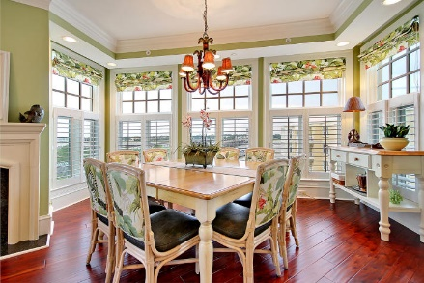

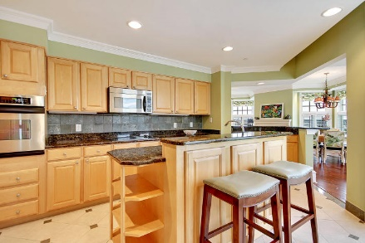
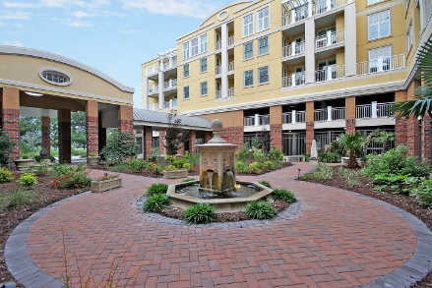
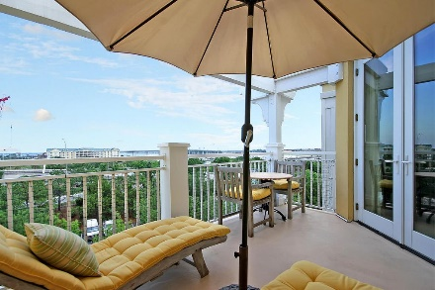
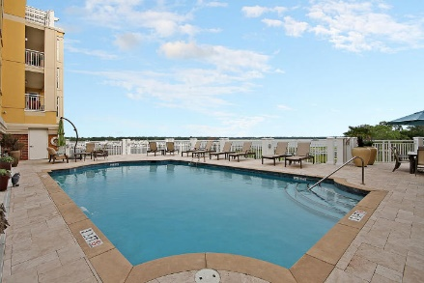
Parkshore Marshfront
Downtown Penthouse!
5018 Old Bridgeview Lane
The Bristol ~ Charleston, SC 29403 ~ MLS# 18016890 ~ $1,125,000
Downtown Charleston Penthouse living with views of the marina on the Ashley River awaits you! This exclusive, gated community is set in the heart of downtown and boasts luxurious amenities such as the garden area in the entrance, a library, conference room, state of the art fitness center & community room you can rent out that's perfect for entertaining with a full kitchen, fireplace & plenty of space for friends & family to relax. The sparkling pool looks over the water & is the ultimate in relaxation. The penthouse elevation gives you heightened views of this amazing location looking out to the river and marina from the two balconies & from throughout the unit's many windows. A fireplace in the main living space brings warmth to the home & the chef's kitchen won't disappoint!
Additional features include:
Saltwater Pool
Garden Area
Library/Conference Room
Fitness Center
Sauna
Locker Rooms
Community Entertainment Room
Community Kitchen
Condo comes with 2 covered, deeded parkings spaces and a climate controlled storage unit both located on the 2nd level of parking garage.
The WestEdge Medical Research Center, currently being built across the street, will offer a brand new Publix Grocery Store and many convenient places to eat.
Book your showing today!
Christopher Smith christopher@mattoneillteam.com 843-267-0735

