Slide 1

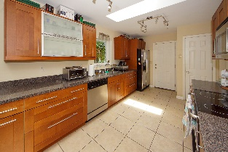
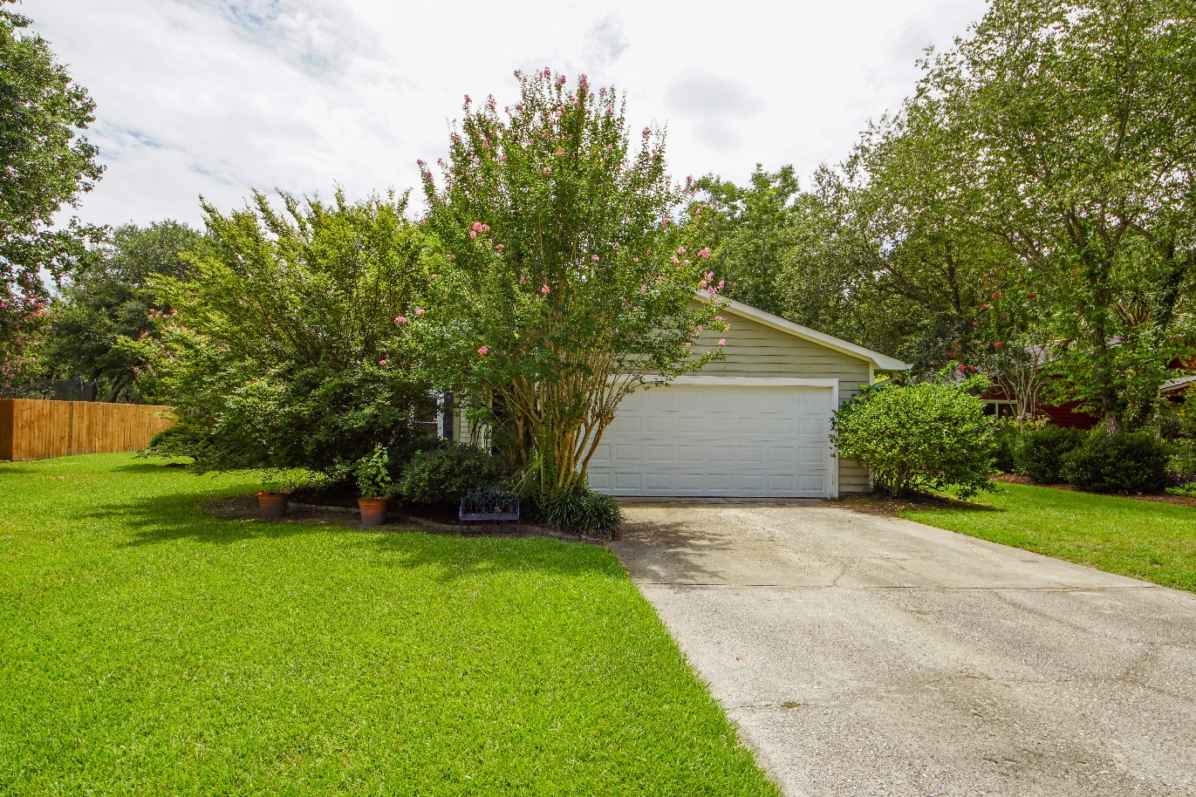
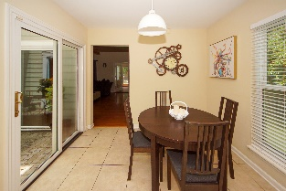
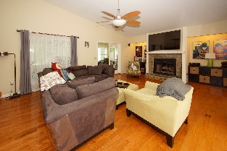
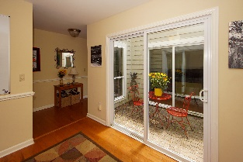
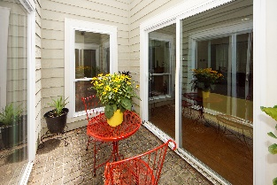
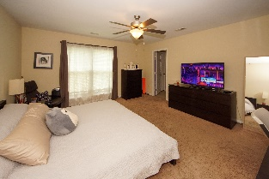
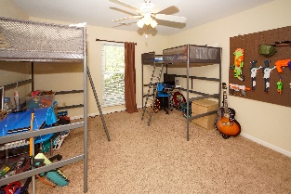
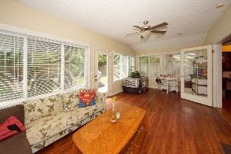
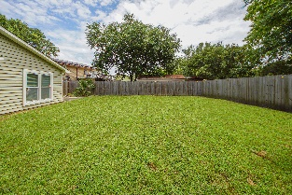


501 Upland Place Coopers Landing Mount Pleasant, SC 29464 MLS# 19021316 $397,000
$5,000 TLC Allowance
Corner lot and spacious home in this lovely Mt Pleasant community! This 3BR/2BA home offers very large bedrooms, family room with fireplace, kitchen with breakfast area, formal dining room along with a tremendous Carolina/sun room that overlooks the fenced back yard! The home sits on a corner lot that backs up to a buffered area but has a gate that opens to the Mt Pleasant Tennis Complex and playground area. Seller is offering a TLC allowance at closing for flooring and fresh paint!
Sandra Estee
(843) 906-0159
sandraestee119@gmail.com
www.EstevaHomes.com
Esteva Properties
887 Johnnie Dodds Blvd
Ste 200
Mt. Pleasant, SC 29464

