Slide 1
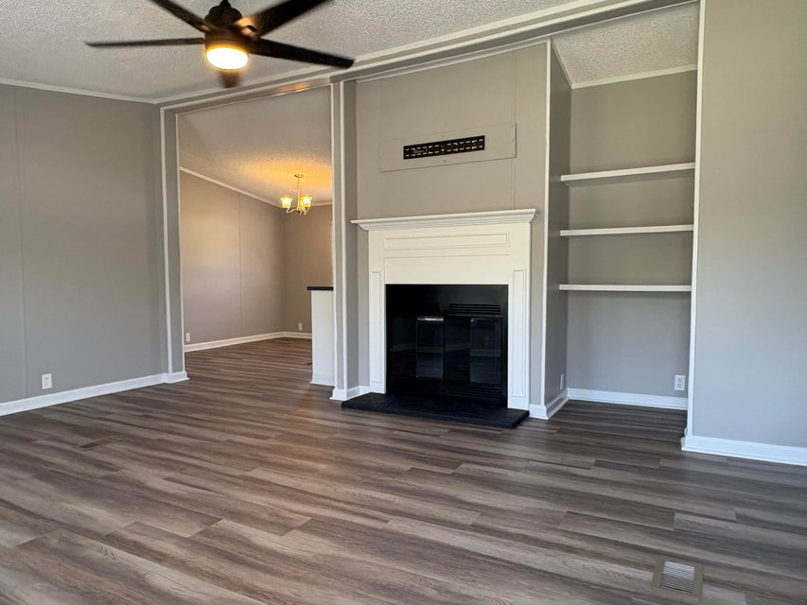
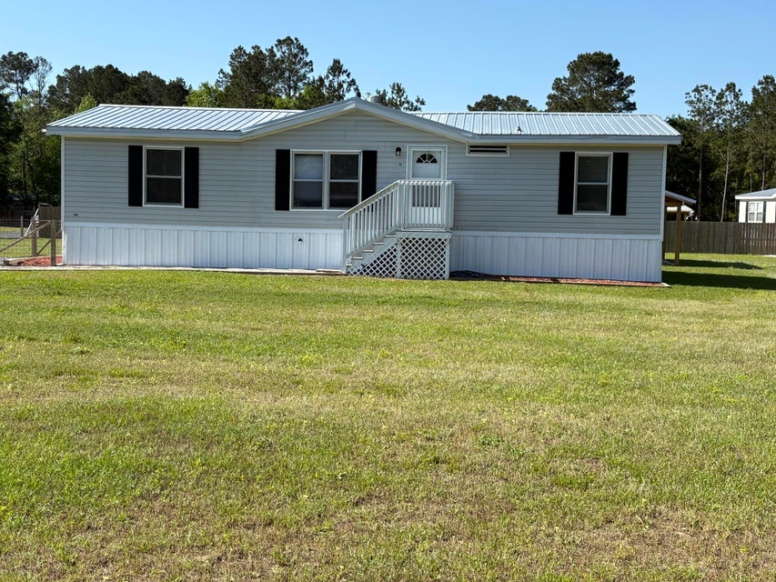
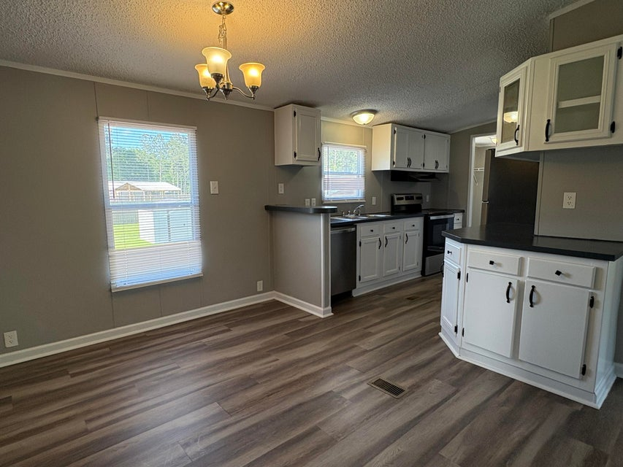
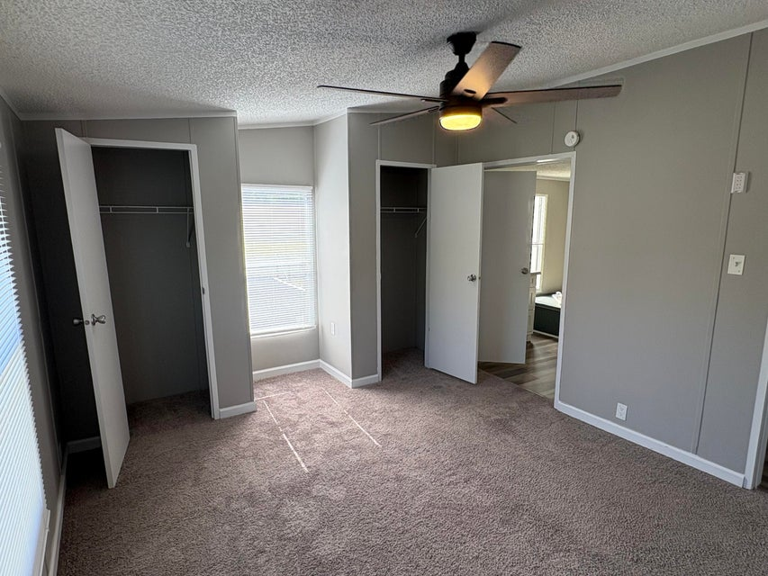
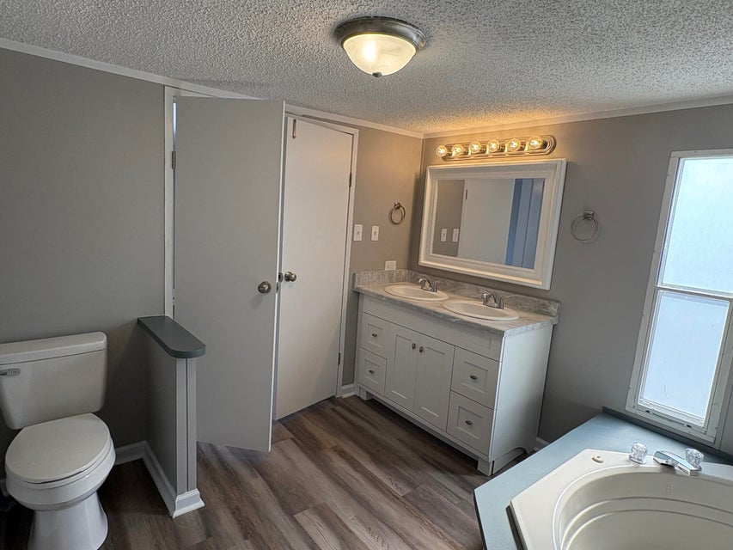
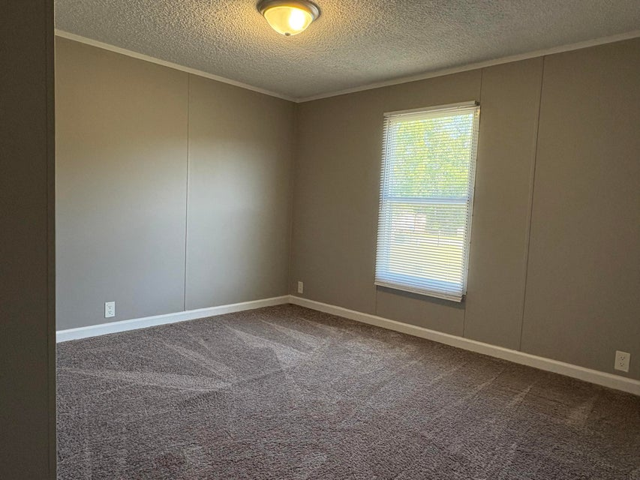
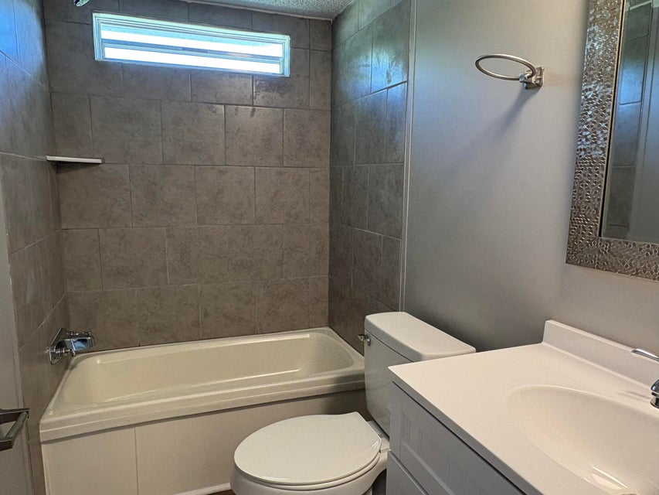
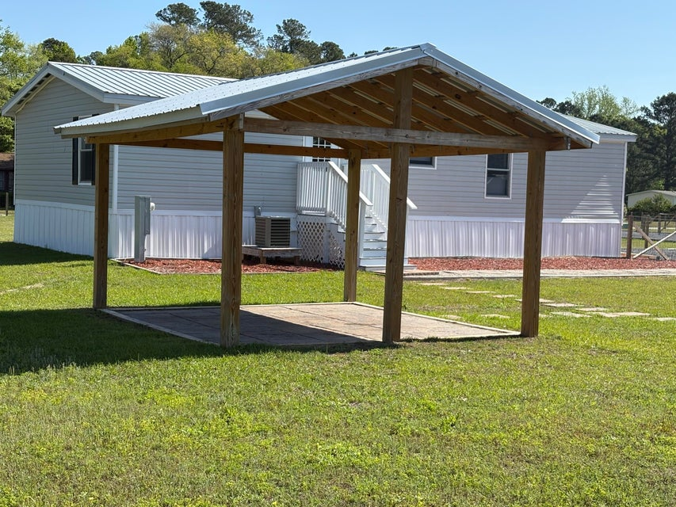
PRICE IMPROVEMENT
2.5% BUYER'S AGENT COMMISSION
501 Sagebrush Court
Moncks Corner, SC 29461 | MLS# 25010345 | $249,900
Recently renovated 3 bedroom home on large fenced in yard. Renovations were completed in 2024 and included a new roof, new rock driveway, new sidewalk, new flooring and paint throughout, new appliances, new bathroom vanities, and new lighting and plumbing fixtures. The home features a nice family room with a fireplace and built-in shelves. The kitchen has a large eat in area and plenty of cabinets for storage. The laundry room and back door are conveniently located right off the kitchen. The primary bedroom has lots of natural light, double closets, and a bathroom with a soaker tub, separate tile shower and vanity with double sinks. The secondary bedrooms are good sized and share an updated hall bathroom.
The backyard is totally fenced in and there is a covered patio area perfect for outdoor dining or grilling out. There is also a shed for extra storage and the well includes a whole house filtration system. The property is conveniently located in Moncks Corner with easy access to Hwy 17A and surrounding areas.
Dora L McGillis
843-343-5012
doramcgillis@hotmail.com
www.hbrtwn.com
Harbourtowne Real Estate
672 Marina Drive, Ste 110
Daniel Island, SC 29492
Harbourtowne Real Estate | 672 Marina Drive, Ste 110 | Daniel Island, SC 29492

