Slide 1
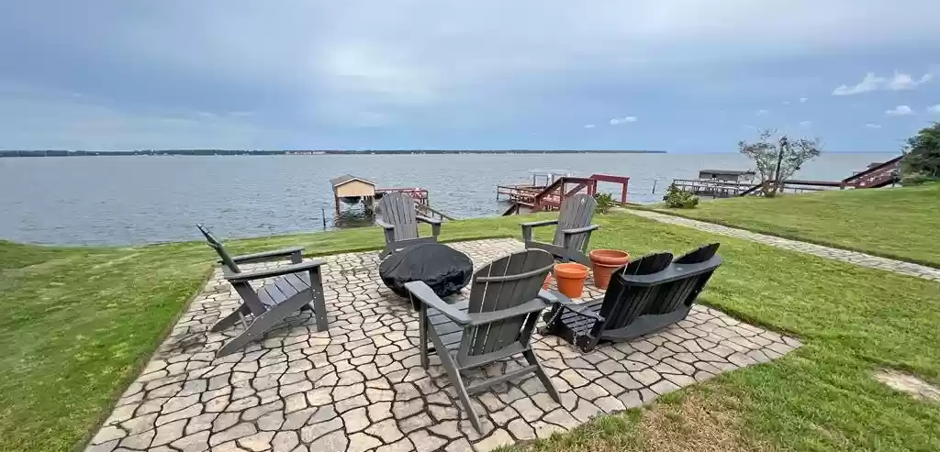
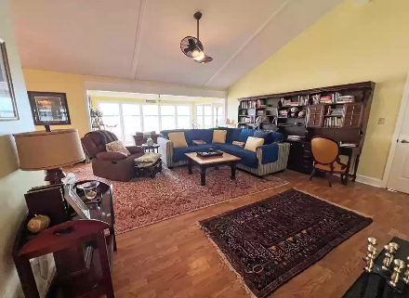
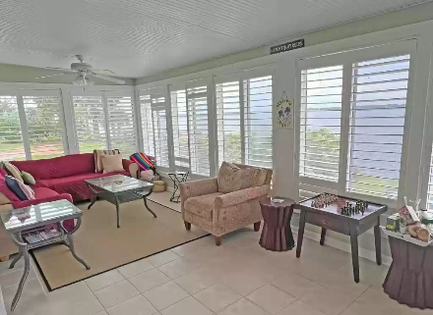
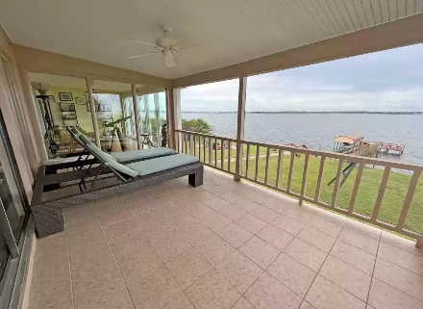
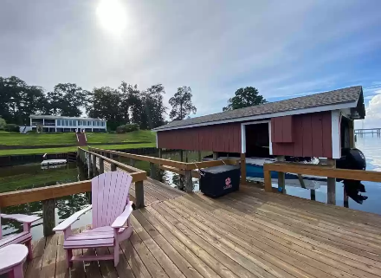

Best View Waterfront
501 Santee Drive
Santee Cooper Resort 4 ~ Santee, SC 29142 ~ MLS# 152846 ~ $795,000
WATERFRONT - in the Santee Cooper Resort on Big Water Shore line on Lake Marion. This Gated community has much to offer in golfing, swimming, fishing and spectacular views! The street main level has 2 large sunroom areas that have the jaw dropping view, Open floor plan of Kitchen, Dinning and Living room, Master bedroom suite with a view, 2nd bedroom, laundry and Oversized garage. The walk out basement host 2 bedrooms, full bath, wet bar, den and entertainment area. Tons of dry storage under the house. New decking on the dock, new appliances and much more. You need to see this breath taking view of the lake. Don't miss it. Gated area has HOA that is explained in the notes of what is included. Property has been updated with FIBER internet with Tricolink.
Lake Homes Realty, LLC
Elloree, SC 29047
www.SCLakeLife.com
Kristie Anderson
(803) 387-9459
kristie@sclakelife.com

