Slide 1
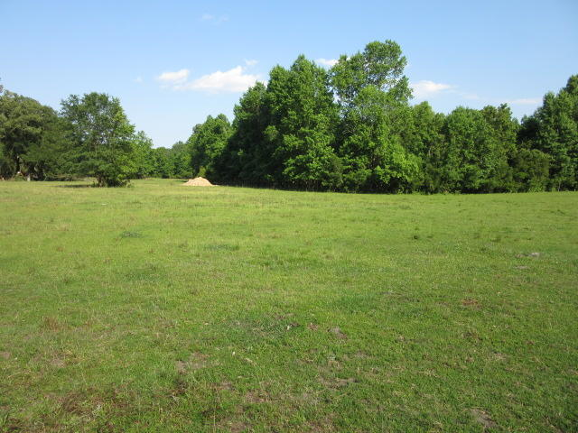
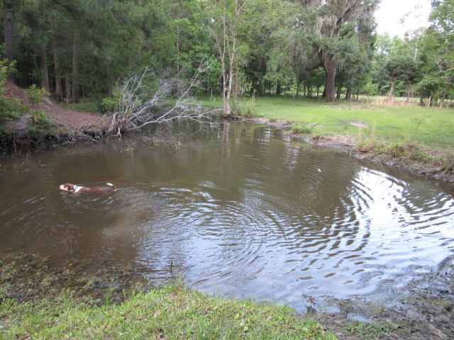
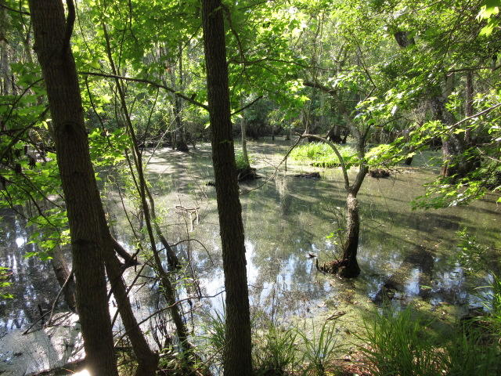
$10,000 PER ACRE
INCLUDING A HOME!
$40,000
Price Reduction!
71.5 Acres ~ MLS# 19015052 ~ $725,000
Owner will subdivide into smaller parcels
DRAFT
100 W Butternut Road ~ MLS# 20004023 ~ $379,000 (0.85Acres)
Located 30 minutes to I-526 in Hollywood. The property is located just a 7 minute drive from Hwy 17 South (Savannah Hwy) at the end of a dead end road… Lots of Privacy! The property is a mixture of open fields, woods, and shallow water duck impound. Excellent soil for perks and could easily be subdivided into smaller parcels for multiple residences. The property includes a double wide mobile home…currently 2 bedrooms that was converted from a 3 bedroom home and could easily be converted back 3 BR.
Rick Willis
843-327-3017 Rick@RickWillis.com The Group, LLC

