Slide 1
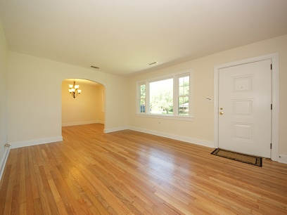
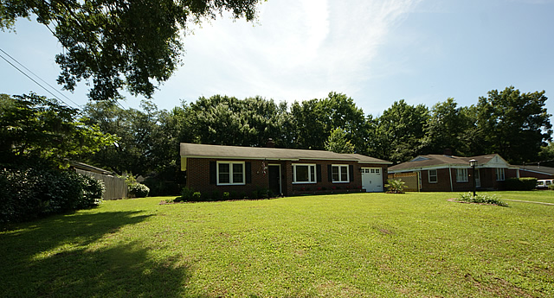
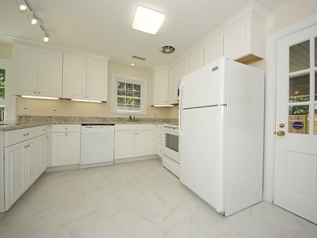
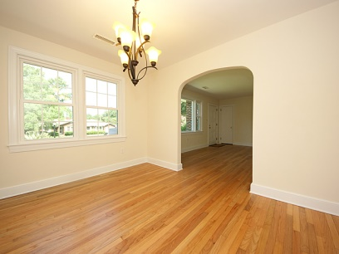
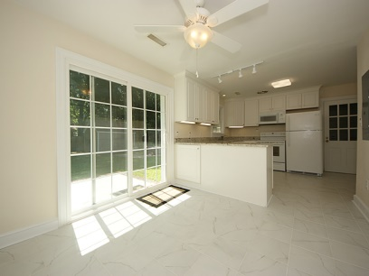
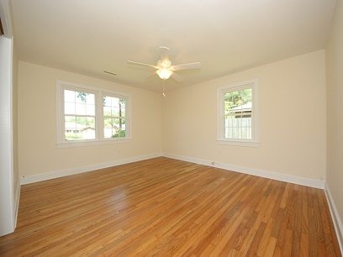
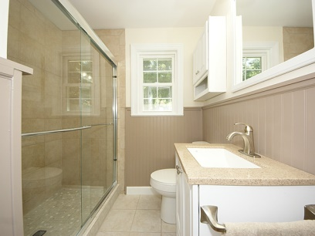
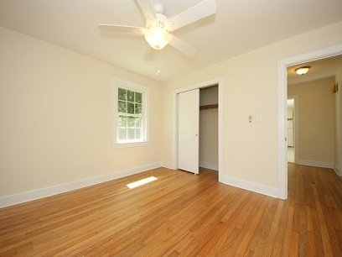
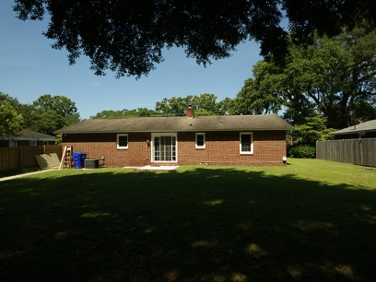
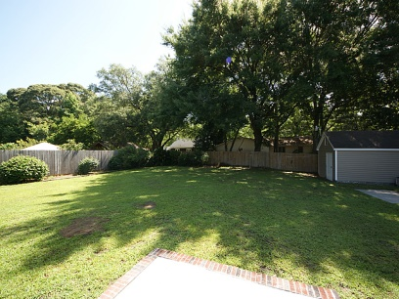
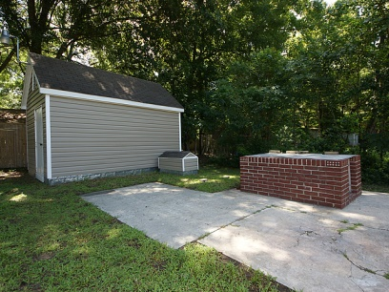
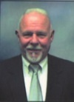

5028 Victoria Ave Park Circle – N Charleston MLS# 1408124 - $189,000
Looking to live in the Historic Park Circle Area. You have found the perfect home, totally suitable for a couple or starter home. Located on one of the most sought after streets and close to the Circle and downtown North Charleston, where you can walk to from this home. The home has been renovated to include, updated Power, Bath, Kitchen, ect. The home has two larger bedrooms, lots of closet space , ceiling fans and Hardwood Floors thruout. The Kitchen has new custom built in cabinets, Granite Countertops and energy efficient appliances, under counter lights, all included. The Kitchen has a Breakfast Area with sliding glass doors that lead outside to the huge backyard and new patio. The yard is fenced on two sides, there is a BBQ pit, ready for your pork or oyster roast. There is a great storage and workshop in the back yard also. The Bath has been totally renovated to include new tile and awesome walk in shower. There is a Large Living room and Dining room combined, divided by the 60's arch way. The original carport has been closed in with brick and heavy steel garage door. The Laundry Room is in this area. The home has all new ceiling fans and light fixtures, updated wiring to include 150 amp service, new Kitchen, Bath, all hardwood floors have been refinished and are beautiful. New energy Windows have been installed. The H/A is estimated to be around 8 yrs old along with the roof. Owner does not warrant the ages. The lot is one of the larger ones in Park Circle and on a hill. The neighbors have all been living in this area and built their homes in the 60's. They were all custom built and like a fort. If you're looking for a great home in move in condition you have found it.
John H. Beckroge
ABR, EPRO
jbeckroge@gmail.com
Mobile 843-367-3196

