Slide 1
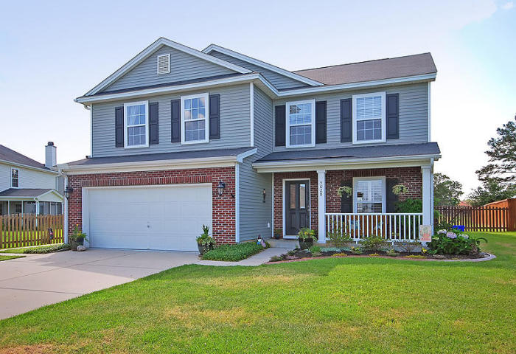
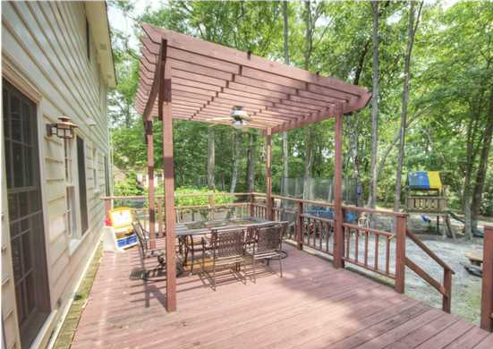
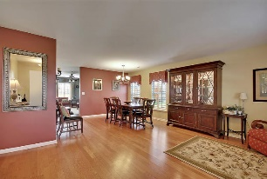
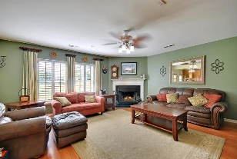
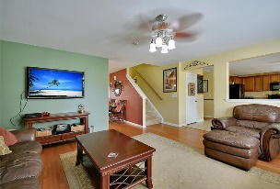
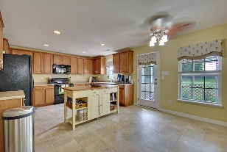
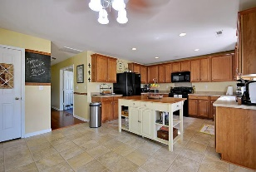
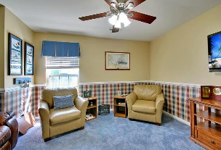
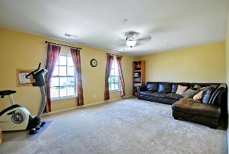
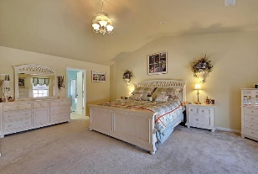
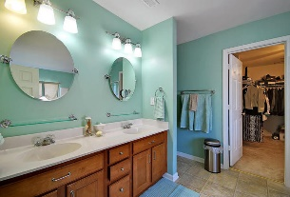
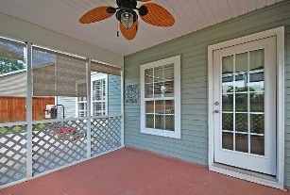
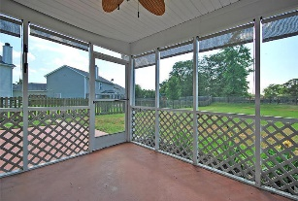
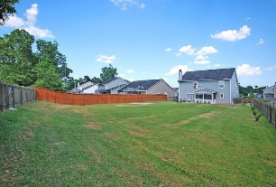


Large Private Lot in Wescott
5028 Wilverine Drive
Wescott Plantation
Summerville, SC 29485
MLS# 15015976
$279,000
4 Bed | 3 Bath | 2,896 sf
This 2,896 SF Wescott home is ready for you to move right in! One of the largest lots in Wescott!! As you enter, you will see that this home has a lot to offer at a great price. The open entryway opens to the large dining room area. There is a large family room with a fireplace that is perfect for families or entertaining. The kitchen has LOADS of cabinets and great counter space for prep and storage and a great pantry as well. Hardwood floors lead you back to a flex room that could be used as an office or media room, with a full bath across the hall. Upstairs, you will be floored by the HUGE loft space that could be a second family room. There are four bedrooms upstairs. The master suite features a full bath with separate tub and shower, dual vanities and a large walk in closet. The spacious master bedroom has tray ceilings. Upstairs you also have a small office area and large laundry room. The exterior of this home does not disappoint either. A huge lot will be perfect for playtime and entertaining, as well as the newly re-screened porch. This home has been well cared for and it shows. Make an appointment to view today.
Larry & Kathy Mazalatis
Larry Cell 843-693-0529
Kathy Cell 843-693-0159
Office 843-871-9133
AGENTOWNED PREMIERE GROUP | 1800 TROLLEY RD | SUMMERVILLE, SC 29485

