Slide 1
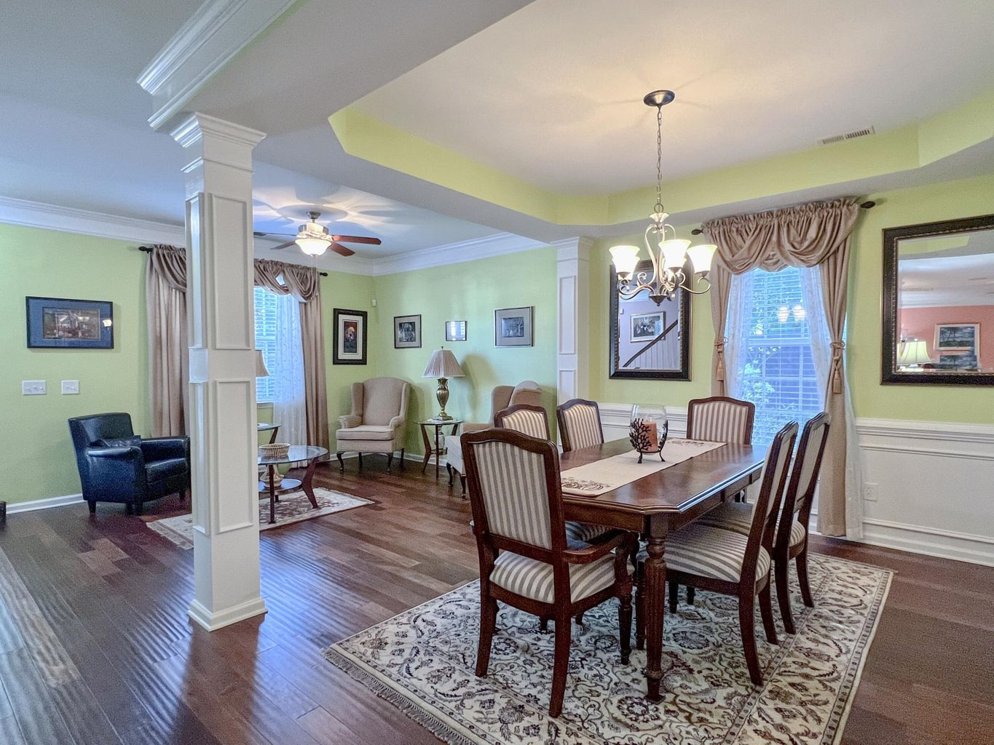
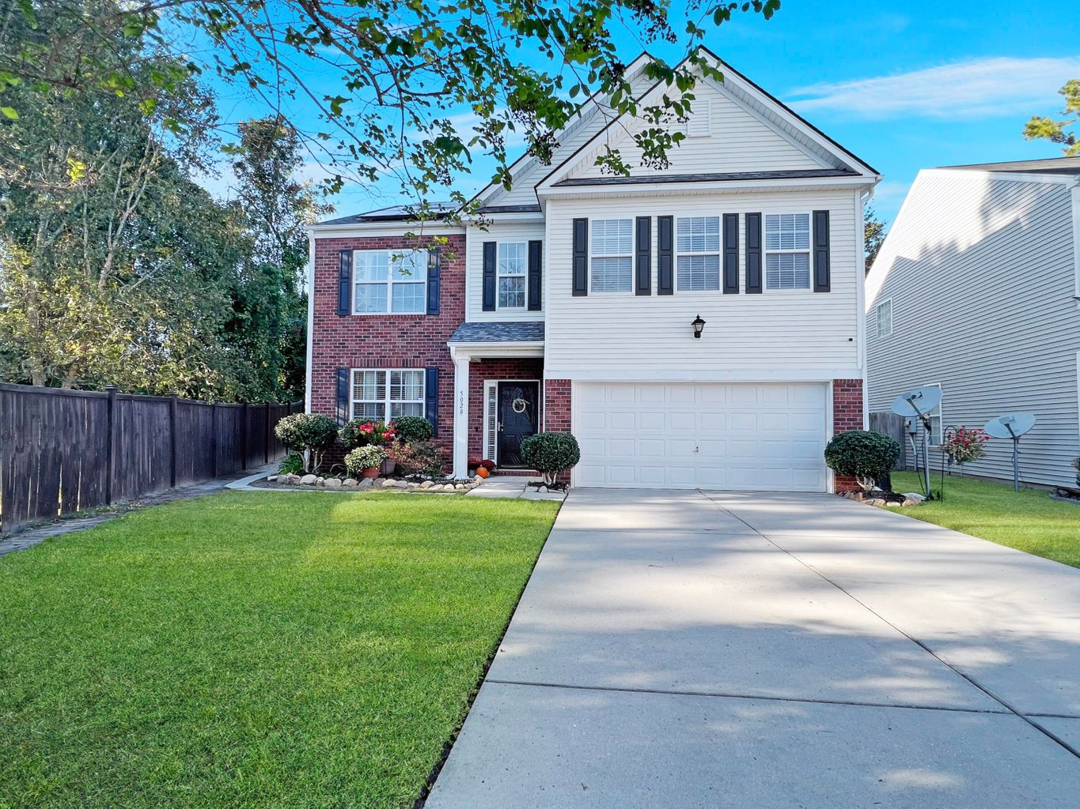
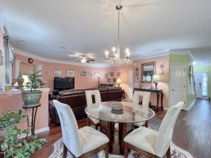
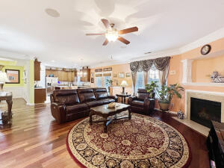
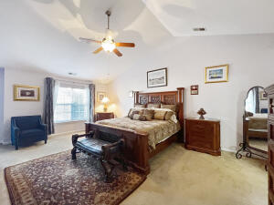
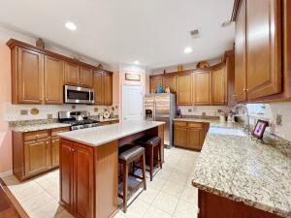
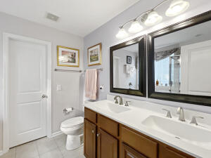
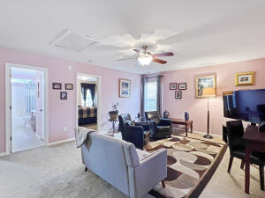
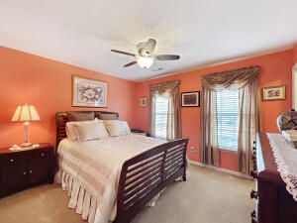
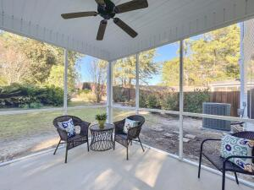
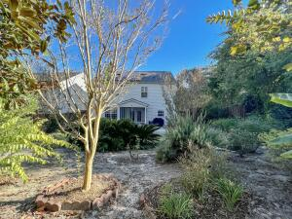


Check Out This Listing!
5028 Whitfield Court
Waterside Landing | Summerville, SC 29485
MLS# 22027324 | $425,000
This one-owner, lightly-lived-in, well-maintained home that sits on a .24 acre private lot has a 2-year-old HVAC system, a brand-new roof, irrigation system and even a wash basin in the epoxied-floored garage! As you enter the home, you will love the beautiful wood floors and large crown moulding. The formal dining area features a tray ceiling and wainscoting. The spacious living room has a gas-burning fireplace and large windows looking onto the backyard and is open to informal dining area and kitchen. The kitchen has a nice tile backsplash, a 5-burner gas stove, an island that seats 4 and a farmhouse sink. Rounding out the downstairs is a half-bath.
Upstairs you will find a large loft/playroom space, laundry room, full bathroom and 3 nicely sized bedrooms, one of which as a large walk-in closet. The 20'x15' primary bedroom features a vaulted ceiling, a high ledge for decorations/plants, a small nook that would be great space for a bassinet or desk. The bright ensuite has a large closet, dual sinks, garden tub and walk-in shower.
Just off of the eat-in kitchen downstairs, there is an oversized screened-in patio perfect for entertaining in the Lowcountry's amazing outdoors. Two additional highlights are the outdoor grilling patio with a built-in gas connection and gutters around the home. The large backyard has mature landscaping throughout and tucked away in the far back is a well-built storage shed for lawn equipment. You will love how far back this house sits and its long driveway just off the cul-de-sac. Such a great home!
Sarah Wacaster
843-751-2400
sarah@sarahwacaster.com
Keller Williams Realty Charleston West Ashley
1180 Sam Rittenberg Ste 300
Charleston, SC 29407

