Slide 1
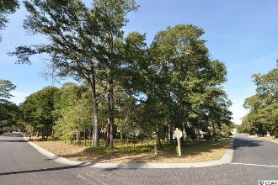
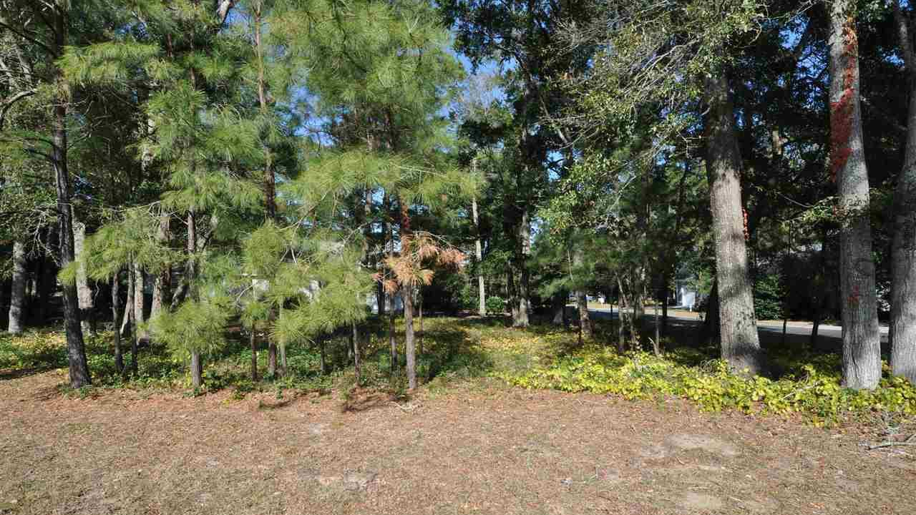
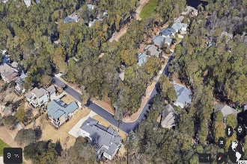
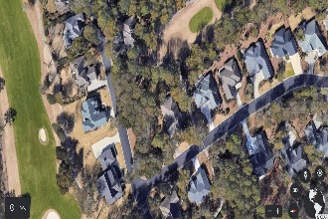
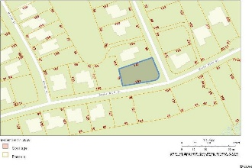
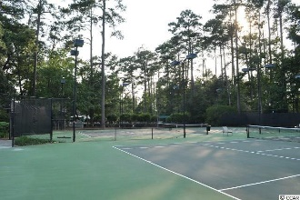
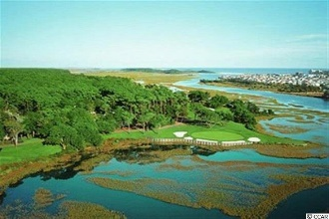
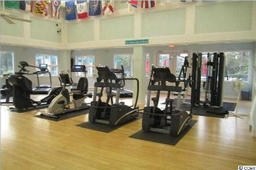
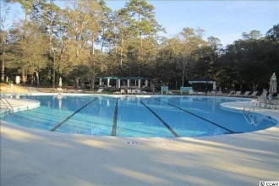
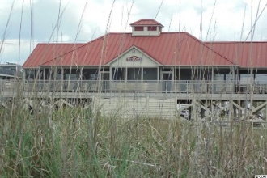


Large Corner Lot
5029 Buck Bluff Dr
Tidewater Plantation | North Myrtle Beach, SC 29582
MLS# 2026458 | $99,999
Tidewater Plantation is a golf/Intracoastal Waterway/beach community. The Bluffs Section adjoins the Cherry Grove Marsh and peaks at the Atlantic Ocean. The Bluffs represent some of the most spectacular property ever introduced in North Myrtle Beach. Home sites are located on the golf course, salt water marshes, freshwater lakes and interior wooded sites. A private gated entrance and amenity area including pool and a Jacuzzi, screened cabana, grilling area, deck overlooking a lovely pond and numerous other upscale enhancements have created this new standard of luxury living on the Grand Strand. This desirable approximarely 1/3-acre lot is situated on prestigeous Bucks Bluff Dr. near where the Atlantic Ocean rolls into the Cherry Grove Marsh and bordering the 14th hole of world-class Tidewater Golf Course. Approximately 1/3-acre: 153' x 97' x 147' x 79' with 153 ' of frontage on Bucks Bluff Dr. The lot is 13,504 sq. ft. 5027 Bucks Bluff Dr., lot 698, adjoining lot 803 to the left is also available for purchase. Lots in Tidewataer may be conjoined under one HOA payment, and seller is offering a discount on the two-lot purchase which would be about .60-acre, part of which has a panoramic tee to green view of the signature 14th hole of Tidewater Golf Course. This is one of the few large, buildable lots left on Bucks Bluff Dr.; you can hear the ocean from this magnificent location. Long-term rentals are allowed on the Bluffs side; so, at this compelling price, flex-building options and low HOAs and taxes, this amazing, rare residential lot is an appealing, excellent investment as well as being sought after for a vacation or permanent home. No flooding ever! There is no time frame to build. Tidewater-approved contractor list and building a home in Tidewater information available. The Bluffs is singular in Tidewater Plantation Resort and is being rapidly built out as well. You must view! In addition to golf and being in an ICW community, Tidewater boasts many other rich amenities, including owners' beach cabana on the Cherry Grove Beach named the 11th best in the natiion, pools & spas, clay & hard-surface tennis courts, pickle ball, bocce, horseshoes, amenities center, fitness center, driving range and putting green, 24-hour gated manned security, and clubhouse with bar & restaurants. There is even a complimentary gated storage yard for boats, campers, recreational vehicles and the like. The on-site, convenient HOA building has rooms for business and other meetings and events and a lending library. There are many clubs and activiites year round. In Tidewater, you can do it all, or just relax in the luxurious Tidewater lifestyle. The Bluffs of Tidewater is contiguous along the Cherry Grove Inlet where the Atlantic Ocean meets the marsh. This lot, across the street, therefore, is highly sought after by the builder, investor or soon-to-be home-owner who desire to acquire an extraordinary golf/ICW/beach property at today's market prices to be built later. Tidewater itself is on a tree-lined road to oceanfront Anne Tilghman Boyce Coastal Reserve, a nature conservancy, including Waties Island, with access for managed recreational use. Tidewater, a historic plantation, is on an elevated peninsula of live oaks and southern pines between the Intracoatal Waterway and the Cherry Grove Inlet to the Atlantic Ocean. The plantation also preserves the unique look of its own origins. It is close to the beach, shopping, entertainment, medical services, outstanding schools and parks and access to major highways. The jewel in the crown of the development is that private owners' beach cabana on the wide, white sands of the Cherry Grove Beach, just a few minutes drive. This charming lot enjoys a lovely, indigineous peaceful environment, along with the excellent reputation of the Tidewater Golf Course, the Pebble Beach of the East. Tidewater Plantation, in one of the U.S.'s top-10 beach towns, North Myrtle Beach, truly reflects a "way of life".
Video Tour: https://youtube.com/embed/IR29DrmlQEQ
Deborah Collins
843-424-9013
dctidewater@yahoo.com
Connie Ross-Karl
702-306-2643
conniesross@aol.com
NEW WAY PROPERTIES MYRTLE BEACH

