Slide 1
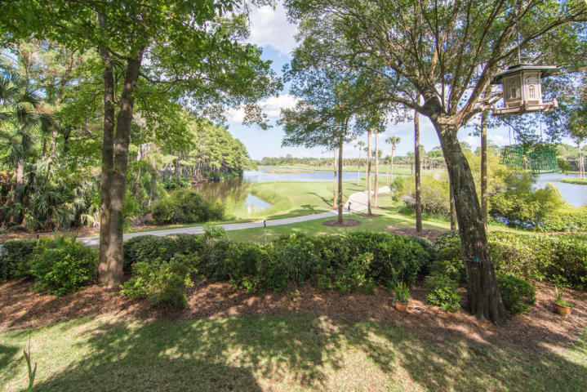
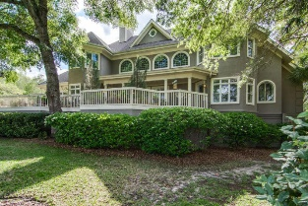
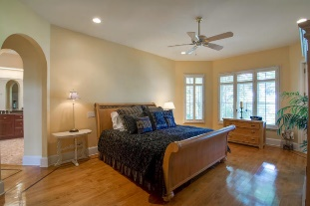
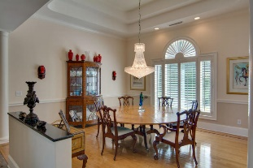
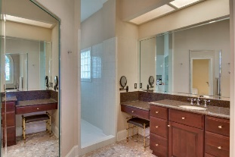
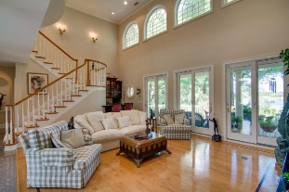
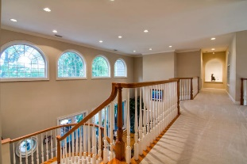
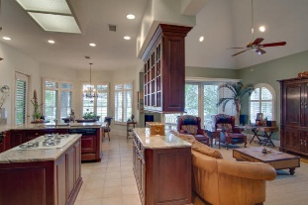
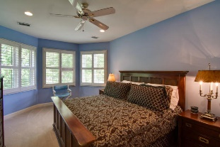
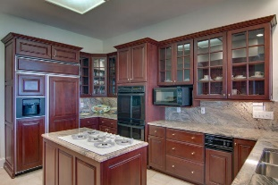
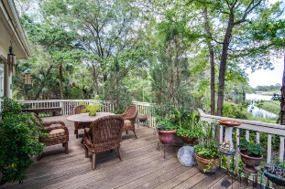
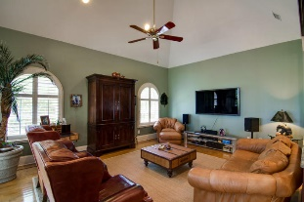
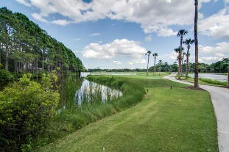

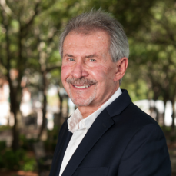
The Best Deal On Kiawah!
502 Bufflehead Drive
Kiawah Island, SC 29455 ~ MLS# 16012722 ~ $1,795,000
4 Bedrooms · 4½ Baths · 4,117sf
Stately home on half acre with large Oaks, palms, and magnolias. The front faces the 8th Green and Fairway of Osprey Point Golf Course. The Ipe wood deck will inspire you to cookouts and cocktails with views of the signature 9th hole, from tee to green. The Neighborhood gives supreme privacy and a 5 minute walk to Kiawah's stretch of 10 miles of sandy beach. This 4,135 sq. ft. home is a two story with an elegant high cathedral ceilings, natural lighting, which the living room area allows you to bring the outdoors in for social gathering with three sets of sliding glass doors, elegant arched windows and a quaint bar. This home also has maple hardwood floors, with cherry inlaid borders and combination of marble and tile floors. Dining room invites for more intimate gatherings with columns around, stately tray ceiling and a peaceful view to the outdoors. The arched way to the kitchen and the inviting TV room area are next to each other. Surrounded by Hunter Douglas window treatments, sliding doors to the back deck, viewing the 9th green, lagoons and fairways. Fully equipped, abundant counter space, glass front cabinetry and overhead lights for natural lighting. Master suite located on the first floor with arching door way leading to it's large walk-in closet and separate toilet facility. One of the guest suites also located on the first floor with beautiful Hunter Douglas window treatment and French doors facing the 8th green, which can be utilized as a home study room. The two guest suites located on the 2nd floor are connected by this magnificent balcony overlooking the living room. One of the magnificent architectural highlights. . Top grade construction defines the residence with it's high end finishes. Two car garage is large enough to have five cars, an independent extra area for storage and two dehumidifiers.
1/2 of 1% of purchase price is due to HOA . Club membership available.
Ron Wallschlager Cell (843) 810-9100 | Office (843) 352-9088 ronw@goldenbearrealty.com
Golden Bear Realty | 1900 Seabrook Island Rd | Seabrook Island, SC 29455
www.goldenbearrealty.com

