Slide 1
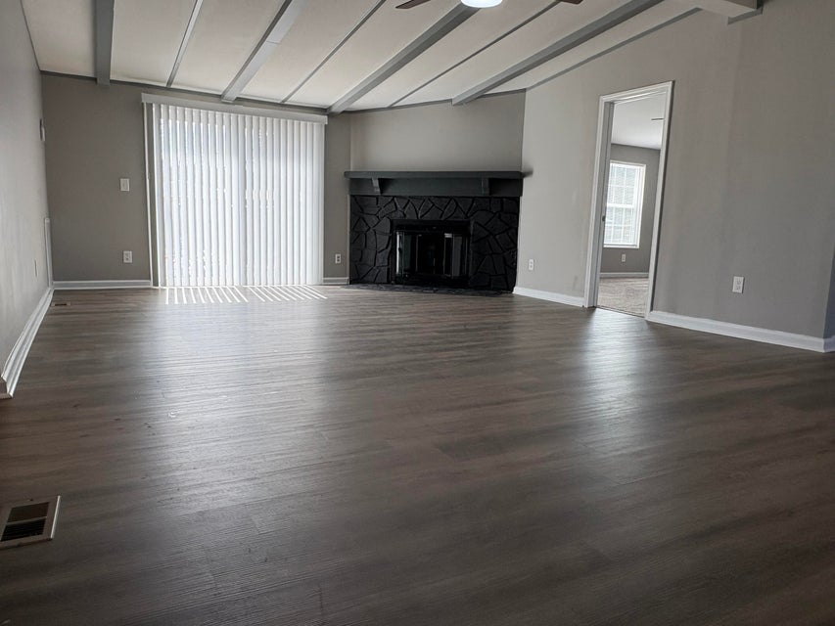
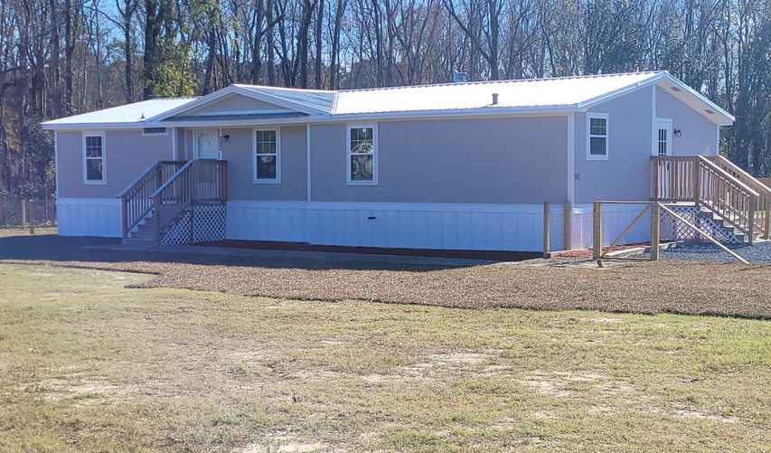
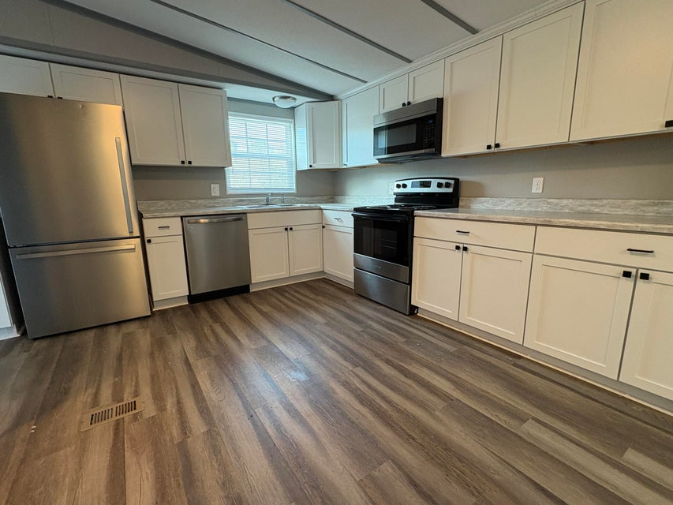
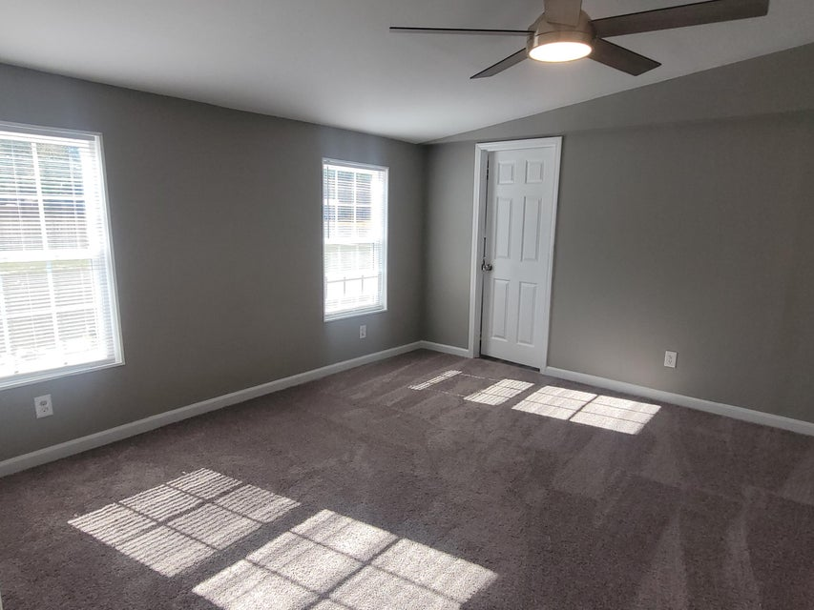
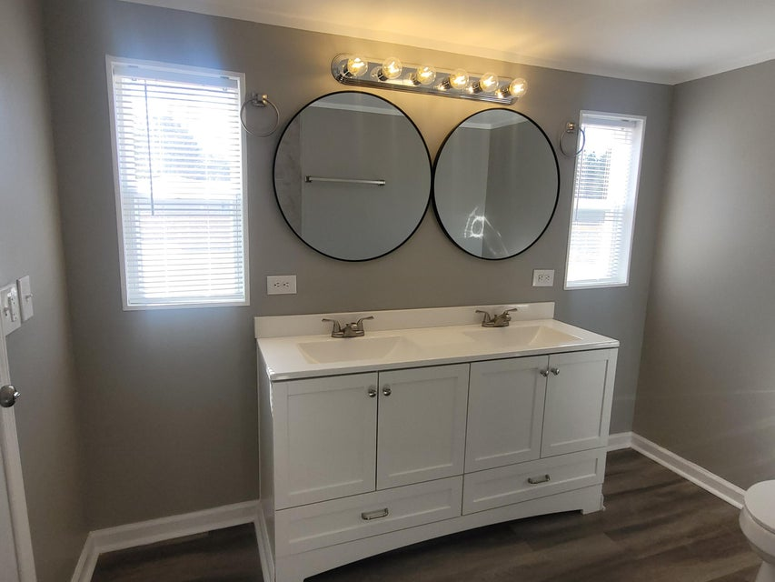
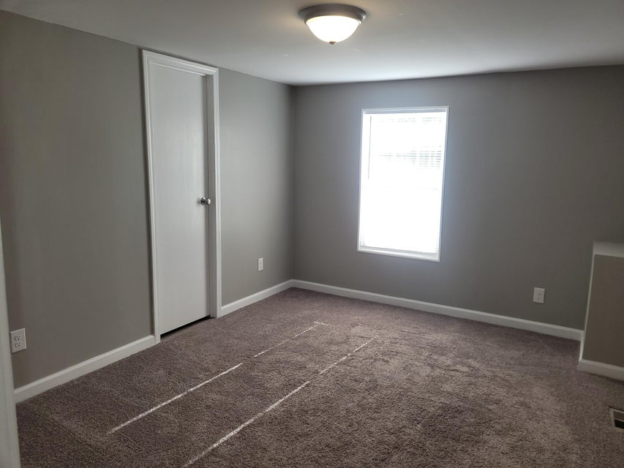
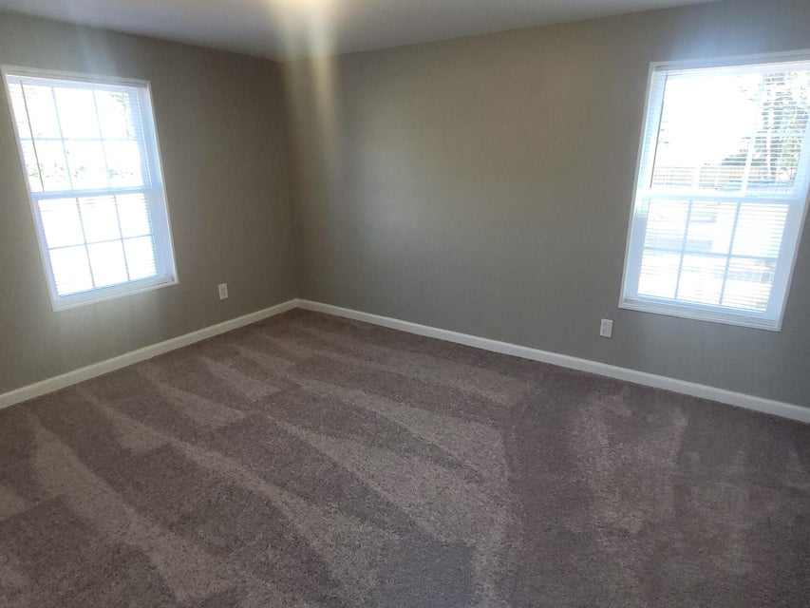
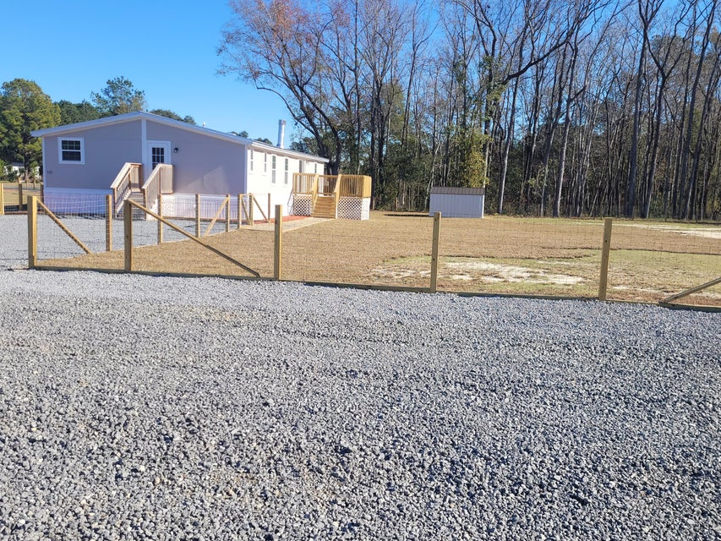
OFFERING $10K IN CLOSING COSTS
502 Sagebrush Court
Moncks Corner, SC 29461 | MLS# 25005717 | $275,000
2.5% Buyer’s Agent Commission
Renovated 3 bedroom on large lot
New roof, windows, doors, HVAC, hot water heater
New kitchen cabinets, countertops & appliances
Spacious family room with fireplace
Primary suite with large closets, double sinks & tile shower
Completely fenced in yard with storage shed
Dora L McGillis
843-343-5012
doramcgillis@hotmail.com
www.hbrtwn.com
Harbourtowne Real Estate
672 Marina Drive, Ste 110
Daniel Island, SC 29492
Harbourtowne Real Estate | 672 Marina Drive, Ste 110 | Daniel Island, SC 29492

