Slide 1
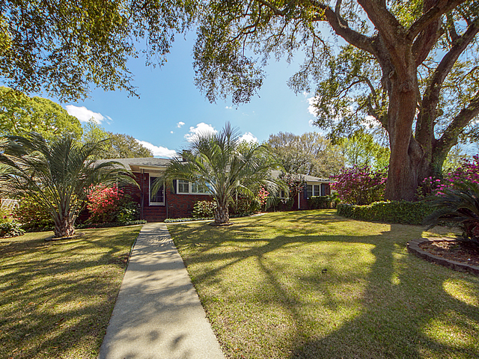
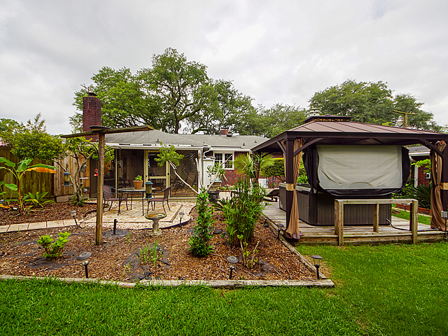
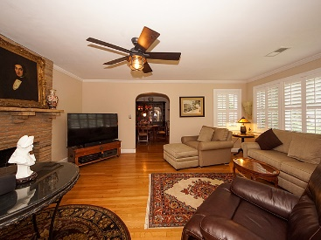
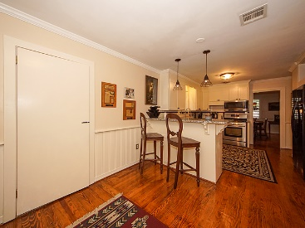
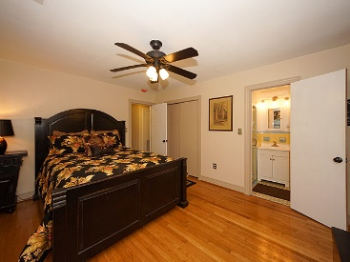
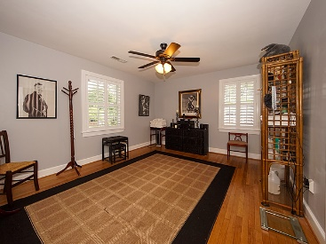
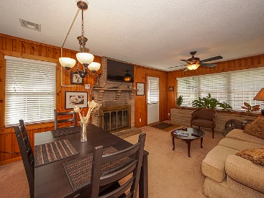
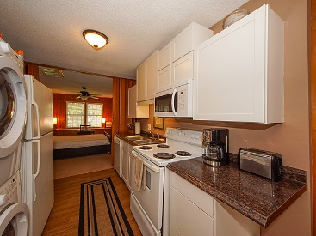
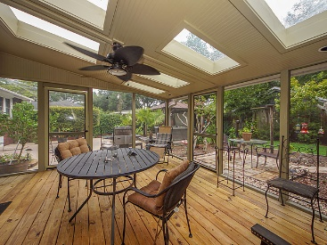
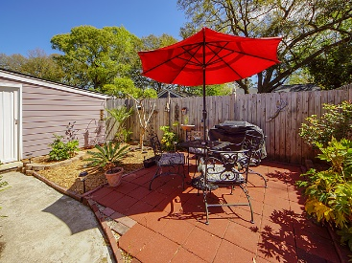


5034 Victoria Avenue North Charleston, SC 29405 ~ MLS# 20016796 ~ $630,000
PARK CIRCLE PRICE ADJUSTMENT
PARK CIRCLE Highly desired area. Main House (1800 sqft) has 3br, 2baths, LR w FP, DR, Eat in Kit.,Screened Porch, Hot Tub, 2 car garage w/ workshop, Firepit area, fountain, PLUS Rental Unit (great income), or use as Mother-in-law suite or a great Master Suite. This apt. has 2 BR, that share a huge walk-in closet, Kit., Great room w/fp THIS IS A GREAT HOME AND JUST 3 OWNERS. IT HAS BEEN TOTALLY updated, NEW ROOF, 2 SEPARATE H/A UNITS GAS HEAT, NEW WINDOWS, BLACK IRON PIPE HAS BEE REPLACED WITH LARGER PLASTIC PIPE THAN NORMAL. GAS RENNAI COMMERCIAL HWH, UPDATED BREAKER BOXES AND MOST WIRING AND PLUGS. UPDATED KITCHEN W/ GRANITE. GUTTERS ON HOUSE AND GARAGE. Plantation shutters in main house LR, DR and front BR. Granite in main house kitchen. Back yard is totally private with most relaxing hot tub and outdoor shower. Garage has new sheetrock and awesome cabinets, workshop is a cab makers dream. Entire yard is landscaped. No realtor signs will be displayed. If wanted mother in law suite could be used as Master Suite for owners.
John H. Beckroge
ABR, EPRO, REALTOR
jbeckroge@gmail.com
(843) 367-3196
Brand Name Real Estate | 4 Carriage Lane Suite 106 | Charleston, SC 29407

