Slide 1
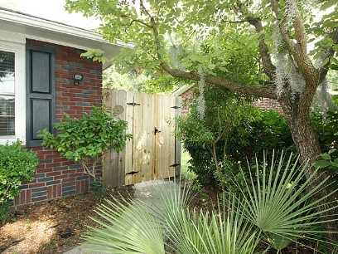
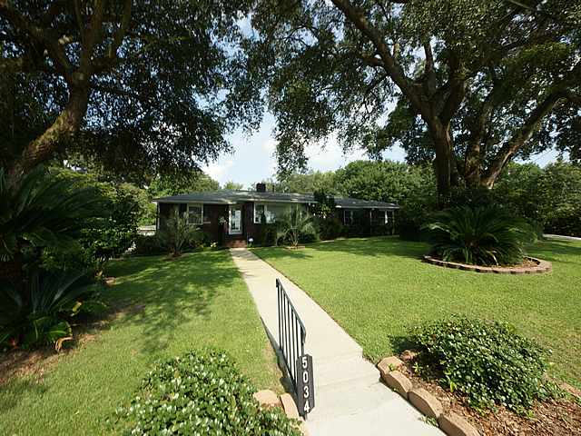
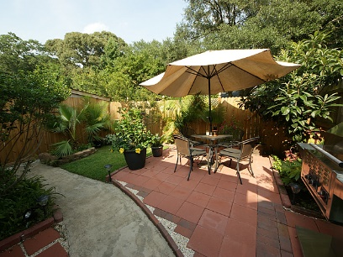
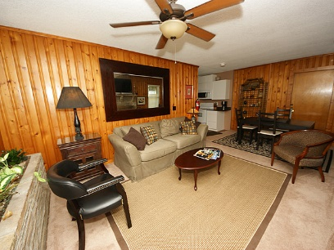
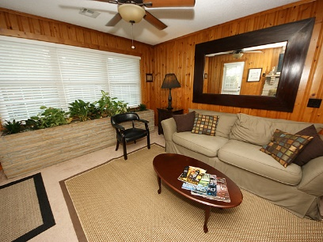
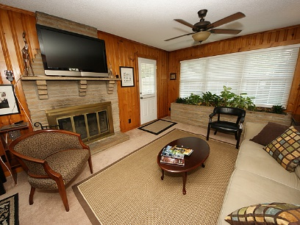
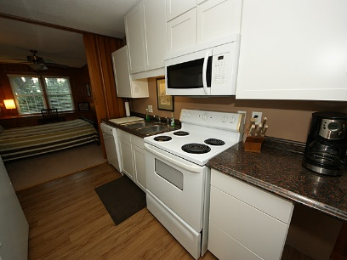
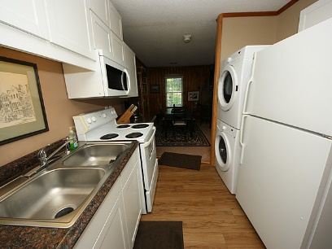
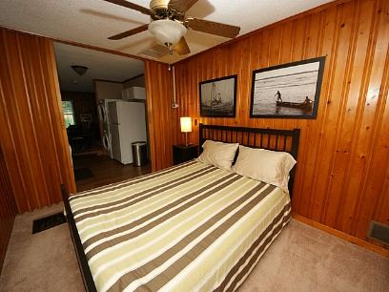
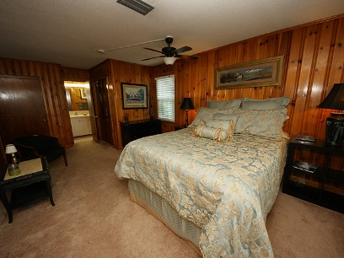
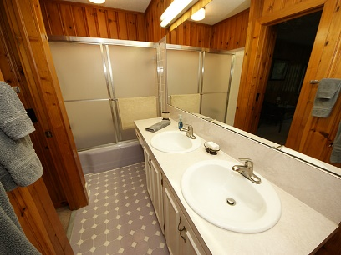
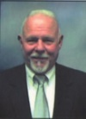

5034-B Victoria Ave Park Circle – N Charleston MLS# 15026799 - $1,900/Mo
Short-Term Rental
Renovated Apartment that is connected to the main home, with a private entrance, drive and private walled courtyard w/grille, fountain, outside entertainment. Large LR w FP, DR, full Kitchen w Washer/Dryer.
Located in Old Park Circle, great location. Looking for two mature adults, non partiers, possible needing short term rental…week to week or month to month.
Completely Furnished that includes Utilities. Just bring your clothes.
John H. Beckroge
ABR, EPRO
jbeckroge@gmail.com
Mobile 843-367-3196

