Slide 1
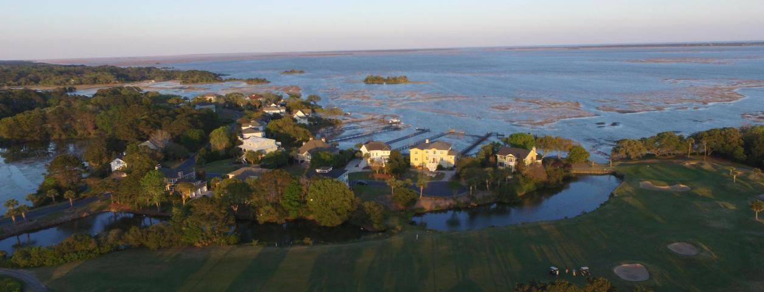
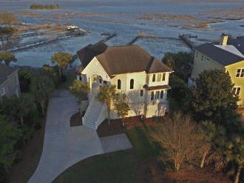
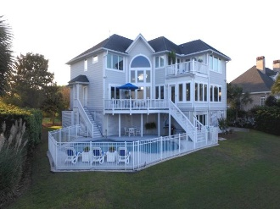
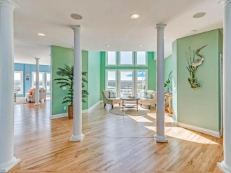
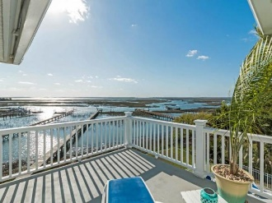
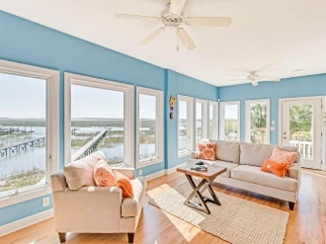
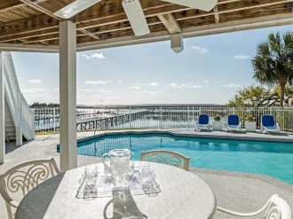
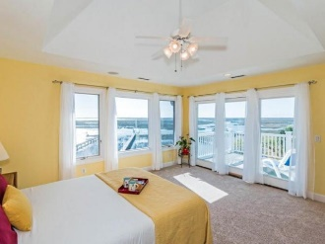
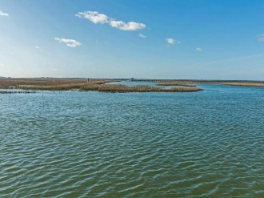
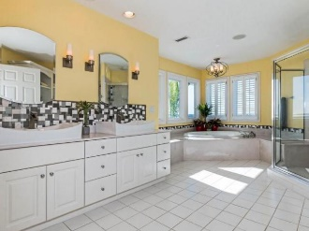
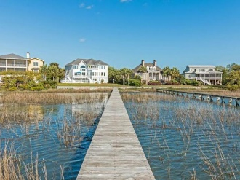


5035 Barrier Island Jumping Fish, Flying Birds, Tasty Shrimp and Shining Stars!
HOUSE FEATURES:
Private waterfront boat dock:
10’ X 10’ pier-head
10’ x 10’ floating dock
Hi-Tide 5,000 lb. electric chain drive boatlift
3’’ in creek at low tide (owner)
Engineered concrete sea wall
In-ground 15,000 gallon pool
Aluminum fence around pool
Deck areas:
Adjacent to M. Bedroom
Adjacent to Family room/office
Pool deck
Family room open to kitchen and breakfast area
Exceptional view from loft
Solid oak hardwood floors throughout first floor
Exercise room with view of marsh
Air conditioned attic cedar storage room
Air conditioned workshop
3 bay garage holding 4 cars with electrical receptacles. Currently one space used for boat.
Underground dog fence
Pella E glass double pane thermal windows
Irrigation system w/ underground well
6’’ seamless gutters installed around entire roof line
30 year architectural fiberglass asphalt shingle
Sontirol security system
Central vacuum system
Gas fireplace
Gas tank-less hot water
In-house speaker system
Thermador SS Gas cooktop
Thermador SS Double electric ovens
GE SS Microwave
GE SS side by side refrigerator
Frigidaire SS dishwasher
Whirlpool Deluxe washer & gas dryer
LOCATION FEATURES:
Private, gated neighborhood
Near Charles Pinckney Elementary, Cario Middle School and Wando High Schools
Near Roper St. Francis Hospital and Mount Pleasant Regional Airport
One of few deep water lots in Mt. Pleasant with private dock leading to the Intracoastal Waterway
HOA:
Charleston National subdivision $394/year
Victory Pointe subsection $693/year
Charleston National Country Club 443.50/mo. for neighborhood tennis and pool
Kay Kennerty MBA, ABR, CRS, GRI
843-345-5011
Kay@agentownedrealty.com
www.KayKennertyHomes.com
The AgentOwned Realty Company
824 Johnnie Dodds Blvd
Mt. Pleasant, SC 29464

