Slide 1
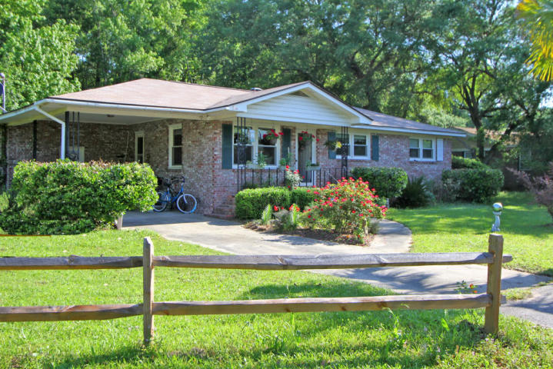
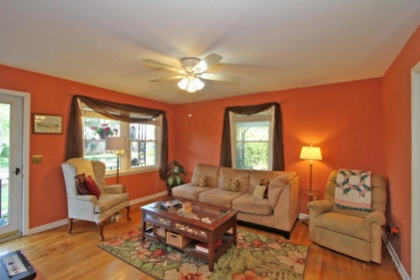
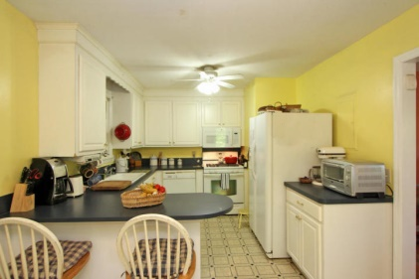
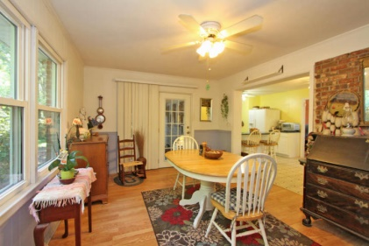
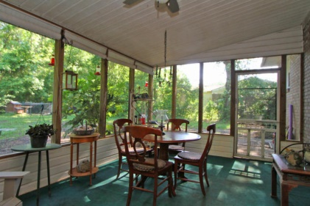
Fast closing- in turnkey condition!!! 3662 Moonglow Dr. John's Island Sunset Shores - MLS# 15010670 - $207,500
REDUCED TO THE BONE!!! Seller will pay buyer's closing costs and prepaids up to $2,000 at closing. Seller will pay up to $2,000 for buyer to re-insulate all HVAC ducts. Seller will provide the buyer with a 13 month home warranty valued at $500.00+ Seller has a current home inspection available for review. This is a 3/1.5 brick ranch with river breezes. Privacy ---- N0 HOA------Park your boat in the car port --- enough room for it and the boat. Public landing across the Stono. This house is priced right!! Act quickly!!!! ... Most repairs have been made....This house has great bones.... Move in ready!!!!!!!!
Norm Cooper
Dunes Properties
843-460-0319
ncooper@dunesproperties.com

