Slide 1
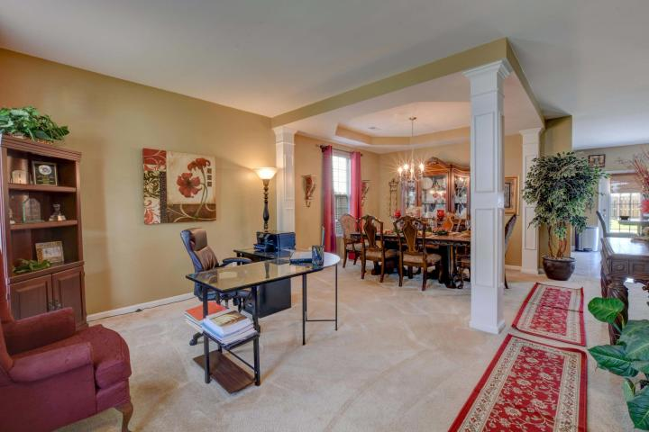
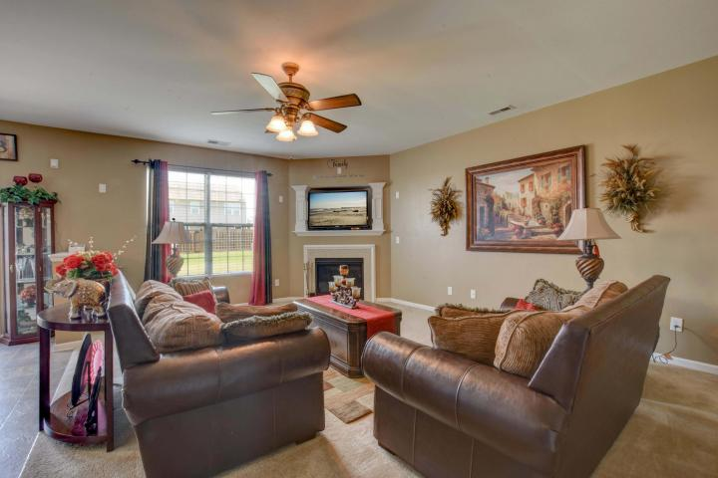
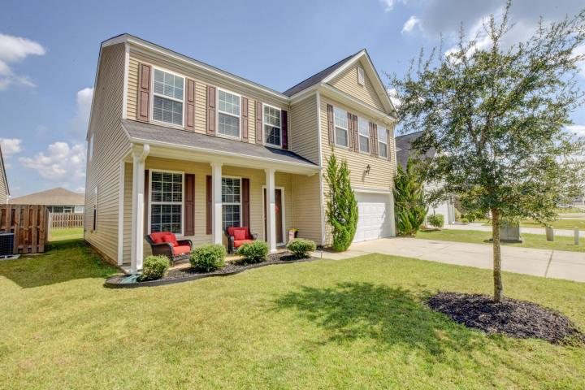
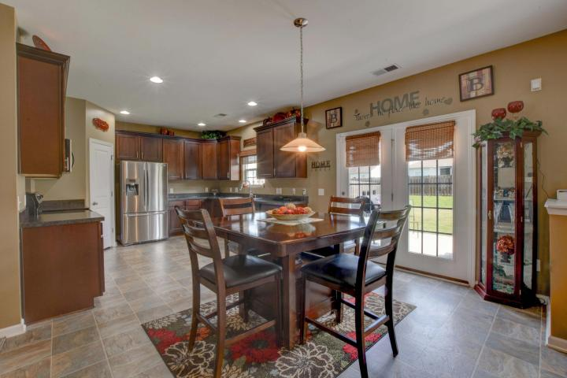
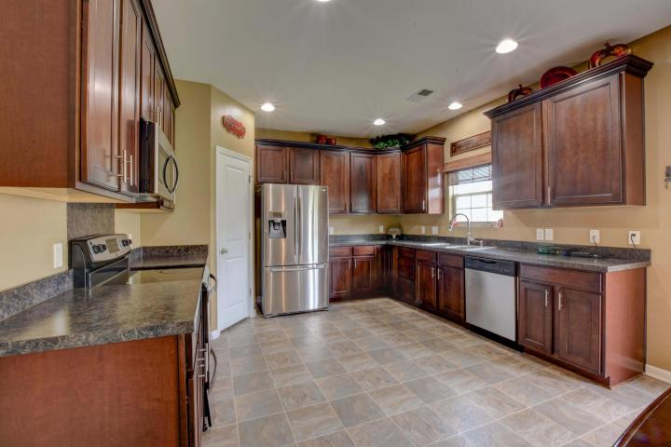
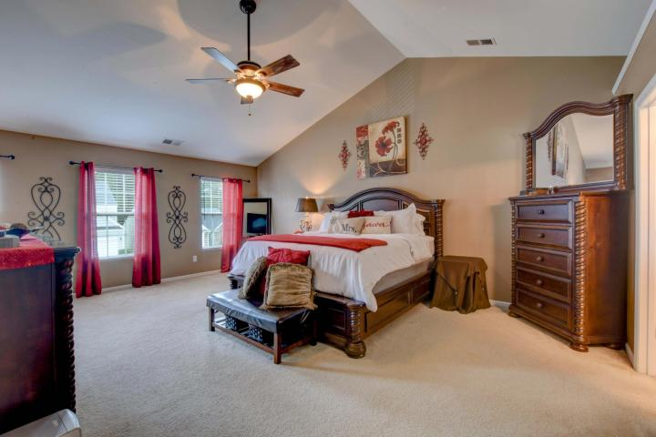
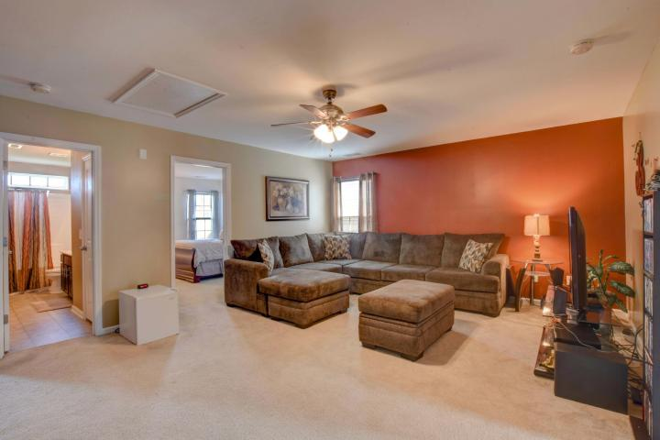

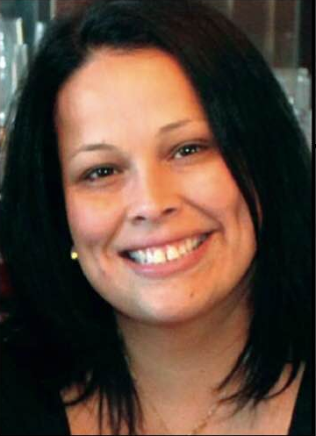
If You Lived Here You Would Be Home Already
5037 Blair Road
Myers Mill ~ Summerville, SC 29483
MLS# 17026016 ~ $249,500
Welcome to Myers Mill!
This gorgeous wide open spaced 4BR 2.5ba home is waiting for your family to fill it with love & memories. All the upgrades you need to live comfortably right here.
Large yard located close to all everyday conveniences and all major highways. Don't miss out on call this your home DD2 schools!!!!
Lisa Horan
Full Service Realtor
843-501-8856
lisaghoran@gmail.com
AgentOwned Premiere Group • 100 Crowfield Blvd • Goose Creek, SC 29445

